Slide 1
Exploration and Encounter
CHY
Lesson 15

Slide 2
Exploration and Encounter
Learning Goal: Explain how necessity spurred on the development of technology which led to advanced exploration
TEST TOMORROW
Questions 1-6 on pages 41-42

Slide 3
Test
4C
Part 1: Matching and some significance (choice) of terms and people
Part 2: Short Answer (5 of 8)
Part 3: Paragraph
Part 4: Quotes (humanism, reformation, superstition)
4U
Part 1: Identify and give the historical significance (8 of 15)
Part 2: Short Answer (7 of 10)
Part 3: Paragraph
Part 4: Document Analysis

Slide 4
Short Answer Questions
Functioning of cities at the dawn of the Renaissance
How humanism changed the way people thought
Renaissance Italy v Northern Europe
Martin Luther leads to Reformation
Compare 2 philosophers
Describe a well-rounded education, Renaissance-style
Impact of art and architecture
Renaissance and the peasant class
Compare Europe and the Ottomans
Compare Europe and the Japanese

Slide 5
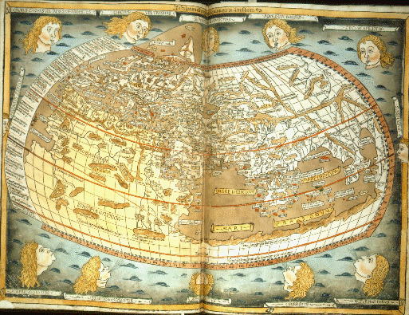

Slide 6
Early Exploration
The desire to grow rich and spread Christianity was strong amongst the Europeans
Wanted better access to the spices of the east (didn’t want to rely on the trade from Muslims to Italians)
Had to develop trade routes of their own in an effort to keep costs down
A sea route was necessary for English, Spanish, Portuguese, French, etc.

Slide 7
Exploration and Encounter
The Crusades- Islamic Culture
1400’s Portugal is dominant explorating nation- western africa, asia etc.
Mythology- the Atlantic
The quest for taste, gold and land
“Floating Islands”
1502 Amerigo Vaspucci

Slide 8
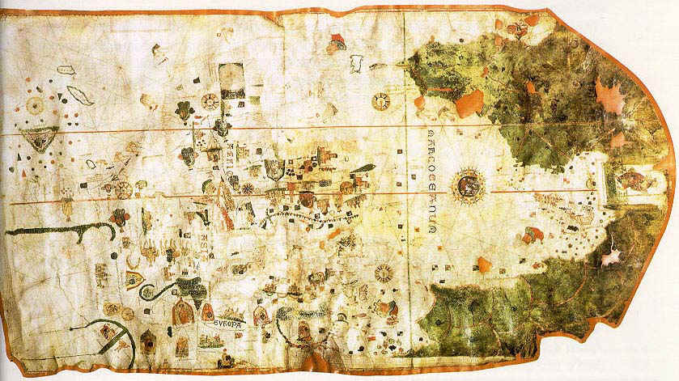

Slide 9
Portuguese Beginnings
1400’s- The Azores, the Canary Islands
Henry the Navigator
The Legend of Prester John
Western Africa- Trading Posts
Vasco Da Gama- 1497 India

Slide 10
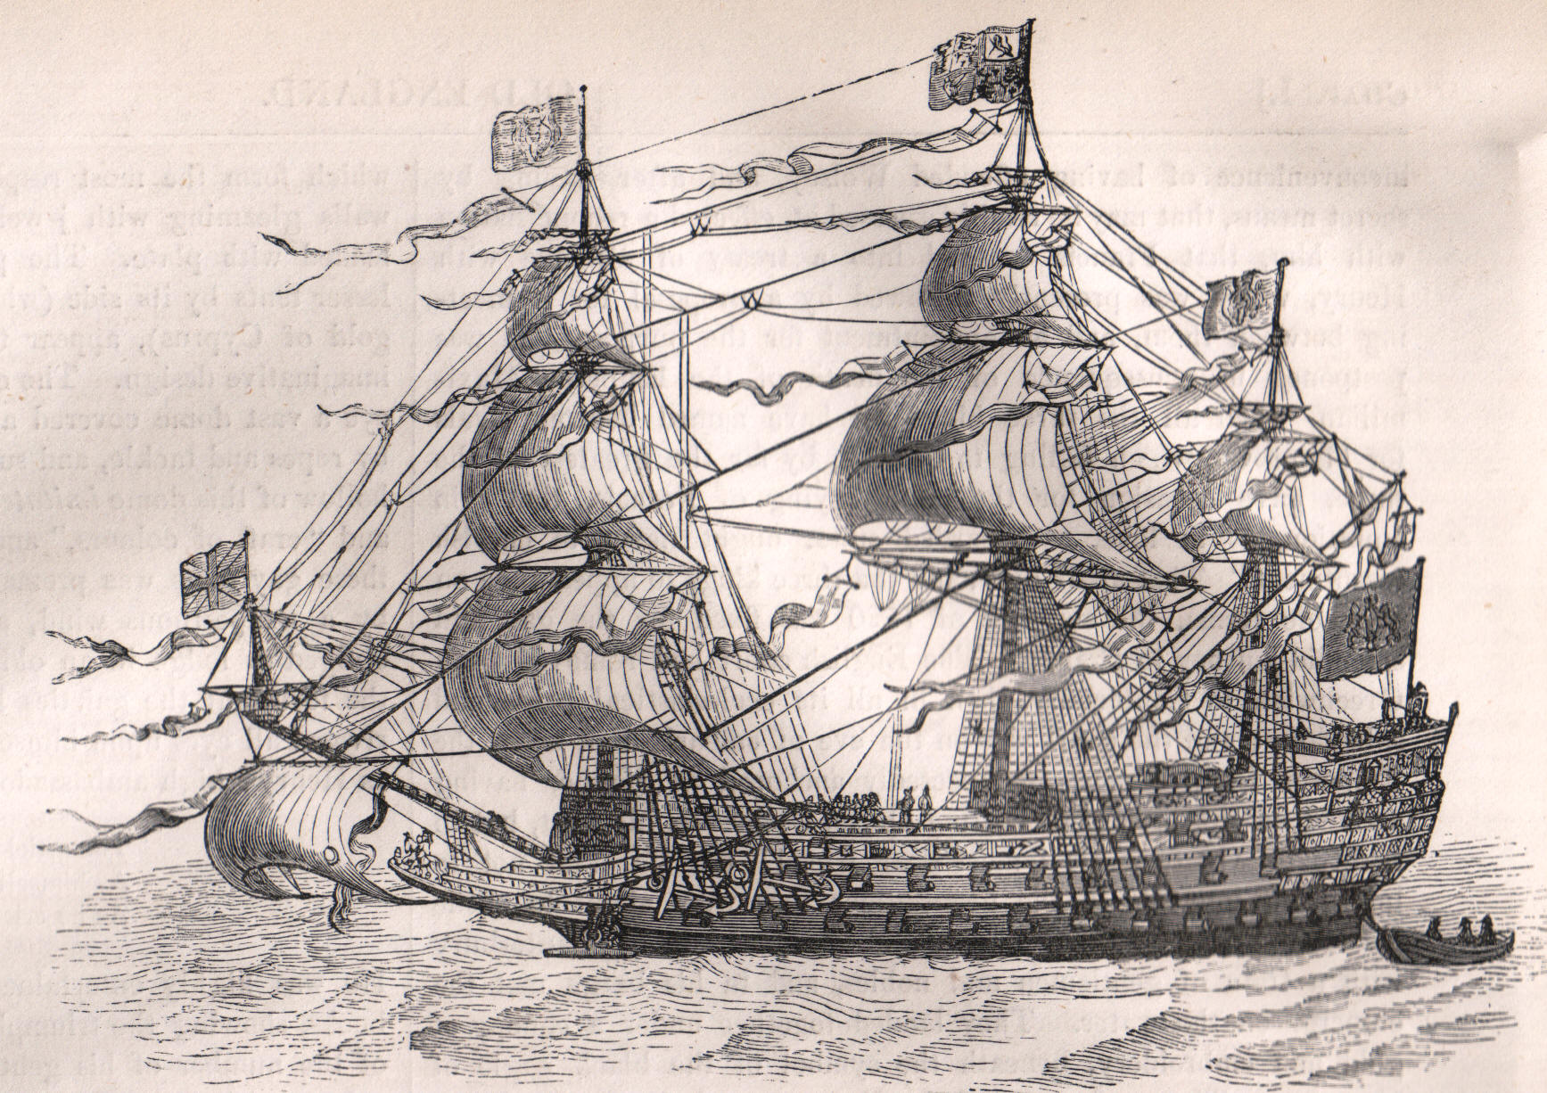

Slide 11
Spain
Columbus 1492- the beginning of spanish conquest
1496- Hispanola
Pope Alexander VI- Papal Bull
Michel de Montaigne- “a kind of purity”
New Spain- Mexico. 1500 ruled by the Aztecs. Conquered by Hernan Cortes 1519- 1521 with only 600 men.
Tenochtitlan (Mexico City)
Fransico Pizzaro defeats the Incas in Peru in 1531- 1536

Slide 12
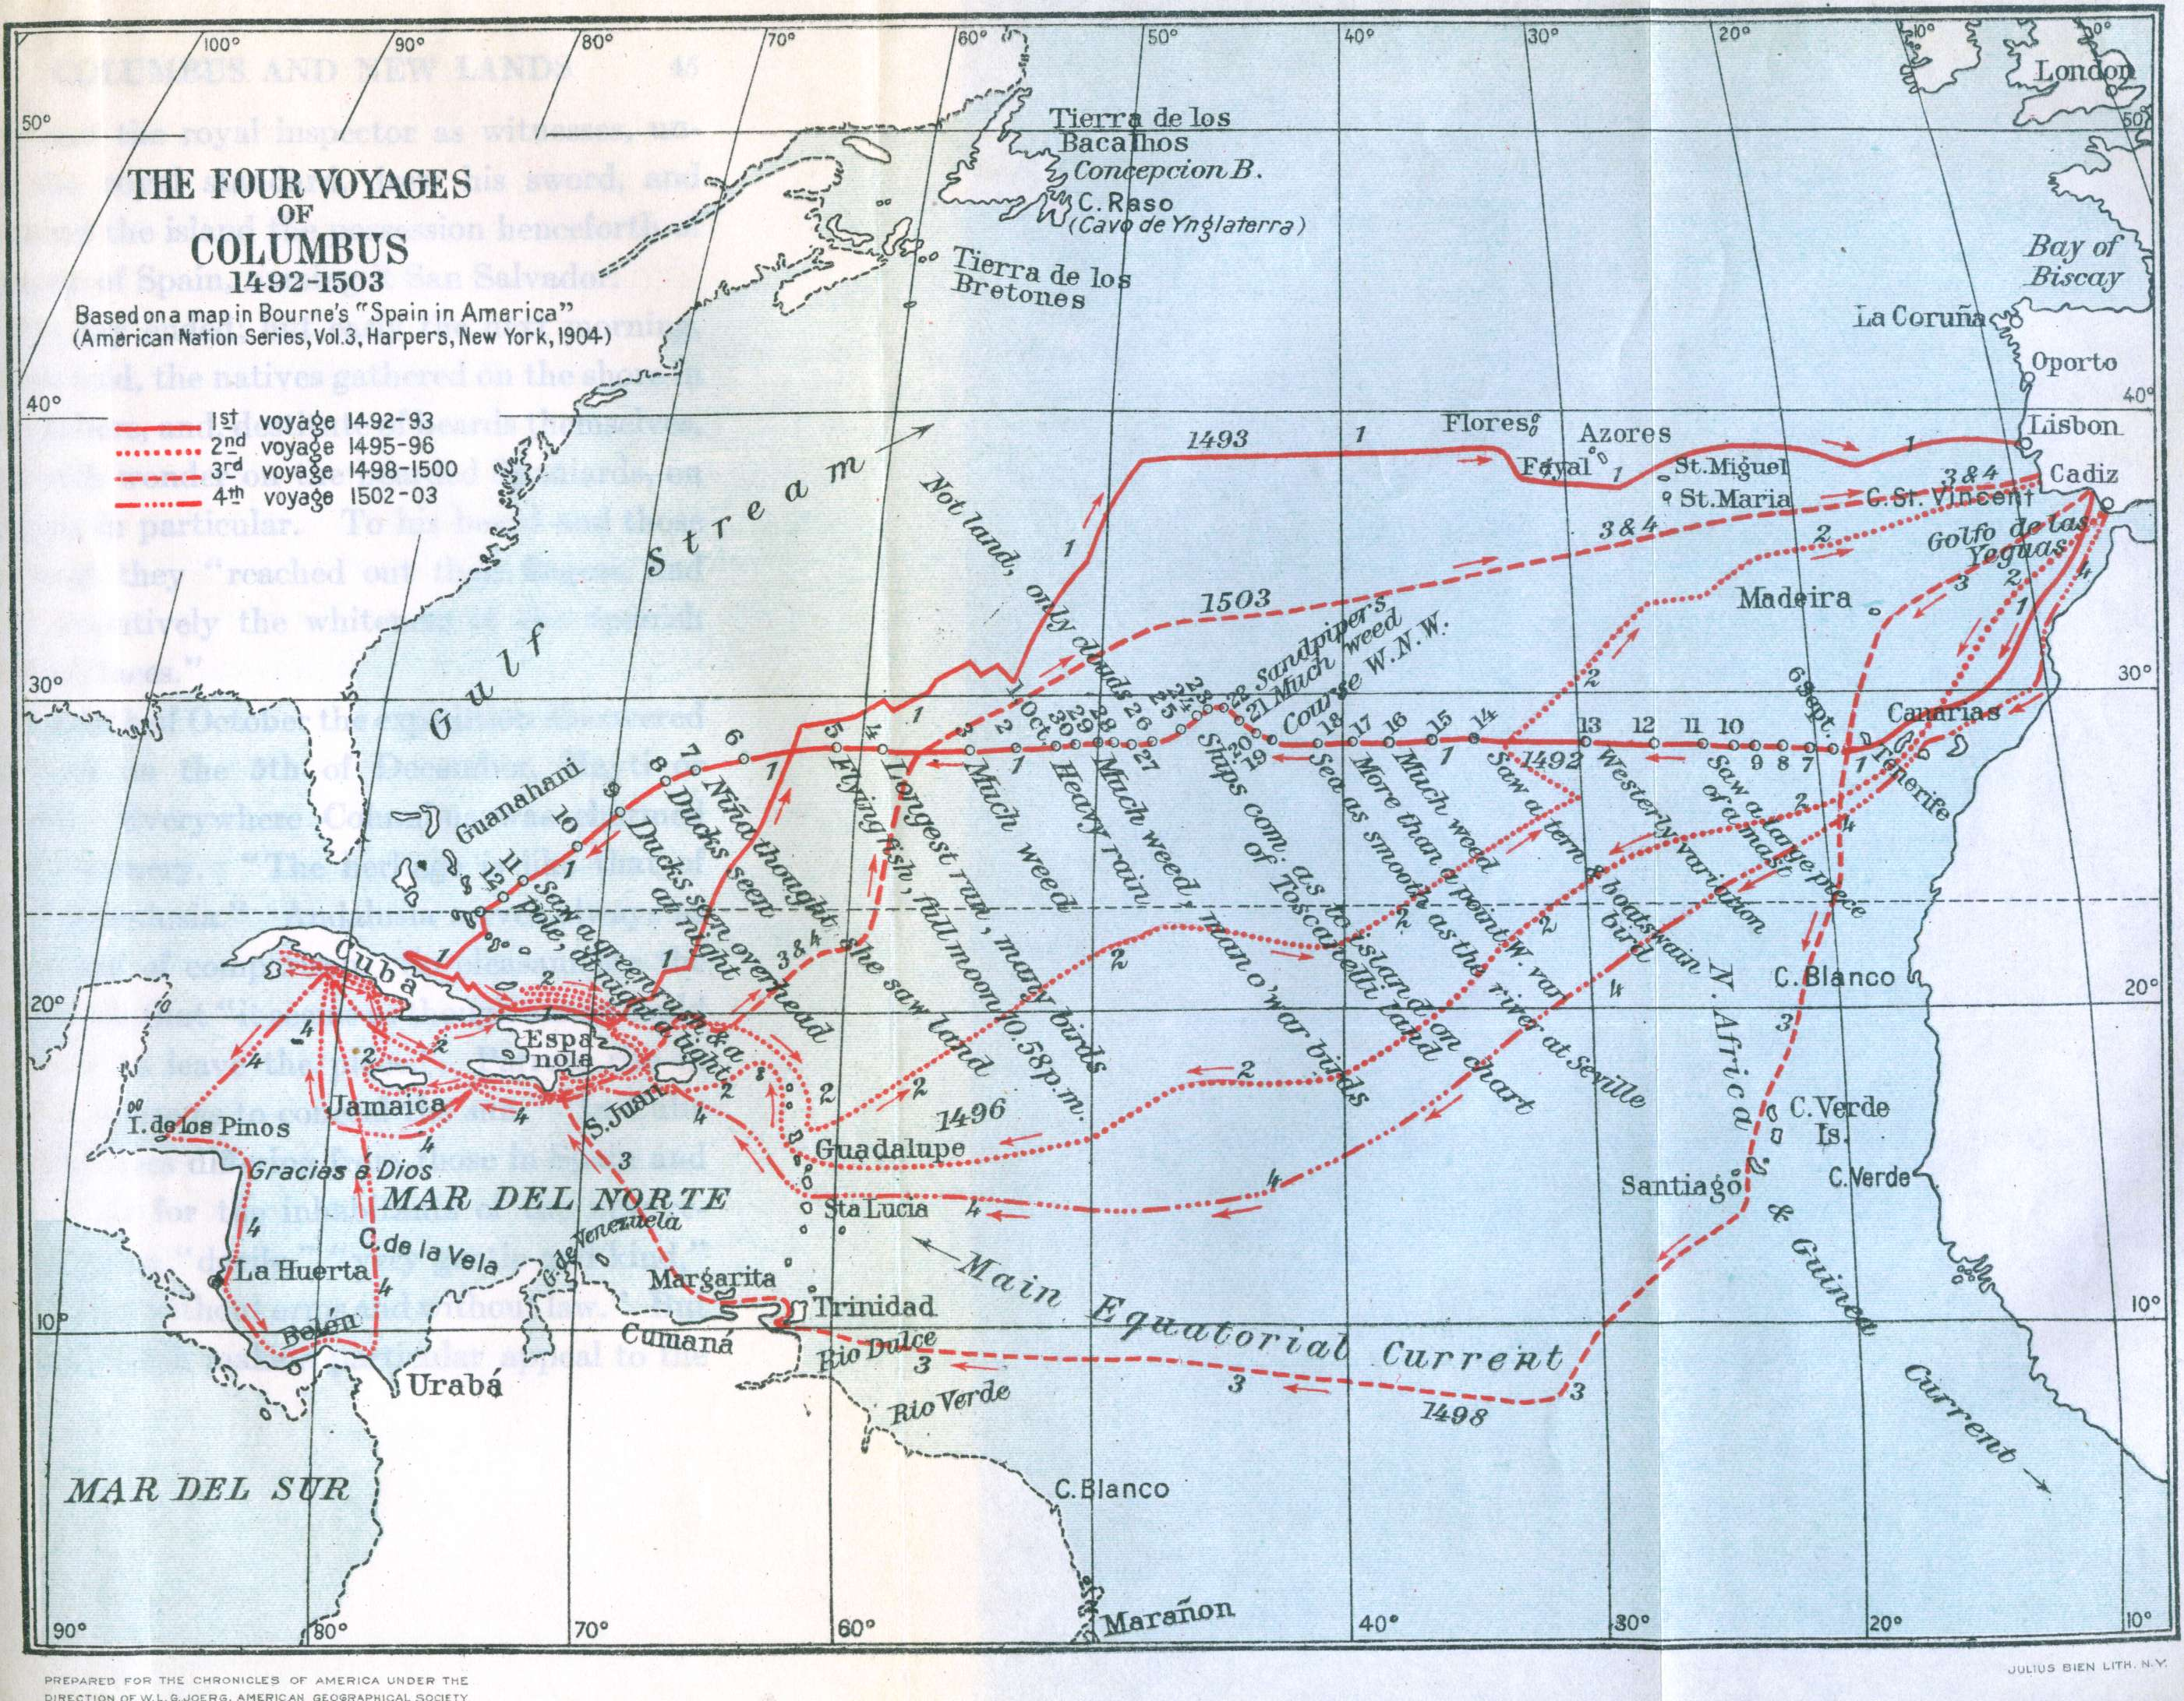

Slide 13
Spain
The Black Legend
Charles V (that guy again)- the official agreement
“indigenous populations were savage and barbarous and inhuman people with no god and no laws and it was natural that advanced societies should rule over lesser ones”
Mercantalist economy

Slide 14
The North American Coast
1001- Vikings set up posts in Newfoundland
1497 Henry VII- John Cabot (NW Passage)
1508 Sebastian Cabot and the Hudson Strait
Jacques Cartier 1534- St. Lawrence, meeting the Iroqouis and the Hurons

Slide 15
The New World
New products
Ferdinand Magellan- circumnavigated the world 1519
Potatoes
Rice
Bananas
Spices and peppers
Tobacco

Slide 16
