Slide 1
And now in other areas…
CHY
Lesson 14

Slide 2
And now in other areas…
Learning Goal:
Recognize other societies that were changing alongside the renaissance and reformation of western Europe
Review the values and ideals of European society
The Ottoman Empire grows
Japan reorganized

Slide 3
Culture and Daily Life in Europe
Renaissance and reformation ideas only involved a small percentage of the people
Ordinary people had their own ways of doing things; their own way of seeing the world

Slide 4
Superstitions
Most people still lived in small villages, struggling with nature to survive
War, famine, and plague continued to affect people
Superstitions were used to explain and control their lives
Belief in spirits meant that nothing was an accident
Bad things were caused by bad spirits
Village priests accepted or ignored this
Villagers use the priests to conteract the bad (it couldn’t hurt!)

Slide 5
The people also use a ‘wise’ person to interpret strange events
These men and women could provide remedies for warding off evil
Really, a belief in witchcraft
Witches could be good or bad
Often unusual people who kept themselves apart from the community
Accusations and stories were embellished over time

Slide 6
Witch hunts began in the mid-1500s (lasted about 100 years)
Put on trial
Punishment was death
Religious and secular leaders accepted witches as explanation for problems

Slide 7
Daily Life
People enjoyed working and relaxing together; drinking, sewing, storytelling, playing games, watching travelling actors perform, etc
Making fun of each other was also common in public displays of ‘charivari’ or ‘abbeys of misrule’
Also showed resentment of the privileges of those who ruled
People stuck with those who lived like them
Joined guilds based on professions
Villagers made decisions about their village together (small villages may only have a dozen families)

Slide 8
Spread of Knowledge
Do I need to explain the printing press?
Almanacs were published with predictions for the weather, etc.
Peddlers travelled around selling books
Priest travelled around taking the messages of Luther, Calvin, etc.
Those of different religions did struggle to coexist

Slide 9
Changes
Wages rose as labour force declined due to plague, and the end of serfdom (peasants were free to go where the money was!)
Religious wars were expensive, money became more scarce
Cheese and eggs were cheapest sources of protein
Salt was important
Spices were introduced from the East (luxury items at first)
New vegetables arrived (asparagus, melons, tomatoes, spinach)
People ate with their fingers; picked from a common dish

Slide 10
Brick and stone housing became more common in the cities
Peasants lived in small thatched roof homes
Glass was difficult to get and expensive
Shutters were used instead
Most people slept on sacks of straw
Traditional culture declined as people moved from villages to cities
Food was bought in a shop rather than picked from a field

Slide 11
City dwellers became more sophisticated
Had less need for magic or ‘wise’ people
Superstition lost its influence

Slide 12
A Vast Empire: The Ottomans
Ottomans: followers of the ghazi (warrior) Osman (ruled 1300-1326)
Small empire that acted kindly towards those they conquered
Lives of peasants improved
Muslims served in the army but didn’t pay taxes; non-Muslims paid taxes but didn’t have to serve in the army
Brief interruption between 1402-1451

Slide 13
Powerful Sultans Lead to Expansion
Mehmed II conquered Constantinople (pop 50 000, down from 1 million) in 1453
No territory but still ruled the Bosporus Strait (trade into the Black Sea)
Attacked the city with 26 ft long cannons
Ran a chain across the strait
Entered the city after 7 weeks
Now “Mehmed the Conqueror”

Slide 14
City opened to new people of all backgrounds and religions
Renamed the city Istanbul
Continued on, capturing the holy cities of Islam: Mecca and Medina (Saudi Arabia)
Carried on through the Middle East, capturing Cairo (Egypt)
(same time as Cortez was capturing the Aztec Empire)

Slide 15
Suleyman the Lawgiver
Ruled from 1520-1566
Called Suleyman the Magnificient in the West, due to cultural achievements
Carried on expanding the Ottoman empire through conquest
Pushed through Hungary and Austria… to the outskirts of Vienna
Only Charles V (Hapsburg Empire in Austria, Germany, Spain, Portugal…) had an empire to rival the Ottomans

Slide 16
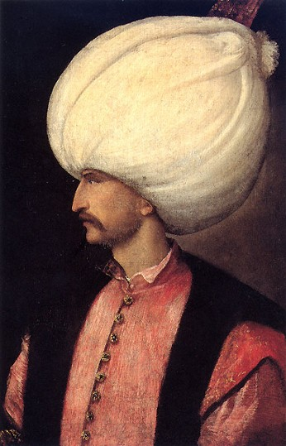
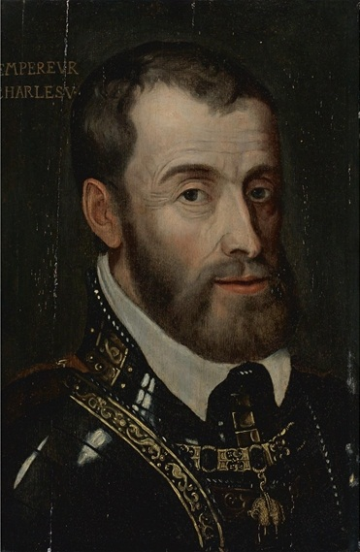

Slide 17
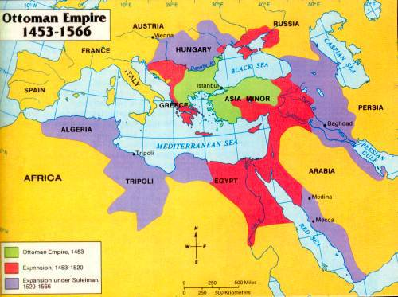

Slide 18
Ottoman Social Structure
Very efficient and organized
New law code for criminal and civil issues
Simplified taxation and gov’t bureaucracy
Daily life was better for most people
Sultan Suleyman had 20 000 personal slaves to run the palace
Slaves were drafted boys from conquered Christian territories
Educated them, converted them to Islam, trained them
30 000 soldiers (called janissaries) trained to be loyal to the sultan only
Christian parents often bribed officials to take their sons because they could become high level officials

Slide 19
Suleyman followed strict Islamic law
This meant the Ottomans granted religious freedom to Christians and Jews
These groups reported regularly to the sultan so that any potential conflicts could easily be minimized

Slide 20
Suleyman was a student of poetry, history, geography, astronomy, mathematics, and architecture
Hired the best of the best to build the Mosque of Suleyman with four schools, a library, a bath, and a hospital
Art and literature flourished; similar to European renaissance
Looked to Persia and Arabia for models
Lots of cultural blending

Slide 21
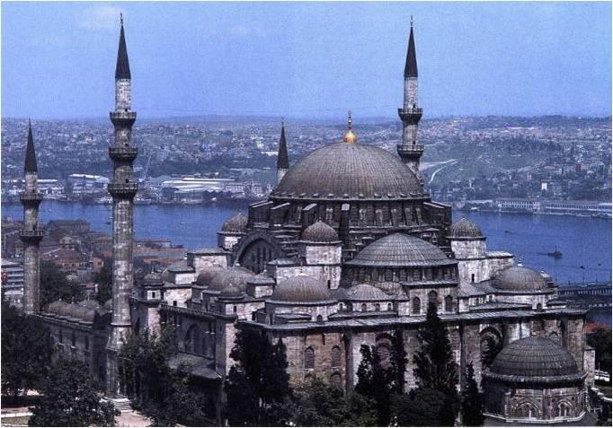
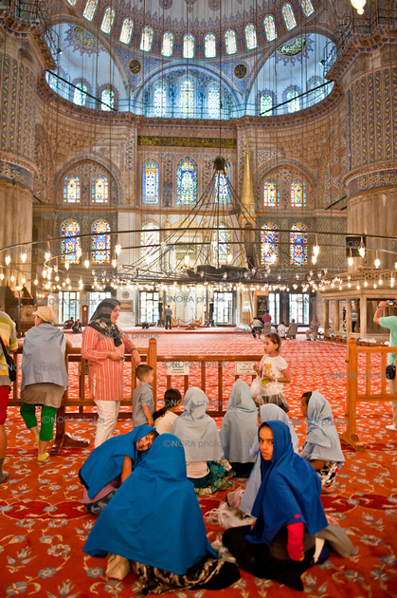

Slide 22
The Empire Declines
Suleyman killed his ablest son and drove another into exile
Incompetent third son inherited
Become the custom for each new sultan to have his brothers strangled
Kept sons prisoner in the harem (no education or training)
Led to weak leaders
Yet the empire continued to influence into the early 20th century

Slide 23
Japan, at this time
Shogun (military leaders) in the north and south began to fight each other in 1300s
In 1467, civil war tore apart the old feudal system
100s of separate domains (regions) took independent power
This sengoku (‘warring period’) lasted until 1568
Powerful samurai took control and called themselves daimyo
Emperor (despite being a descendent of Amaterasu the sun goddess) lost all real power and became a figurehead

Slide 24
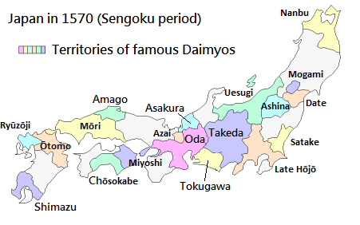
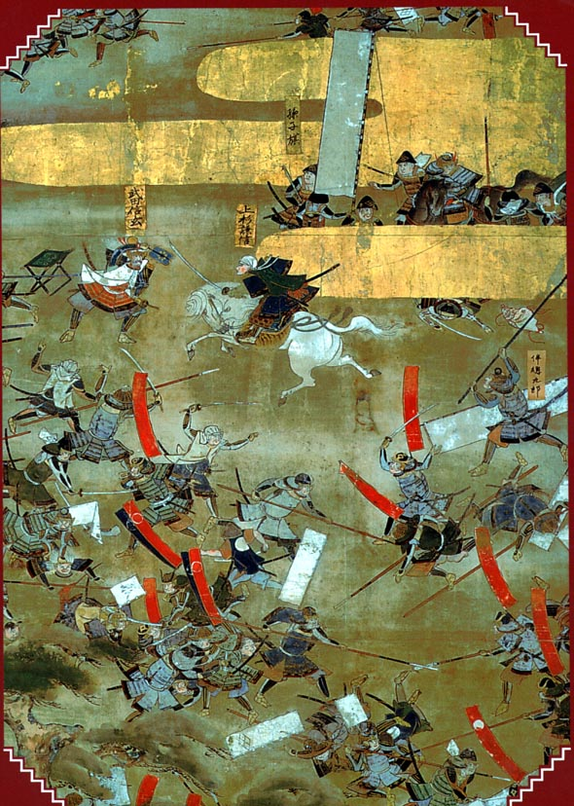

Slide 25
Similar to European feudalism
Built castles and armed themselves with samurai on horseback
Constantly fighting with each other for land and power
Ambitious daimyo sought to control the entire country
1575, first time firearms (muskets) were used successfully in Japan, by Nobunaga
He was unable to retain control for long and committed seppuku
Japan was finally unified in 1600 by Tokugawa Ieyasu
Moved the capital from Kyoto to Edo (now Tokyo)

Slide 26
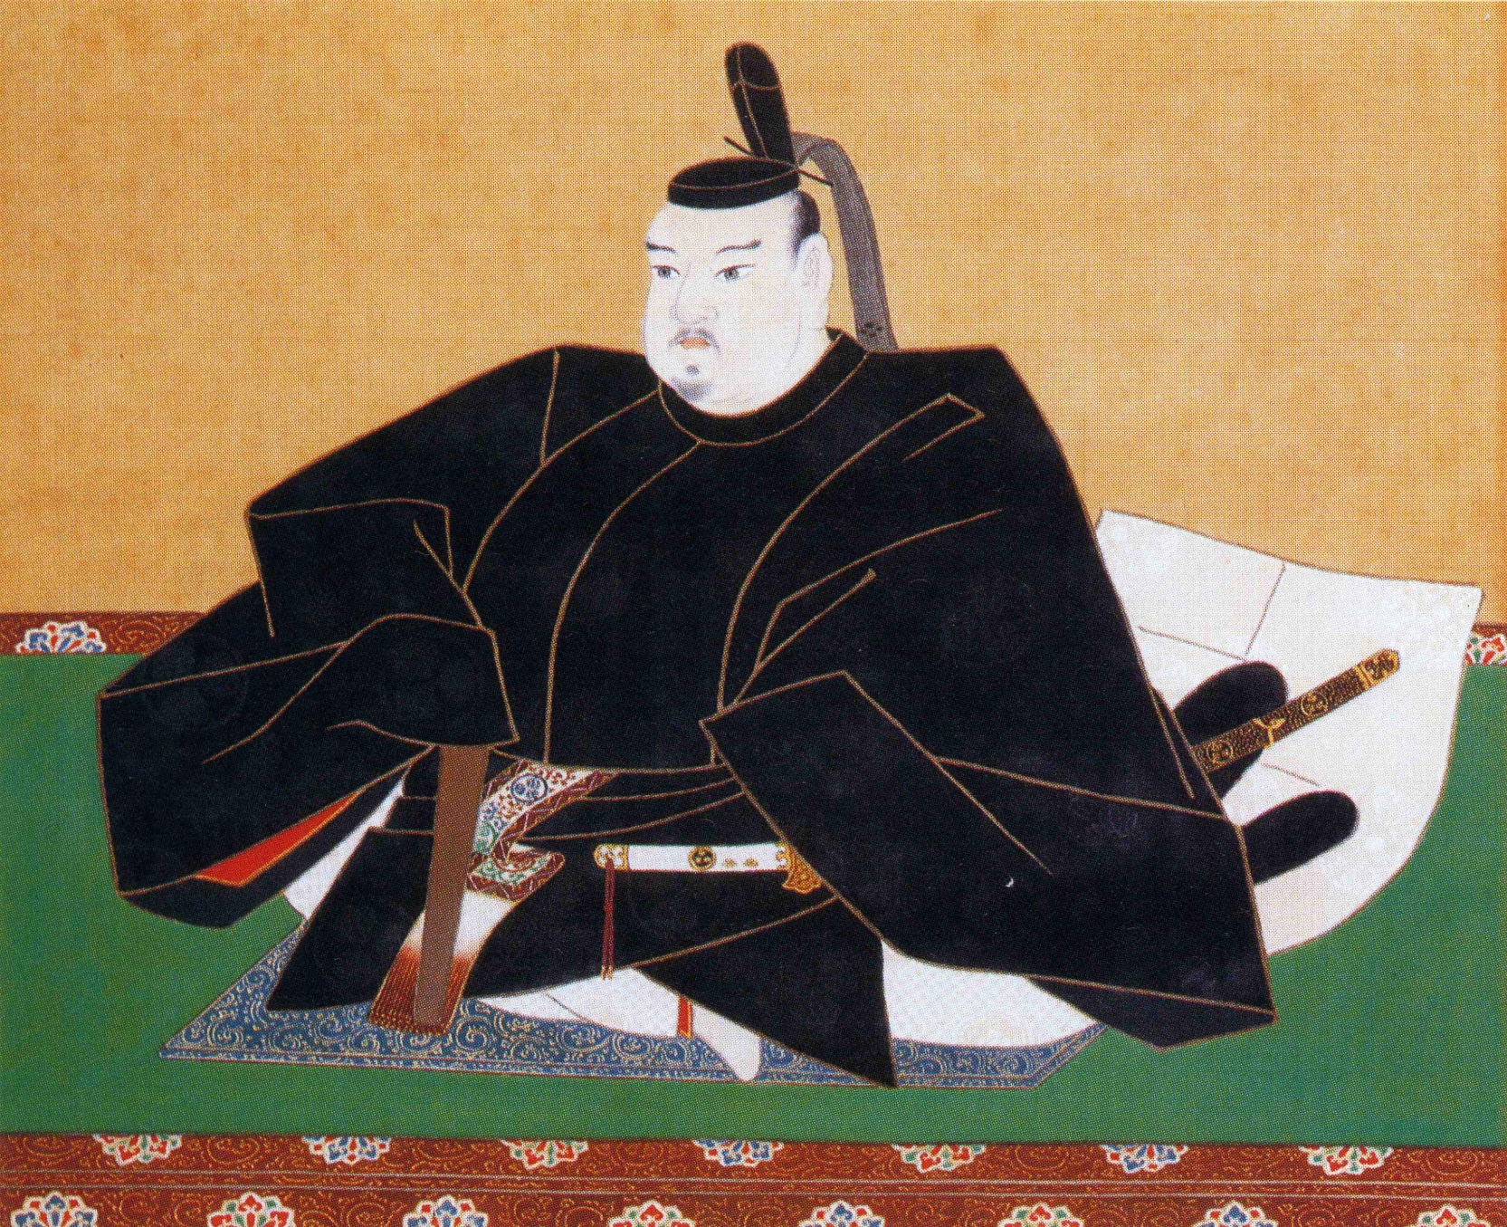
Tokugawa Ieyasu
Shogun who unites Japan in 1600

Slide 27
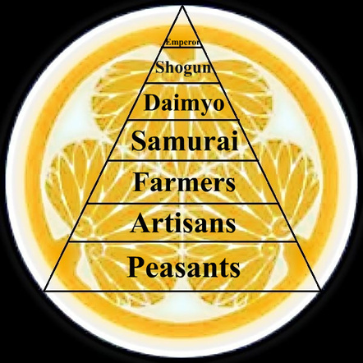
Social structure in Tokugawa period
Merchants were even below the peasants
Culture was very important to samurai
Poetry, drama, tea ceremony, Zen Buddhism all thrived

