Slide 1
A New Political Order
CHY
Lesson 29

Slide 2
A New Political Order
Learning Goal:
Analyze the changes that took place in political organization
Note and discussion
Summary activity

Slide 3
The Style of Absolutism
Big question in political circles was the idea of the legitimacy of authority
By what right does an individual or group rule?
Guided by the concepts of order, authority, and rights
1650s-1750s, a new form of absolutism was the answer
Rule by divine right of God
Was most elaborate in France

Slide 4
This form of absolutism is related to classicism, the trend of the time
What is Classicism?
(back to the admiration of the Greeks and Romans)
Absolutism reflected the Roman imperial ideal
The best quality of life had existed at that time

Slide 5
Politically and socially, this meant order and obedience to rules institutionalized by kings
This would bring stability
Establishment of a centralized authority
Large bureaucracy that was responsible to the monarch was needed
Monarch also took control of the national finances and military

Slide 6
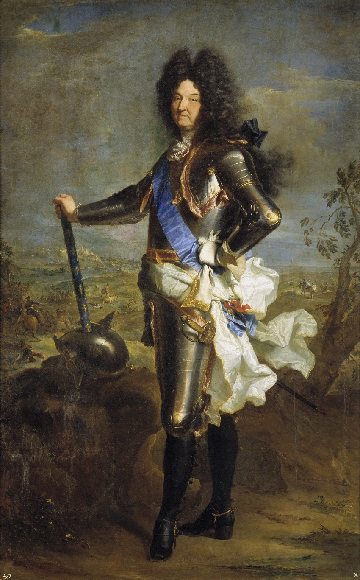
Bourbon Monarchy of France
Louis XIV (1643-1715) led in the development of this system
Became known as ‘Le Roi soleil’ (the Sun King)
As planets revolved around the sun, Louis was the centre of the nation
Believed he was God’s ruler on Earth
Other European rulers emulated him

Slide 7
Had to limit the authority of the nobility
Created a system of civil servants (intendants), who had jobs at the pleasure of the king
Not hereditary… based on merit, and the king’s kindness
Collected taxes, administered the regions, etc.

Slide 8
The Economy
Control of the economy was a major concern
Land taxes were continued from old system
Head taxes were new
Civil servants also collected tax on items such as tobacco, salt, wine
Louis XIV wanted to enhance France’s power through diplomacy and a strong army
Encouraged a favourable balance of trade (more out-less in)
Institutionalized ‘Five Great Farms’ in Northern France (1/2 the land)

Slide 9
Built roads and canals to make production more efficient
Promoted making of fine glass, silk, and tapestries for export
By 1688, the army reached 290 000, all under his authority
Disciplined, uniformed, with a pay scale like a civil servant
Encouraged lifetime service
Developed sophisticated military strategy (gun with bayonet was newest weapon)

Slide 10
Louis XIV wanted religious conformity, too
French national Catholic Church was stressed
Lots of pressure on Huguenots (about 5% of the pop)
Revoked Edict of Nantes in 1685, to get uniformity
Huguenots emigrated to England, German states, Holland, and America
Those who remained were often persecuted

Slide 11
video
The Palace of Versailles
Louis XIV had this built for himself and his court
An outward symbol of his absolutism
Finished in 1701
The best talents of France helped in its design and construction
Cost up to 10% of the annual budget
Louis lived and governed from here
Louis’s movements were ministered by nobles

Slide 12
Absolutism and the Social System
Nobility ceased to have control of the government or military but he didn’t want to do away with them
They became his entourage
Completely supplanted the old feudal system; people were loyal to the king now, rather than a territory
The state of France was truly formed
Modelled himself and his state after the Emperor Augustus
He may not have said it, but he believed, “L’etat c’est moi”

Slide 13
Task:
Outline the characteristics of absolutist government. What elements still exist in Canada’s government today?
Evaluate the reign of Louis XIV. Develop criteria for the evaluation by generating a list of leadership qualities and applying them to Louis XIV.
Homework: Read pages 78-83.

