Slide 1
Revolution!
CHY
Lesson 50

Slide 2
Revolution!
Learning Goal:
Explain how the ideas of the Enlightenment led to drastic changes in governance
What do you think?
What did they think?
Causes of the American Revolution
https://www.youtube.com/watch?v=Eytc9ZaNWyc

Slide 3
The Thirteen Colonies
What were they like?
Government system
Laws and customs
Traded with each other
Had been around for 150 years
Felt American rather than tied to Britain

Slide 4
Causes of the Revolution

Slide 5
Seven Years War (French and Indian War)
A proxy war in North America fought between France and Britain
British victory led to end of French control of N America
Cost of the war was debilitating to Britain
Since the American colonies were the beneficiaries of Britain’s victory, Britain taxed the colonies to get their money back.
Americans complained about ‘taxation without representation’
They had no representatives in British parliament

Slide 6
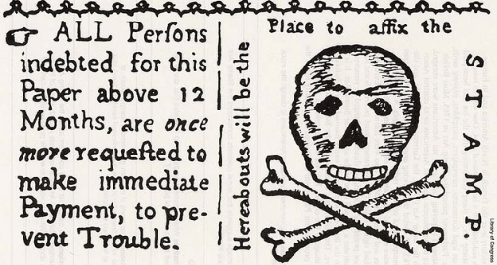
Stamp Act
1765
Colonists had to pay a tax (in the form of a stamp) on all printed documents (newspapers, legal documents, etc.)
Colonists fought back by terrorizing the British tax collectors
Was repealed eventually

Slide 7
Townshend Act
1767
Allowed Parliament to put taxes on many other goods including glass, lead, paper, and tea
Some colonies tried to negotiate a solution; others sent clear statements to British Parliament explaining that Br had no constitutional right to legislate for the colonies
British troops had to come into Boston (1768) to prevent an uprising… resistance made it impossible to collect the tax

Slide 8
Boston Massacre
1770
Tension over the presence of troops remained
Br troops fired on a crowd, killing 5 civilians
Publicized by Paul Revere in his engraving called, “The Bloody Massacre”
Got everyone riled up!

Slide 10
Boston Tea Party/ Intolerable Acts
1773
A tax on tea was levied (put in place)
‘Sons of Liberty’ boarded a tea vessel dressed as native people
Dumped all the tea in the harbour
Resulted in the ‘Intolerable Acts’ (1774)
Aimed at the colony of Massachusetts (where Boston is)
Called the ‘Coersive Acts’ by the British
Included the Quebec Act which gave land and freedom to the former French colonists that the thirteen colonies really wanted

Slide 12
First Continental Congress (1774) Second Continental Congress (1775)
Formed to draw consensus among the colonies
Attempted to prevent war
Knew that British occupation was coming
1st met in Philadelphia with 12 of 13 colonies represented
Demanded to be granted full rights of British citizenship
Would meet a year later if no changes had been made
April 1775, British tried to seize guns and gunpowder
Led to a skirmish with colonists

Slide 13
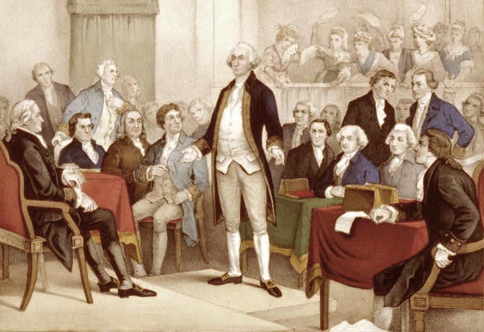
2nd met in May 1775
They prepared for war
King George III, August 1775 declared that the colonies were in “open and avowed rebellion”
Demanded that loyal subjects bring traitors to justice

Slide 14
Thomas Paine and Common Sense
One of the most influential pamphlets in American history
Galvanized the American public to support the Revolution and condemn the monarchy in England.

Slide 16
Led to the Battle of Bunker Hill
Several thousand British forces trapped in Boston by 10000 American militia
British forces attacked twice and were pushed back by American fire power
Third attempt was successful as Americans ran out of ammunition
Seige still held
Eventually, British had to abandon Boston
Good for American morale

Slide 17
Declaration of Independence
After George III’s proclamation, and Bunker Hill, there was no hope for a peaceful end
Colonies asked for a formal declaration of independence
Committee was struck to write this (included John Adams, Benjamin Franklin, and Thomas Jefferson)
Written by Thomas Jefferson
Continental Congress voted for independence on July 2, 1776
Declaration was approved on July 4, 1776

Slide 18
Tasks:
Read American History, pages 71-72
Answer the questions on each page
Read “Excerpts from Thomas Paine’s Common Sense”
Complete the Analysis worksheet
Read the Declaration of Independence
Complete the primary source analysis question sheet.

