Slide 1
Renaissance and Humanism
CHY
Lesson 4

Slide 2
Humanism and the Renaissance
Learning Goal:
Be able to describe the belief system of Christian Humanists and their impact on Europeans.
Note and discussion
Reading Assignment
Video to finish off with
** remember questions due tomorrow

Slide 3
Questions that analyze: (page 14)
Why would residents be proud of each city? (Constantinople, Beijing, Seville, Tenochtitlán, Delhi, Timbuktu)
If cities are a reflection of societies, what inference can you make regarding the societies that created these cities?
What might account for our limited recognition of some of these cities? Would students in other parts of the world have the same answers as you? Why or why not?
10. If future historians were to infer information about our society, based on Canadian cities, what inferences do you think they would make regarding large cities near us?

Slide 4
Vocabulary
Medieval
Secular
City-states
Feudal
Republic
Oligarchy
Despot
Humanism
Medieval princes
Communal family
Nuclear family
Serf

Slide 5
The Renaissance
1350 CE- 1600 CE (CE replaces AD in order to be secular)
Recovered the classics from ancient Rome and Greece
  Such as?
Much more secular than the thinkers who had gone before them
Values
The worldly life
Expanded Knowledge
Encouraging humans to develop their best potential
Yet…a larger age of religious domination

Slide 6
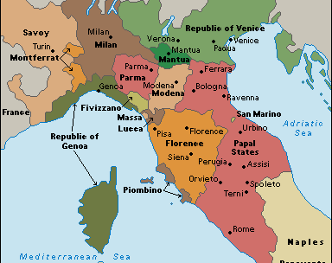
Growth of the Italian City States

Slide 7
Growth of the Italian City States
Italy was the commercial bridge between the west and east (Asia)
Florence, Genoa, Venice, Milan, and Pisa were major city-states
Became expert in modern business practice (bookkeeping, creating letters of credit, developing markets)
Florence became the major banking centre
Land based wealth changed to Trade/Credit based wealth

Slide 8
Governance
Republics formed with merchants as the ruling class
Political authority was in the cities rather than countryside castles
Eventually became despotic and oligarchical
Warfare between cities was common

Slide 9
Diplomacy became important to foster good relationships
Known as balance of power politics—make sure no one city became overwhelmingly powerful
Popolo grasso (the ‘fat people’) were the wealthy merchant class
Popolo minuto (the ‘little people’) were small shopkeepers and workers (guilds)
Medici family became the dominant family (rich bankers)

Slide 10
Women in the Renaissance
The experience of women in history did not begin to be explored until 1970s
Quickly realized that women’s experiences were very different\
In Renaissance Italy, women actually found their authority diminish
Ideas on love and marriage made women more subordinate
Evidence of this is limited to upper and middle class women
Little is known about other classes

Slide 11
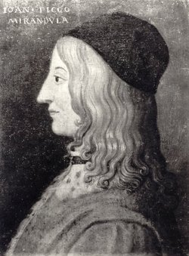
Humanism

Slide 12
Humanism
A very new era, called Humanism by writers and artists… connected to the Greek and Latin (Roman) classics; often preserved by Muslim scholars
While they weren’t abandoning religion, they believed the living in this world was more important
Middle Ages- knowledge of divine things
Renaissance- life rooted in faith, and rooted in active pursuits of politics etc.
The discovery of the world and of man
The idea of the time was the man who excelled in all things, a Renaissance Man

Slide 13
Giovanni Pico della Mirandola
God created Humans with the ability to shape their own lives
The Charge of God:
“The nature of all other beings is limited and constrained within the bounds prescribed by us…Thou shalt have the power (then) out of thy soul’s judgment, to be reborn into the higher forms, which are divine”

Slide 14
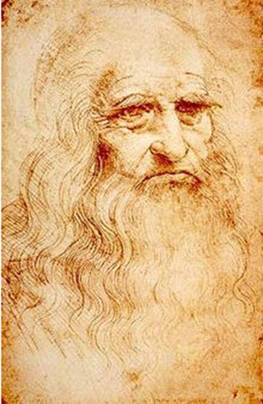
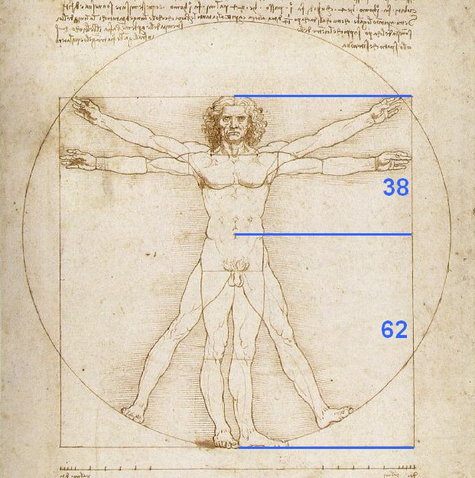
Humanism
Leondardo Da Vinci
The Golden Section

Slide 15
Humanism
Reflective time period
Education
Desiderius Erasmus (1466- 1536)- reason is what distinguished humans and their reflective ability to make choices
Responsible Citizens (the civitas)
The Church did respond with a push in religious art and architecture

Slide 16
Assignment: Due Monday
Complete the reading(s) you have been provided. For each reading, write a paragraph response that includes the following:
Explains what the author believes to the essence (true sense) of Humanism.
At least one example (quote) of Humanist Thought that best describes or sums up the author’s belief system
By the end of Monday’s class, all students should understand the beliefs of all 4 great thinkers. All 4 readings are available at msbew.weebly.com

Slide 17
Horrible Histories
http://www.teachertube.com/video/horrible-histories-the-renaissance-report-285255
https://www.youtube.com/watch?v=Vufba_ZcoR0

Slide 18
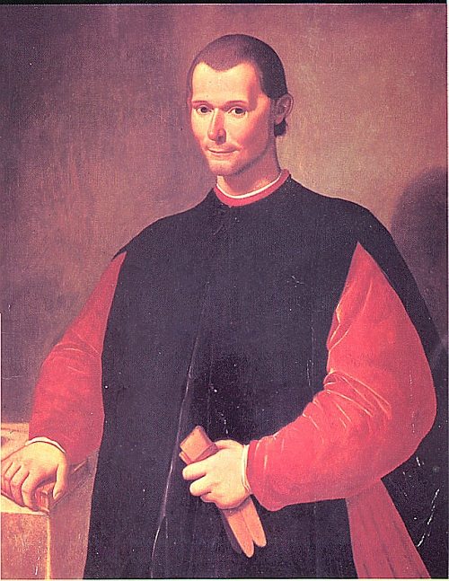
Machiavelli

Slide 19
Machiavelli
1494 France invaded Italy
Niccolo Machiavelli- Florentine civil servant
The Prince (1513)
Realism

