Slide 1
Humanism Expanded
CHY
Lesson 9

Slide 2
Humanism Expanded
Learning Goal: Compare and contrast how humanism developed across Europe.
Reading assignment
Humanism note and discussion
Individual philosophers

Slide 3
Review:
Approximately when did the Renaissance take place?
What was the land ownership system called?
What major forces shaped the lives of Medieval Europeans?
What events began to change the way people thought?
What is John Green’s argument about the Renaissance?
What is humanism?

Slide 4
Humanism Expanded and Explored
Writers and artists saw the classics as inspiration for their own work
Stressed living in this world, human dignity and being a responsible citizen
Valued knowledge for knowledge’s sake, and to guide one in personal and political conduct
Thought the study of history was important (who doesn’t?)
Saw the importance of education for males and females
Moral training for an honest life and to prepare one for membership in the community

Slide 5
The papacy (Pope and Church) supported (were patrons of) this culture
Papal States acted as another city state with alliances, and battle with other states.
Sponsored art and literature
Acted as Renaissance Princes, just as those from other city-states, based on merit and ability

Slide 6
Machiavelli
1494: France invaded Italy
City-states realized they had to work together to fight off this incursion
Niccolò Machiavelli (a civil servant from Florence) didn’t like what he was seeing
Became the first political scientist
Most influential work is The Prince (1513) which is a study of the modern state

Slide 7
Saw the state as neither secular or spiritual, it was its own thing
Sovereign and powerful and exist on their own
He was a republican at heart but wasn’t sure it could work, especially in challenging times
An authority was needed to save Italy from the outsiders
Learned the value of history (particularly the classics)
But demanded a grounding in the present reality

Slide 8
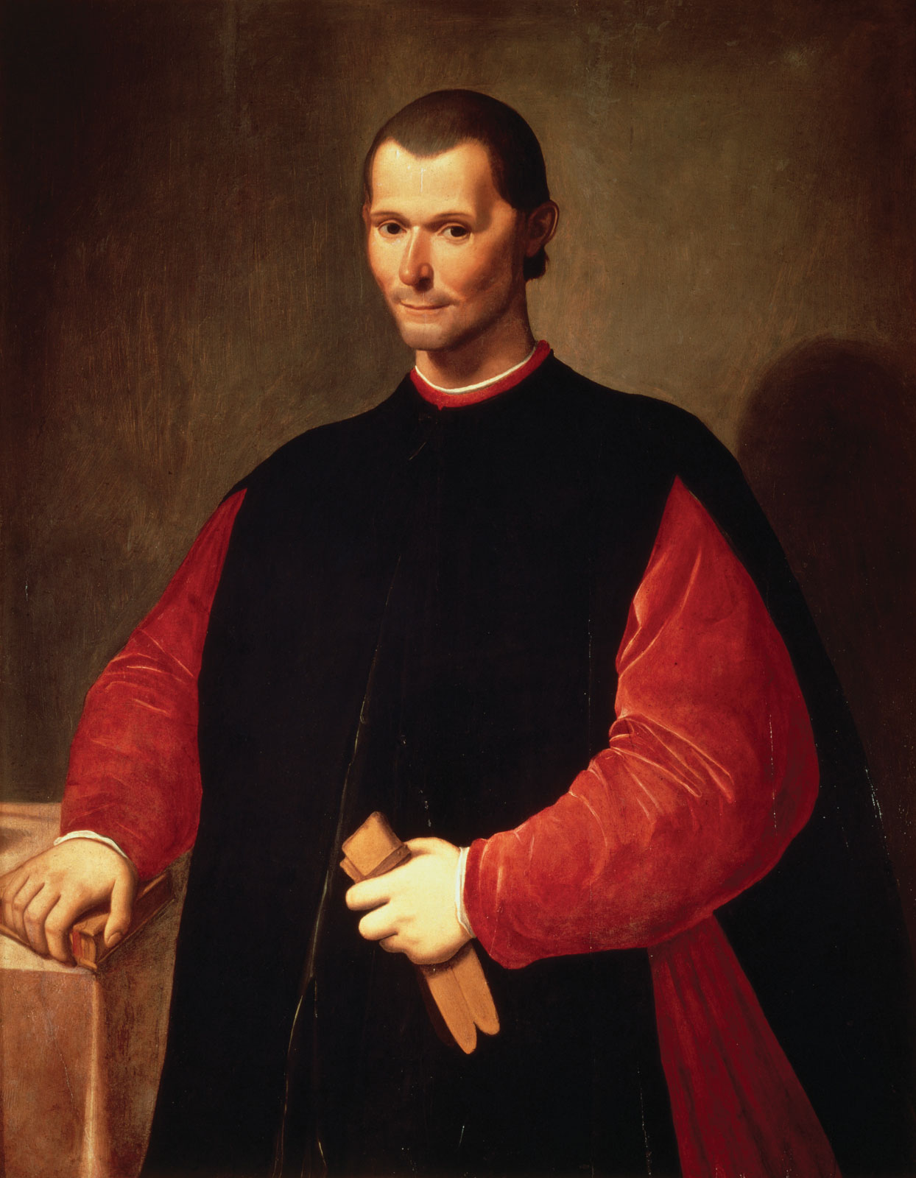
Believed a ruthless, realistic view was necessary
Power was obtained and retained with this ruthlessness
Human nature required a strong ruler (a prince)
Is it better to be loved than feared, or vice versa?

Slide 9
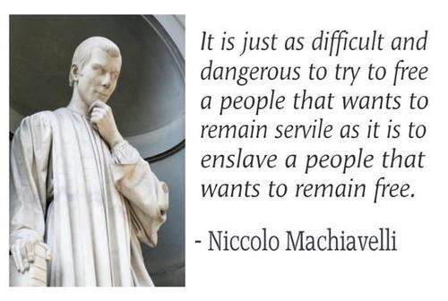

Slide 11
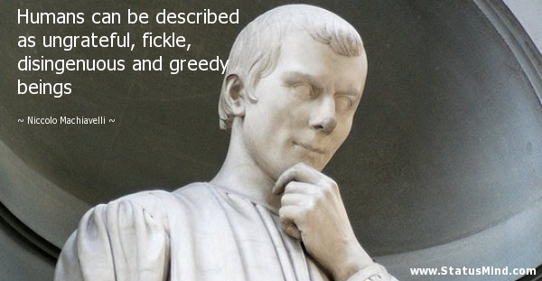

Slide 13
Christian Humanism
The Renaissance in the North
Much less secular than the in Italy
Humanism here looked back to the earlier, simpler version of Christianity
A combination of Christian and classical elements
Applied reason (scientific analysis) and study to ancient sacred texts and the classics
Wanted to separate traditional beliefs from dogma (a set of beliefs authorized by the Church)

Slide 14
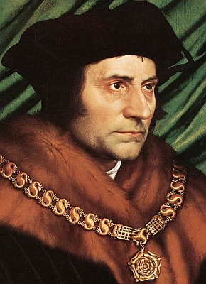
Thomas More
Tried to reform, rather than break with the Catholic Church
Thomas More (1478-1535) was a public servant and lawyer who brought the Renaissance to the north
Wrote Utopia (1516) as a protest against the politics and society of the time
Attacked bad laws and excessive punishment
Really concerned about the enclosure of common lands for private use
His ‘Utopia’ had a society where people eat and work communally, like early Christians
Was executed for treason for not acknowledging Henry VIII was head of English church

Slide 15
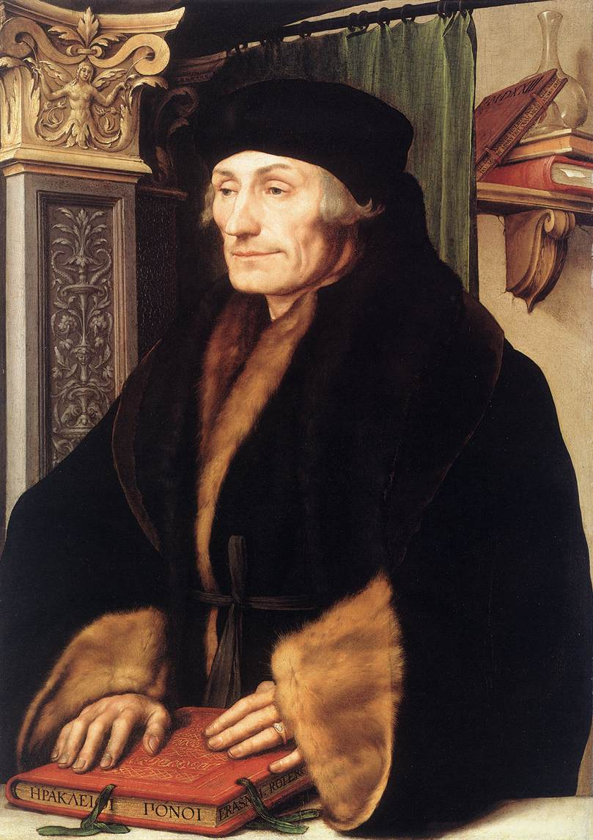
(Desiderius) Erasmus
Dutch humanist, priest and monk
Valued education to help us live a moral life, and to be useful to society
Encouraged translation of the Bible into vernacular languages (the languages people spoke)
Encouraged leaders to be educated so that all could attain a good life in this world, where we can add to learning, happiness, and peace

