Slide 1
The Roaring 20s
CHC 2DR
Lesson 34

Slide 2
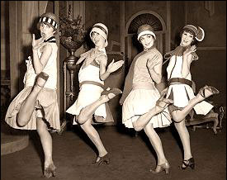
The Roaring 20s
Learning Goal: Explain how the lives of Canadians changed in the 1920s
Review questions from last week.
Note on the 1920s
CSI work

Slide 3
Warm-Up:
What were the main points of the Treaty of Versailles?
What did soldiers face when they returned home from war?
How was Canada different after the war than it had been before the war? The people? The attitude? The gov’t? technology?
What was the Winnipeg General Strike about?

Slide 4
Urbanization
More people were moving into the cities
With improved technology, fewer people were needed to work in agriculture and the fisheries
Skyscrapers began to appear→ CIBC tower in Toronto was 32 stories!
Popularity of the car meant more suburbs→ homes with driveways and garages

Slide 6
Toronto Skyline, 1930
05 Bank of Commerce Building
06 The Royal York Hotel
07 The Armouries
08 The Goal Tzedec Synagogue
09 The Canada Life Building

Slide 8
Fads and Fashions
Mass media advertising began
American radio broadcasts, magazines, movies, billboards poured in
Mahjong→ a Chinese game that led to parties with Chinese robes, decorations, etc.
Crossword puzzles were another fad

Slide 9
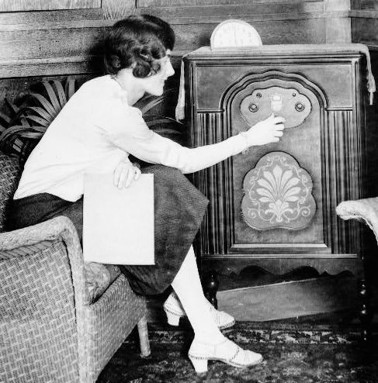

Slide 10
Dancing was the real rage→ dance marathons
Flapper→ a young woman who dressed outrageously
Skirts above the knee, stockings rolled down, unfastened galoshes in winter
Men wore baggy knickers or pants, bow ties, and a ‘snappy’ hat

Slide 11
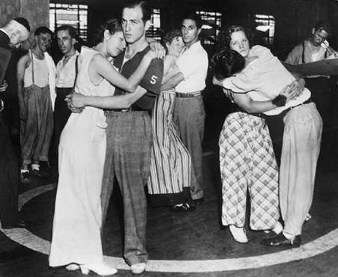
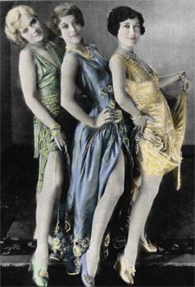

Slide 12
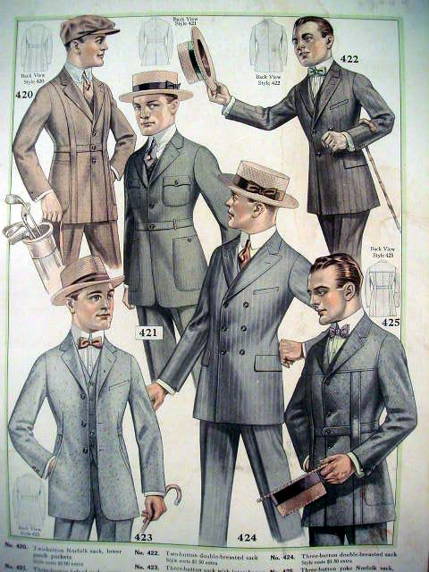

Slide 13
Entertainment
Jazz music arrived from New Orleans (Louis Armstrong, Duke Ellington)
The Charleston
Charlie Chaplin, Greta Garbo, Mary Pickford, Rudolph Valentino

Slide 14
Women
Agnes Macphail was elected to the H of C in 1921
By 1929, women made up 20% of the workforce
Female jobs were considered less valuable than male jobs
Lower wages
Almost impossible for minority women to find work

Slide 15
The Persons Case
Emily Murphy was made the first woman judge in the Empire
Challenged by a lawyer because a women was not considered a ‘person’ under the law
Therefore a women could not be appointed to the Senate
1928→ Supreme Court of Canada decided that women were not ‘persons’
Judge Murphy and the “Famous Five” took their case to Britain’s Privy Council
Declared that men and women were ‘persons’
Cairine Wilson was appointed to the Senate in 1930

Slide 16
The Automobile
Car and Truck Numbers
In 1911, there were 22 000 cars and trucks in Canada
By 1930, there were 1,200,000 vehicles in Canada

Slide 17
The Ford Model T
The most popular car of its time
It was at a price the average North American could afford
In 1924, it cost $395
Affectionately called the ‘Tin Lizzie’
750 000 were sold in Canada

Slide 18
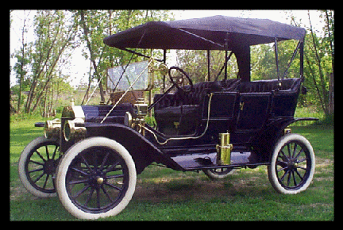
The Model T video

Slide 19
The McLaughlins
1907-The McLaughlin family began manufacturing the Buick in Oshawa
The next secured the rights to the Chevrolet
Sold to General Motors (GM) in 1918
By 1924, Ford, GM, and Chrysler dominated Canada’s auto industry

Slide 20
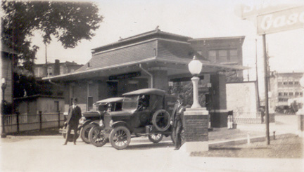
How the Car…
Made New Jobs
Gasoline, glass, rubber, and paint industries grew
New jobs in service stations, parking lots, repair shops
Traffic police were needed
Tourist cabins sprang up along roads
Main roads were paved
20% of N American jobs related to cars

Slide 21
b) Changed Society
Put N. America on wheels
Brought the country together
Became possible for summer cottages and vacations far away
Possible to live far from work
Suburbs formed outside large cities
More money was spent by governments on highways

Slide 22
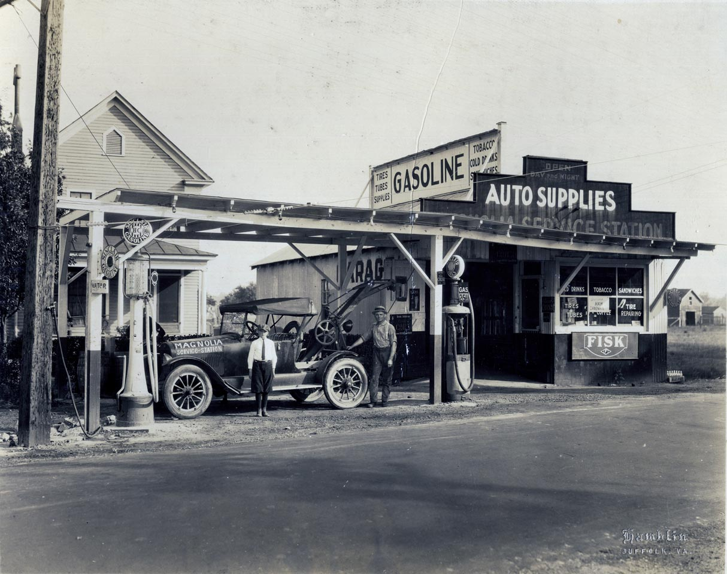

Slide 23
Canadian Sources Investigated:
Read the background information on pages 30-33 (the paragraphs on the white background).
Make a list of events that took place between 1900 and 1930 that advanced (made more equal) the political and legal rights of women. NOTE: I counted 13 points! Be careful, some are not in order.
Read the 2 quotations found in Evidence 2.18, at the top of page 33.
a) What does the first quote say about women?
b) In your own words, what does the second quote mean? Why does Sankey compare Canada’s constitution (BNA Act) to a tree?

Slide 24
Read Evidence 2.22 on page 35.
What message is Clarkson giving to women of the 21st century?
What does this message suggest about the long term-consequences of the fight for women’s rights in the 1920s?
Answer one of the ‘After Reading’ questions at the bottom of page 35.

