Slide 1
Responses to the Depression
CHC 2DR
Lesson 54

Slide 2
Responses to the Depression
Learning Goal: Recognize how the government changed its position over the course of the depression.
Review questions
By the Numbers
Government note
Thinking Historically Task

Slide 3
Review Questions
What caused the Depression?
What was ‘relief’?
What organizations provided support for those in need, when the gov’t wasn’t prepared to help?
Who were the two prime ministers during this time?
What was wrong with the relief camps?

Slide 4
What terms did people come up with to show that they blamed Bennett for the situation?
How did different parts of Canada suffer differently?
What types of entertainment were available?
What was Bennett’s ‘New Deal’? What was it modelled on?

Slide 5
By the Numbers:
Unemployment Rate:
1929: less than 3%
1933: 27%
Business Profits and Losses
1929: $398 million in profits
1933: $98 million in losses

Slide 6
Government Responses to Economic Conditions
1930 federal election focused on unemployment
Mackenzie King was in power when the election was called (Liberal)
R.B. Bennett (Conservative) promised to fix the problem
Bennett won a large majority and was in power for the worst 5 years of the depression

Slide 7
Considerable debate about what level of gov’t should provide relief
Bennett said provincial and municipal
Provinces said federal and municipal
Municipalities couldn’t handle the problem on their own

Slide 8
Conditions just kept getting worse
Canadians began to demand gov’t action

Slide 9
The On-to-Ottawa Trek
Relief camps were set up in remote areas of Ontario and northern BC
Young men cleared trees, built roads, and did other manual labour
Paid very little
Lived in cold, crowded shacks
By April, 1935, they were fed up

Slide 10
A walkout was staged in BC, demanding higher wages and better conditions
They headed to Vancouver
Planned to head to Ottawa by train, and confront the PM
1500 men gathered in Vancouver, holding rallies and collecting money for food

Slide 11
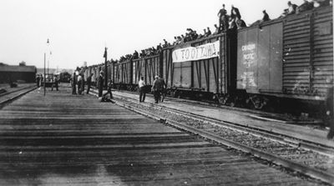
When they got on the trains, they found lots of support from citizens, as they headed east

Slide 12
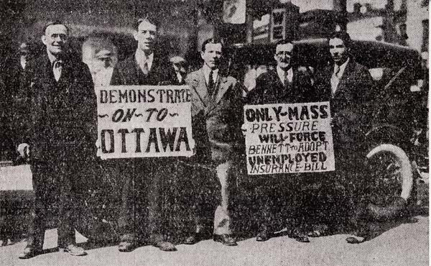

Slide 13
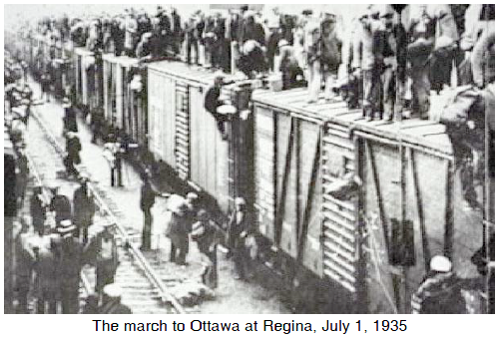

Slide 14
The Regina Riot
2000 trekkers reached Regina in mid-June
Federal gov’t was determined to stop them there
Trek leaders were allowed to go to Ottawa, but not the masses
Bennett accused the leaders of being communist agitators
He refused to make changes

Slide 15
Public meeting set for July 1
Regina police and RCMP tried to arrest the leaders
The crowd (large because it was a holiday) panicked
Many vandalized area stores and fought the police
1 police officer died, hundreds of police and civilians were injured.

Slide 16
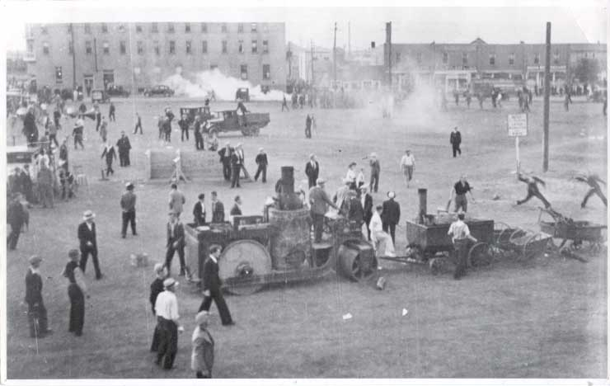

Slide 17
Trekkers returned to their camps, by freight trains again
Had really gained nothing
1935 election, Bennett lost
Relief camps were closed

Slide 19
Historical Significance
When Prime Minister Bennett agreed to meet with some of the trek leaders he had no intention of meeting their demands. Was meeting a mistake when he had no intention of listening to what they had to say? What could Bennett have done differently, in your view?

Slide 20
Cause and Consequence
Was the On to Ottawa Trek a success? Consider both short term and long term consequences.
Is there any way to connect the Winnipeg General Strike to the On to Ottawa Trek?

Slide 21
Historical Significance
Once again, our right to assemble and freedom of speech had been shut down by the government
From now on, we will expect more and demand more from our government.
Government response – the creation of the welfare state

Slide 22
Wrap Up – On a Scale Of…
10.
9.
8.
7.
6.
5.
4.
3.
2.
1.
Put a check beside the appropriate number in response to: On a scale of 1-10 how important is it to remember the On To Ottawa Trek?

Slide 23
New Political Parties
Neither the Liberals nor the Conservatives seemed to have solutions
People looked elsewhere for support
The Communist Party was an option but people were suspicious
Bennett had the Communist Party leader (Tim Buck) arrested for ‘communist agitation’. He spent 2 years in Kingston Pen.

Slide 24
Co-operative Commonwealth Federation (CCF)
1932
Roots were Western labour and farmers’ groups
Wanted to introduce socialism—government control of the economy, so that all could benefit

Slide 25
Promoted:
Government ownership of banks and transport
Crop insurance
Medical services for all
Employment insurance and pensions
Foreign policy that promoted peace and cooperation

Slide 26
Wrote in the Regina Manifesto, to provide all people with a “genuine democratic self-government, based upon economic equality.”
Led by J.S. Woodsworth
Evolved into New Democratic Party (1961)

Slide 27
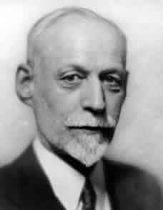
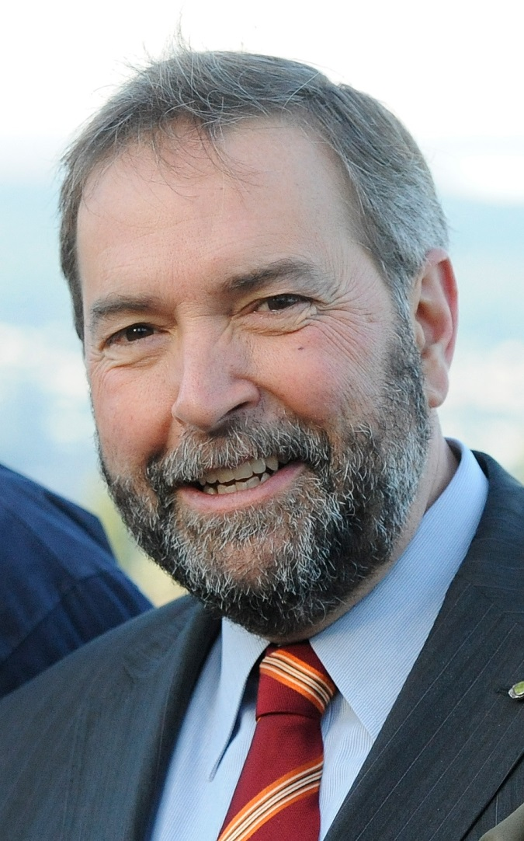
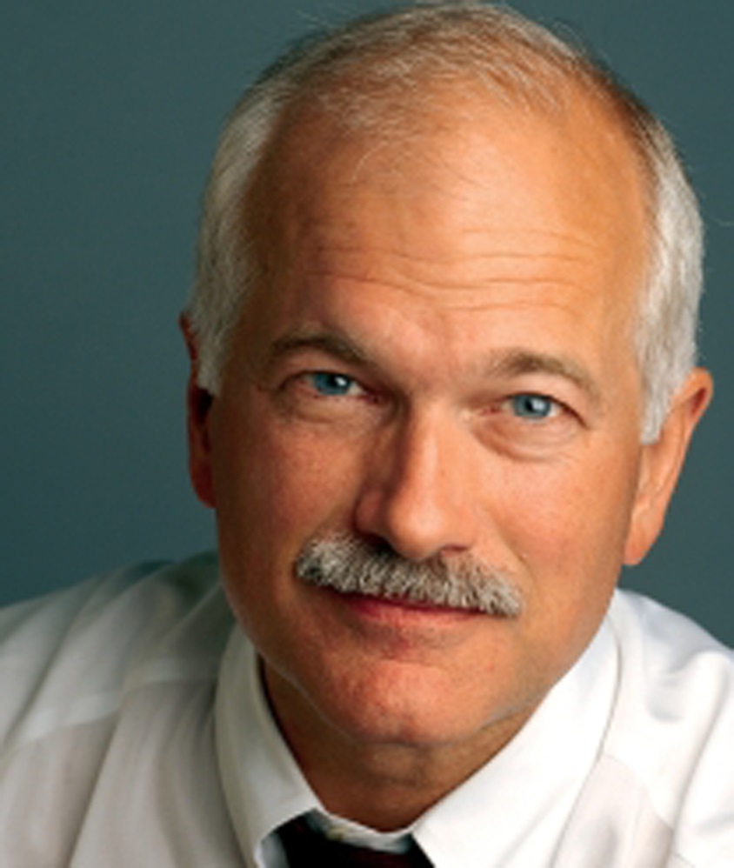

Slide 28
Social Credit Party
From the west
Led by William Aberhart (known as “Bible Bill”) an evangelical minister
Wanted to distribute $25/month to every Albertan.. A “social credit”
Depression would end if people had more money to spend
Won Alberta election in 1935

Slide 29
Governed Alberta and BC between 1935-1992
A bit in Quebec
Won most of Alberta’s federal seats in 1935
Fell apart in the 1970s

Slide 30
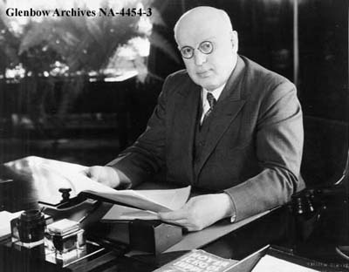

Slide 31
Note:
First Nations (Indigenous Canadian) farmers were not included in these parties
Gov’ts encouraged them to return to their traditional ways!

Slide 32
Union Nationale
Maurice Duplessis
Blamed rich anglophone business owners
French needed to reclaim the power
Minimum wages, provincially owned hydroelectric system
Would encourage more foreign investment in Quebec
Eliminated ‘subversive’ organizations
Remained in power until 1959!

Slide 33
Technological Changes of the 1930s
Air Transportation
Airplanes were put to many civilian uses
Commercial airlines evolved to carry passengers
Federal gov’t created Trans-Canada Airlines in 1936 (now Air Canada, sold to shareholders in 1988)
Airports were built with regular flights between communities

Slide 34
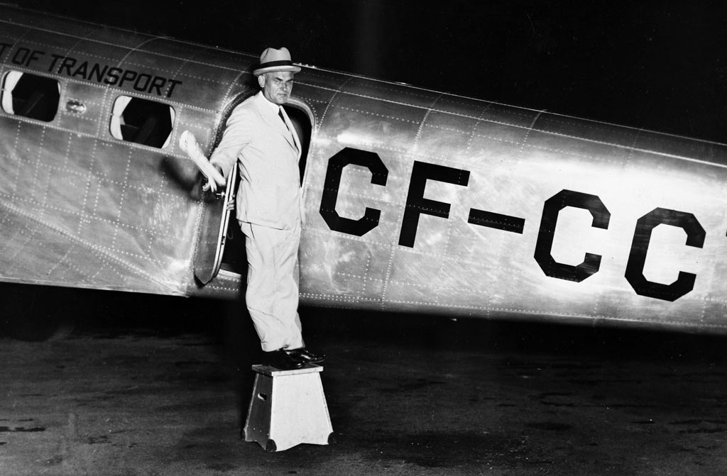

Slide 35
Bush planes began opening up the north
Planes that could land on water were key to resource development and exploration
Planes were also used to transport mail and freight

Slide 36
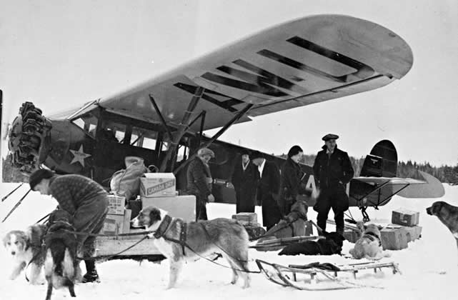

Slide 37
Bombardier, Inc.
Joseph-Armand Bombardier wanted to develop a way to get around in rural Quebec winters
Developed the snowmobile
Now, Bombardier builds jets, planes, subway systems, and railway cars
Recognized worldwide

Slide 38
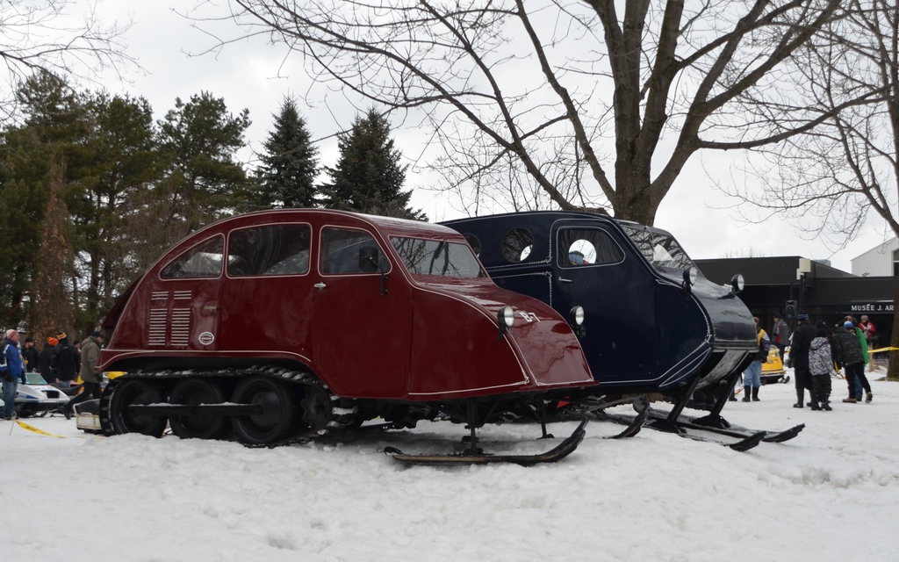

Slide 39
Baby Food
Malnutrition was a big problem
1930: 3 doctors from the Hospital for Sick Children developed a pre-cooked cereal for babies that was healthy (Pablum)
Today, it is the first solid food of millions of children around the world

Slide 40
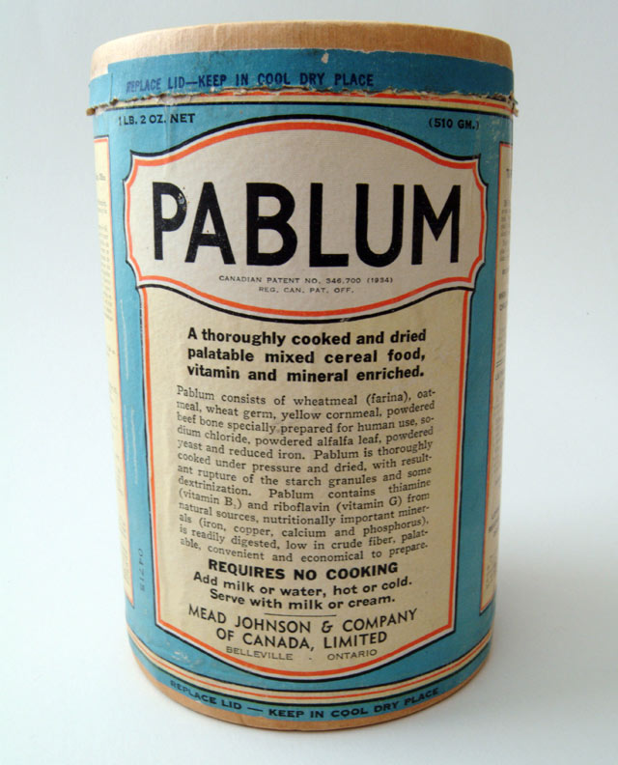
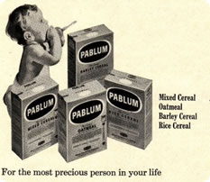

Slide 41
Questions:
Why would the government have thought it important to create a government-owned national airline?
How was the development of Pablum connected to shifts in society, such as urbanization, mass production, the changing role of women, and technological change?

Slide 42
Tasks:
Read pages 232-237 of Creating Canada.
make notes from what you read
Answer: Ethical Dimension (p 233), Explorations (p 234), Recall… Reflect… Respond 1 & 2 (p 237)
2. Complete the handout, “BLM 3.2 Changing Social and Political Beliefs…” using Creating Canada and Canadian Sources: Investigated

Slide 43
Canada, Immigration, and Jewish Refugees
Canadian Sources Investigated: pages 62-67
Words to know: refugee, anti-Semitism, fascist, Holocaust, Final Solution
During Reading: The People’s View (pages 62-64)Questions 1 (finish it later), 2, and 3 (use hand out chart for 2 and 3)
Page 64, Q2 (bottom right)
Page 65, During Reading, Q1, 2, &3)
After Reading, page 67, Q2 (9-sentence-like paragraph)

