Slide 1
Canada and the USA
Lesson 47
CHC 2DB

Slide 2
Canada and the USA
Learning Goal: Recognize the continuous influence that our southern neighbour has on us!
Finish up and discuss treatment of the unemployed
Note and discussion
Culture of celebrity: The Dionne Quintuplets

Slide 3
Canada and the USA
Cultural connections deepened, and Canada’s place in North America was emerging

Slide 4
American Isolationism
Isolationism→ the reluctance to become involved in world affairs (especially Europe’s)
Believed that they were better off focusing on their own issues
After WWI, USA went back to traditional isolationist position

Slide 5
Refused to join League of Nations
Like Canada, the US didn’t like the idea of contributing to collective security
They figured they would have to spend time and money protecting European countries (conflict prone)
Why might the Canadian and US governments have similar views on the collective security requirements?
In what ways might Europe be ‘conflict prone’?

Slide 6
Consequences of Isolationism
Immigration to USA
New policies limited immigration of Asians and eastern Europeans
Unions feared immigrants would work for lower wages
Became harder for Canadians to immigrate to the US

Slide 7
International Trade
Higher tariffs kept Canadian products out of the US
Economists disagreed with tariffs but gov’ts persisted

Slide 8
The Canadian Auto Industry
Adopted American practices in the 1930s
US companies continued to build in Canada
1933, only 40 000 cars were produced
All Canadian auto companies disappeared
Limited options on cars to keep costs down
Model T was ‘available in any colour the customer wanted, as long as that colour was black.’

Slide 9
Canadian Wheat Board
Prairie farmers organized wheat pools (co-ops) to coordinate the sale and delivery of wheat
Partially paid farmers when they delivered the grain, the rest when it was sold
This worked great in the 1920s
Priced dropped in the stock market crash, so pools couldn’t get back the money they’d already paid

Slide 10
Gov’t had to step in and offer subsidies… demanding more control
Canadian Wheat Board was established in 1935
Similar marketing boards were set up for eggs, milk, and turkeys
CWB lost power in 2012, due to Harper’s objections
A victim of pressure from the USA

Slide 11
Responses to American Cultural Influences
Concern about US influence in our radio programs
CBC was formed in 1932, to develop a Canadian radio network
By 1940, 90% of Canadians could listen to the CBC
Not as much success with a Canadian movie industry (NFB founded in 1939)

Slide 12
Dionne Quintuplets
Born May 28, 1934
First set of 5 identical babies in the world
Poor family near North Bay
Made wards of the province soon after their birth
Raised in ‘Quintland’, a place for tourists to come and see them
Booming industry for the region
No money went to the sisters or their family

Slide 13
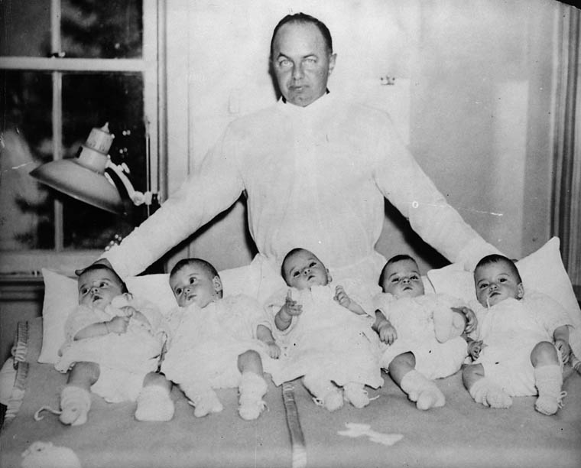

Slide 14
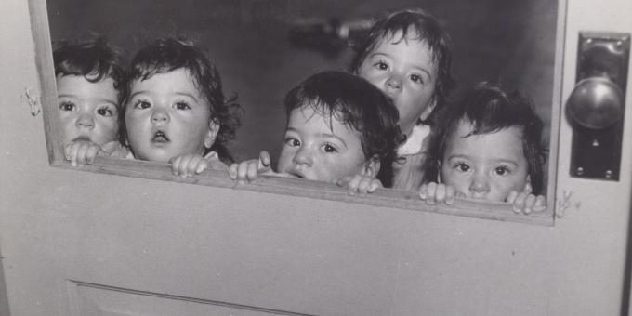

Slide 15
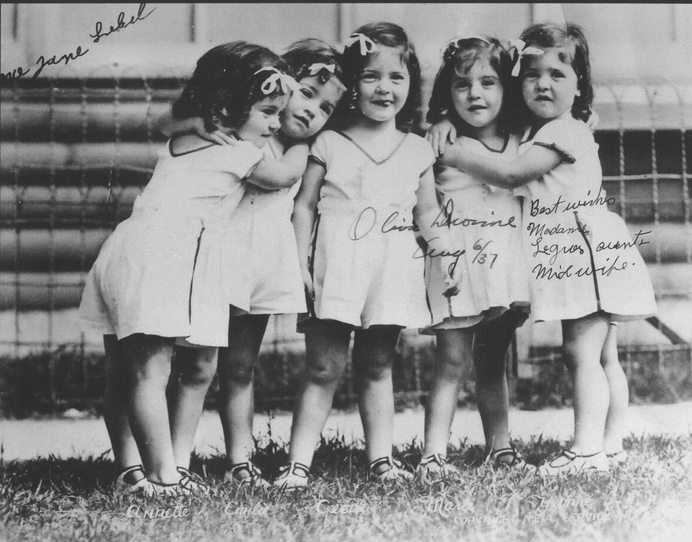

Slide 16
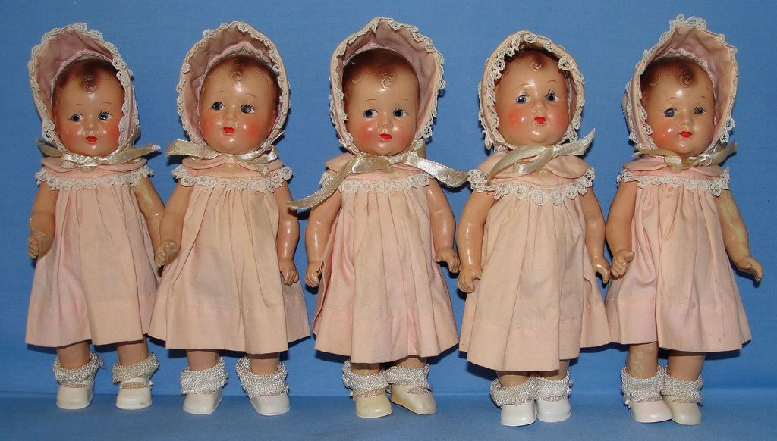

Slide 17
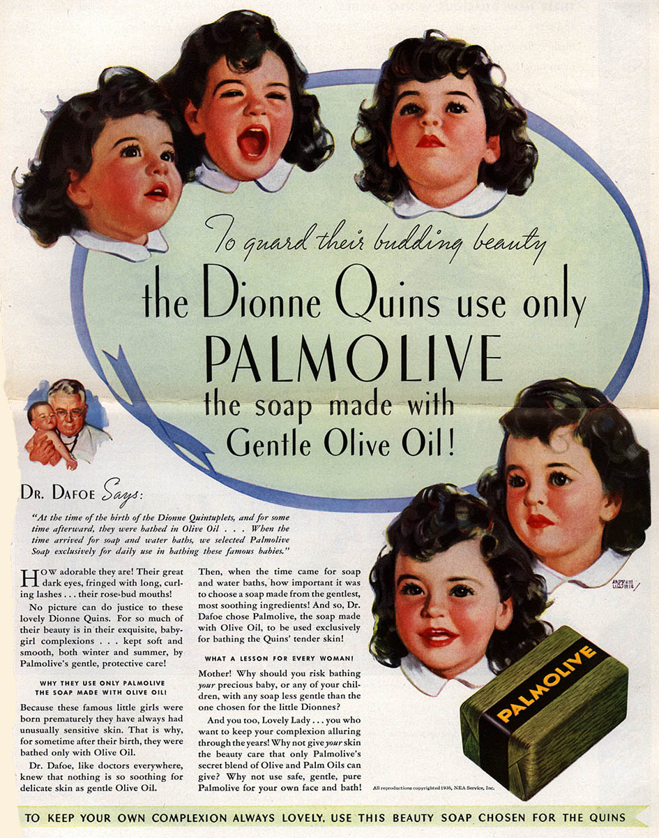

Slide 18
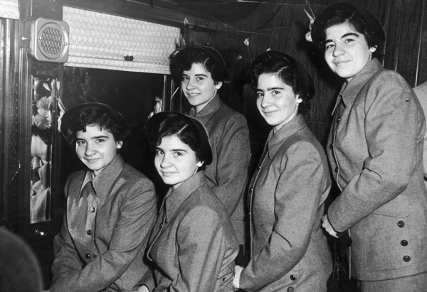

Slide 19
CSI: Continuity and Change
Pages 56-61
Read through the evidence and discuss with those around you.
On your own,
Make a list of comparisons to how (you hope) things would be done differently today.
What questions would you ask Dr Dafoe, Mr Dionne, the little girls?
What do you think should be done for the two remaining women today?
https://www.nytimes.com/2017/04/02/world/canada/ontario-dionne-quintuplets.html?mwrsm=Email&_r=0

