Slide 1
What in the World Was Going On?
CHC 2DR
Lesson 55

Slide 2
What in the World was Going On?
Learning Goal: Explain the political upheaval that was happening around the world.
Minds On… What do you think?
Note and discussion
Consolidation…

Slide 3
Minds On
With the person beside you, discuss this question:
“As long as things in a country work smoothly, does the kind of government matter?”

Slide 4
League of Nations
Formed after WWI to promote international peace and prosperity
It was a failure!!!! Why?
1) Although it was an American idea, they never joined. Many Americans did not think that they should get involved in the world’s problems.
2) The League ignored obvious problems when military invasions seized land in other countries.

Slide 5
What were these problems?
Totalitarian governments were forming
They provided answers to the depression, in many places
According to Mussolini: “All within the state, none outside the state, none against the state.”
Restricts individual rights and makes everyone subordinate to the government
Using fear and oppression

Slide 6
Fascism
People wanted economic security
If that required a leader with a strong hand, that was ok
Fascism: tells citizens that their nation and race are superior
Believe democracies are soft, and lack moral strength
Use propaganda to spread message of state power
Discourage questions about human rights

Slide 7
Where was this happening?
Communism in the Soviet Union (USSR)
Fascism in Germany
Fascism in Italy
Fascism in Spain
Totalitarianism in Japan
… Canada?

Slide 8
1. Communism in the USSR
Began in 1917
Started as a ‘dictatorship of the proletariat’
Proletariat: those who make a living by earning a wage
Discouraged religion
Used media as a propaganda tool

Slide 9
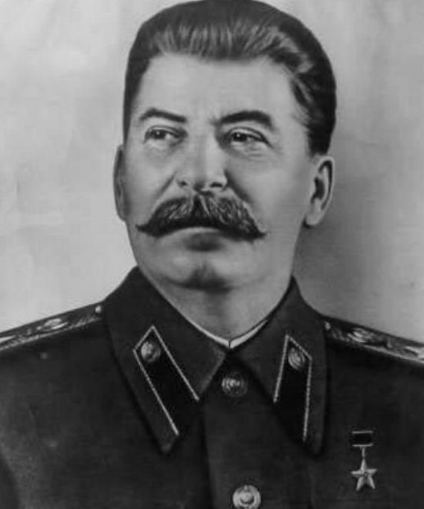
Stalin emerged as the leader and created the USSR (merging with other states)
Crushed all opposition
Millions of Soviet citizens were executed, imprisoned, deported, or starved, in the 30s

Slide 10
Canada and Communism
Communist Party of Canada founded (secretly) in 1921
Police harassed suspected communists
Most Canadians feared communism after what they saw happening in the USSR
Fear that it threatened democracy was promoted by politicians

Slide 11
“We know that throughout Canada this [communist] propaganda is being put forward by organizations from foreign lands that seek to destroy our institutions. And we ask that every man and woman put the iron heel of ruthlessness against a thing of that kind.”
R.B. Bennett, in a speech, 1932
Would a Canadian leader of today be likely to make a similar speech? Explain your response.

Slide 12
2. Fascism in Germany
A democracy was created (by the Allies) following WWI.
Germans didn’t like it, as it wasn’t solving their problems
Hyperinflation
Too many political parties so no one could get solid control
Cost of reparations was too big a burden

Slide 13
Adolf Hitler appeared to be an ideal leader
He offered solutions
Leader of the National Socialist German Workers’ Party (Nazis)
Hitler’s rise to power is explained in many ways
** homework activity

Slide 14
He was a powerful speaker
He appealed to the unemployed
Believed that non-Aryans (mostly blue eyed, blonde people) were inferior
Aryans were the master race
Blamed undesirables (Jews, Roma, communists, homosexuals, the disabled) for Germany’s problems

Slide 15
Minds-On
Review:
What was the role of the League of Nations?
What is appeasement?
What is totalitarianism?
What leads to totalitarianism?
Compare communism with fascism. Provide an example of a nation that practiced each.

Slide 16
By 1933, through a variety of shrewd moves and some good fortune, Hitler was made chancellor… the highest political position (stopped here!!!)
He then took over
Suspended the constitution
Got rid of all other political parties
Created a secret police (Gestapo)
Built concentration camps for those who opposed him

Slide 17
Hitler called himself ‘Fuhrer’ meaning leader or guide
Began to rebuild the military
League of Nations did nothing to stop him
He began taking over neighbouring areas with German-speaking people
League of Nations did nothing

Slide 18
World leaders were afraid of the consequences if they responded (war!)
They followed a policy of appeasement, giving in to Hitler in hopes that he would stop once he gained some of what he wanted

Slide 19
3. The Rise of Fascism in Italy
Benito Mussolini was the leader by 1922
Believed in a strong union of citizens, regardless of social rank
His ‘blackshirts’ claimed to restore order by attacking communists, socialists, etc.
Mussolini abandoned democracy by 1925
Aimed to fix the economy
Many admired his successes

Slide 20
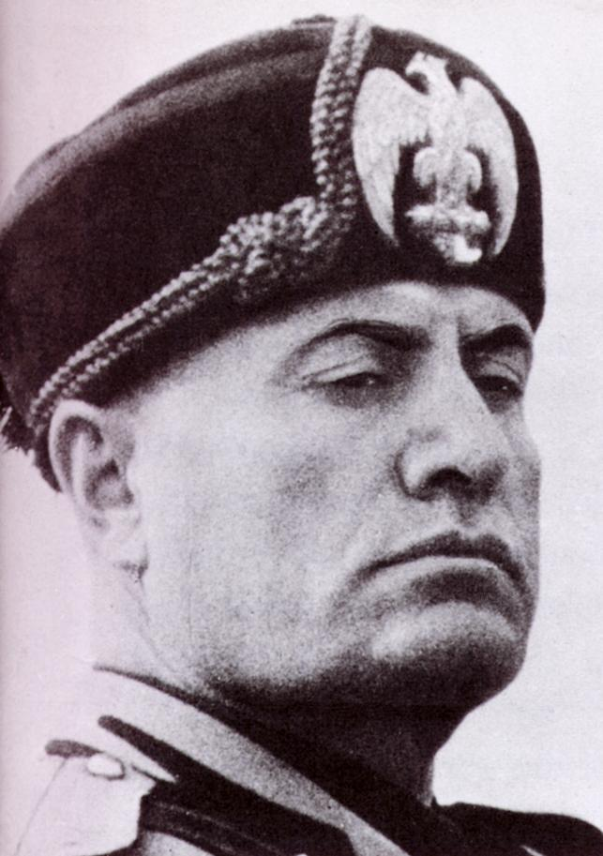
Improved wheat harvests
Developed hydroelectric systems
Reduced unemployment
Expanded auto and airplane manufacturing
“the trains ran on time!”

Slide 21
Mussolini decided to improve international influence
Wanted to expand into Africa
Invaded independent Ethiopia in 1935
Emperor Haile Selassie asked the League of Nations for help
He was ignored (appeasement was the answer)
1936, Hitler and Mussolini formed the Rome-Berlin Alliance

Slide 22
Cause and Consequence:
With a partner, consider the situation in Germany and Italy in the 1920s and 1930s. List several conditions that are necessary for a totalitarian regime to thrive.

Slide 23
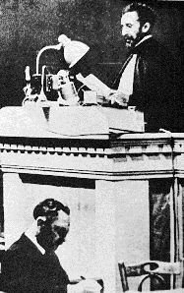
In his speech, Selassie told of the suffering that had occurred when Italian planes sprayed poison gas on soldiers, civilians, and livestock. What criteria should world leaders have used when deciding how to respond to Selassie’s appeal?

Slide 24
“No interest in Ethiopia, of any nature whatsoever, is worth the life of a single Canadian citizen. No consideration could justify participation in such a war”
--Ernest Lapointe, Canadian Minister of Justice, 1935
What does this tell us about Canada’s position? Has this changed at all? Use examples to prove your point.

Slide 25
4. The Rise of Fascism in Spain
In the 30s, Spain was beset by problems
Democracy was struggling
Civil war broke out in 1936
1 million Spaniards were killed
Rebels were led by Francisco Franco
Admired Hitler and Mussolini (they supported him)
Used brutality and terror

Slide 26
League of Nations did nothing
Hitler may have used Spain as a test for his battle strategies
By 1939, Franco controlled the country
He remained in power until 1975

Slide 27
Canadians in Spain
a) Canadians volunteered to fight fascism in Spain
Formed the Mackenzie-Papineau Battalion, in 1937 (after leaders of the 1837 rebellion)
Known as the Mac-Paps
1700 went and 1/3 died

Slide 28
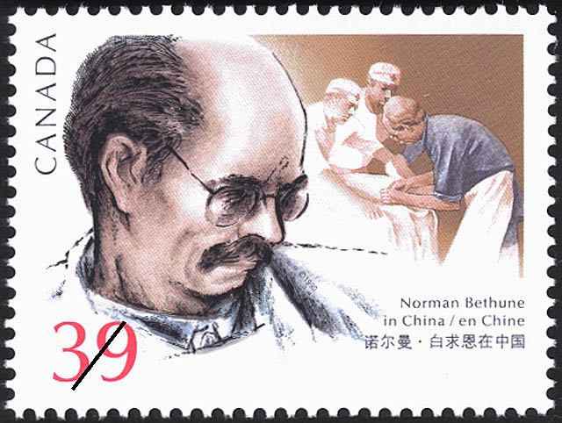
b) Norman Bethune
Doctor from Gravenhurst
Supported gov’t-run medical system
Joined the anti-fascist side in Spain
Developed a mobile blood transfusion service, while in Spain
Saved many lives

Slide 29
Ended up supporting the Communists in China, when they were fighting the Japanese
Died in 1939 after developing an infection while operating on a wounded soldier.
Would you go to war in a foreign country to support your beliefs?
How does this relate to today?

Slide 30
5. Totalitarianism in Japan
Japan wanted to expand its territory into Asia
Japan had developed a military-led government and had strong feelings of nationalism
Needed natural resources to fight wars
Japan had very few
Japanese businesses had invested in Manchuria, China for iron, coal, salt, and farmland

Slide 31
Chinese nationalism was growing
Japanese invaded Manchuria in 1931
Japan already controlled Korea (since 1910)
China appealed to the League
It condemned Japan’s actions, but did nothing
By 1937, there was a all out war between Japan and China

Slide 32
Japan bombed civilian targets
Was brutal and cruel
Millions of casualties
6 week massacre in the city of Nanjing
As many as 300 000 soldiers and civilians were raped and murdered
Caused Western countries to harden their attitude towards Japan

Slide 33
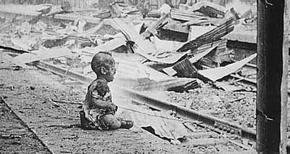

Slide 34
6. What about Canada?
Ku Klux Klan sprang up
Canada had no refugee policy to accept those facing persecution in their home countries
Immigration process made it impossible for them to come to Canada (too difficult)
1933-1945, fewer than 5000 Jews were admitted
PM Mackenzie King feared allowing more in would threaten national unity

Slide 35
The St Louis Incident
ship left Hamburg, Germany with 900 Jews (spring 1939)
Had tourist visas for Cuba but hoped for refugee status
Not allowed off the boat
Appealed to Canada and USA for help but both refused
Had to return to Europe
More than half were later killed

Slide 36
Voices:
“We must nevertheless seek to keep this part of the continent free from unrest and from too great an intermixture of foreign strains of blood, much the same thing lies at the basis of the oriental problem…. I fear that we would have riots if we agreed to a policy that admitted numbers of Jews. Also we would add to the difficulties between the Provinces and the Dominion.”
-- William Lyon Mackenzie King, diary entry, March 1938

Slide 37
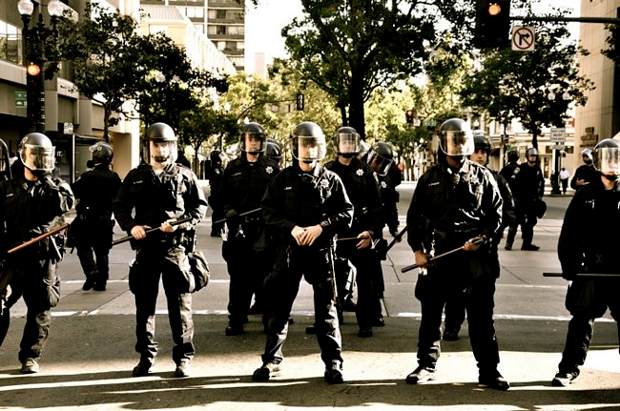
Tasks:
Identify two or three forces at work during the 1930s and explain how each promoted the rise of totalitarian governments. Could the same thing happen today? Explain the reasons for your response.
The world’s failure to confront totalitarian governments led to another world war that started in 1939. Who or what should be blamed for this failure to stop totalitarian governments? Or was no one to blame? How should nations make decisions about when and how to help? Express your opinion in a paragraph that provides evidence to justify your position.

Slide 38
Tasks:
1. Answer the “Recall… Reflect… Respond” questions
(page 278 of Creating Canada) (see previous slide)
2. Read pages 212-221 in Spotlight Canada.
Answer ‘A Wartime Diary’ questions on page 213.
Answer “Canada and Fascism” questions on page 219.
Complete the Case Study on pages 213-216
Make notes on the remaining information (pages 216-221)

