Slide 1
Appeasement
CHC 2DB
Lesson 58

Slide 2
Getting the War Started
Big Question:
“How did appeasement lead to the start of WWII?”

Slide 3
Minds On:
“What do you know about WWII already?”
In groups of 2 or 3, write down everything you already know about WWII… on chart paper

Slide 4
Appeasement
Name of Leader | Picture | Country/ Type of Government | Quote from Leader about WWII | What does this quote mean?

Slide 5
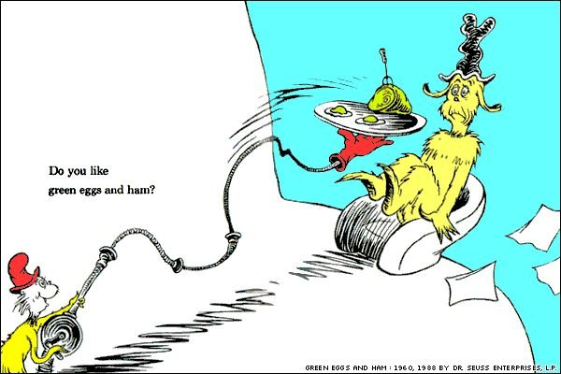
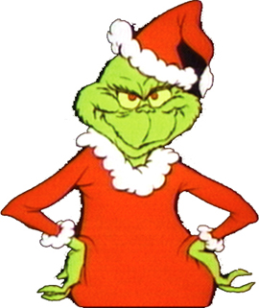
Any guesses as to how these characters are connected to the start of WWII?

Slide 6
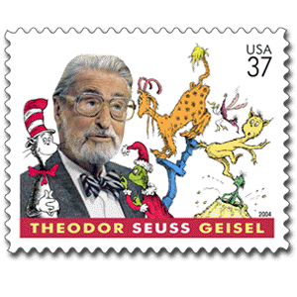
Before Dr Seuss became a writer of children’s books, he wrote political cartoons for newspapers
He spoke out against appeasement… he wanted governments to do more about Hitler’s ‘power grab’ in Europe

Slide 7
Dr Seuss’s Cartoons
From your cartoon:
What is appeasement?
b) What is the message of this cartoon?

Slide 8
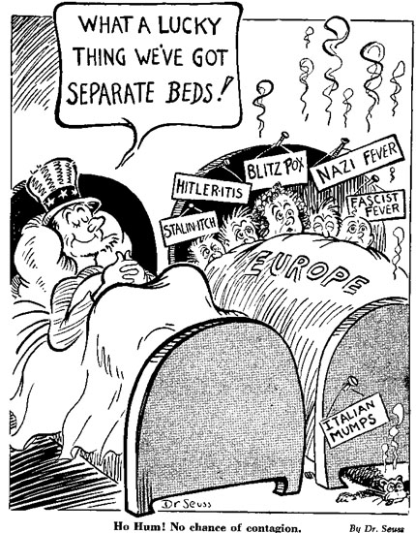

Slide 9
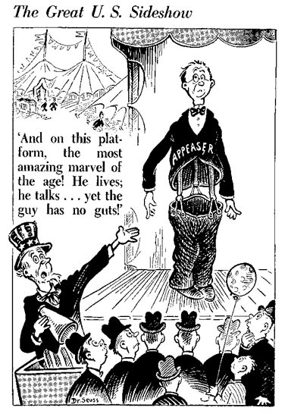

Slide 10
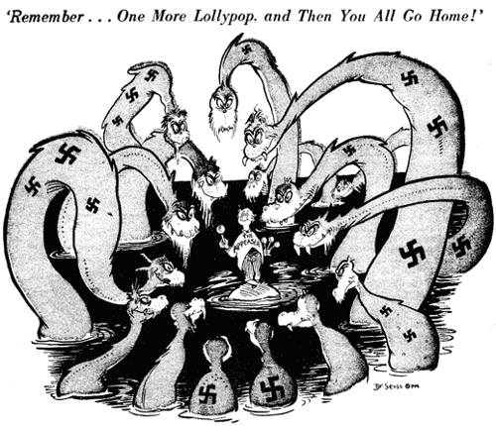

Slide 11
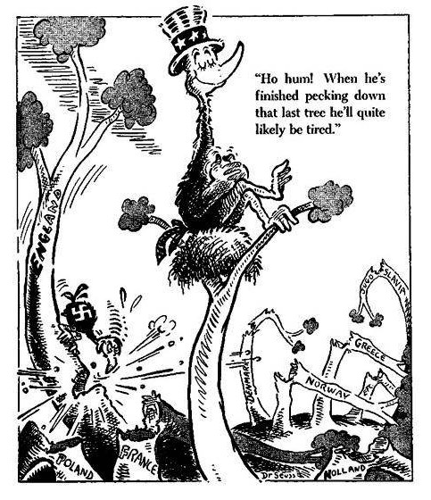

Slide 12
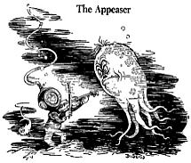

Slide 13
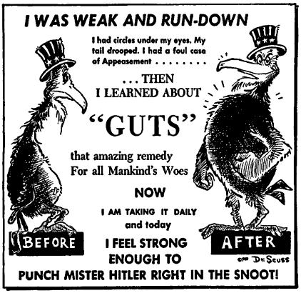

Slide 14
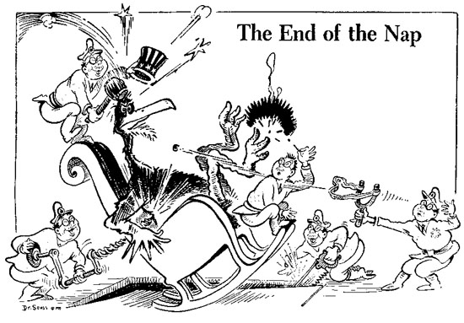

Slide 15
Four Corners:
What should the Prime Minister of England do?
a) England should let Hitler take Poland
b) England should attack Germany
c) England should negotiate with Germany
d) England should boycott German products
Write your answer on your white board.

Slide 16
Consolidation:
Write 5 adjectives (describing words) about Europe before the war.

