Slide 1
The War Begins
CHC 2DR
Lesson 72

Slide 2
The War Begins
Learning Goal: Explain how appeasement led Europe back to war.
Appeasement activity
Notes and discussion
Hitler's actions
Blitzkrieg

Slide 3
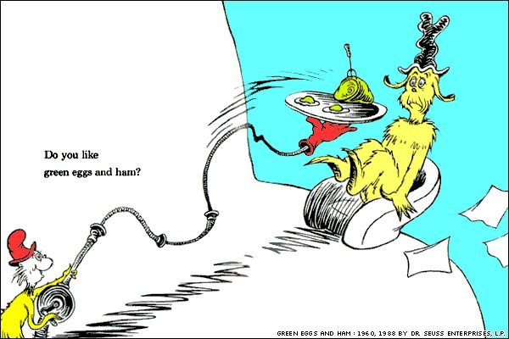
Any guesses as to how these characters are connected to the start of WWII?

Slide 4
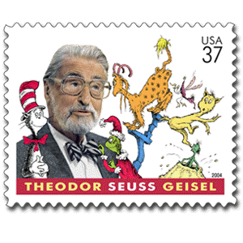
Before Dr Seuss became a writer of children’s books, he wrote political cartoons for newspapers
He spoke out against appeasement… he wanted governments to do more about Hitler’s ‘power grab’ in Europe

Slide 5
Dr Seuss’s Cartoons
From your cartoon:
What is appeasement?
b) What is the message of this cartoon?

Slide 6
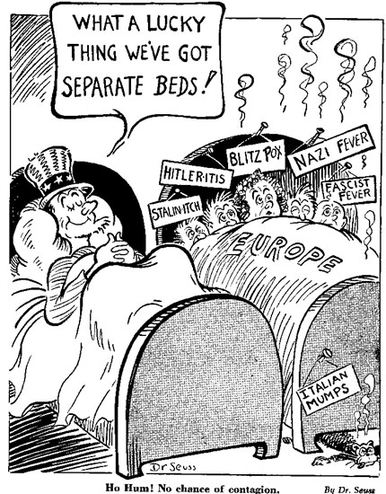

Slide 7
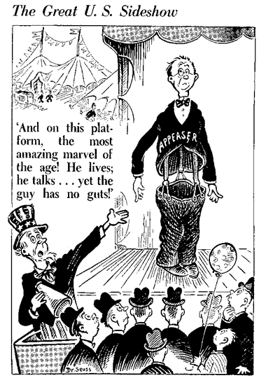

Slide 8
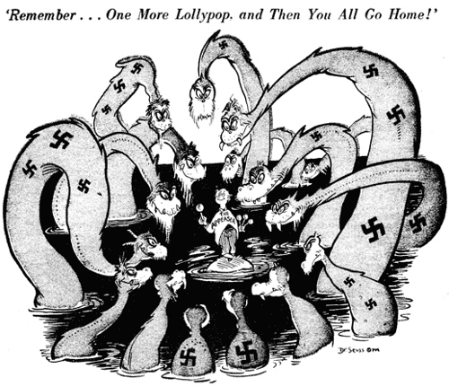

Slide 9
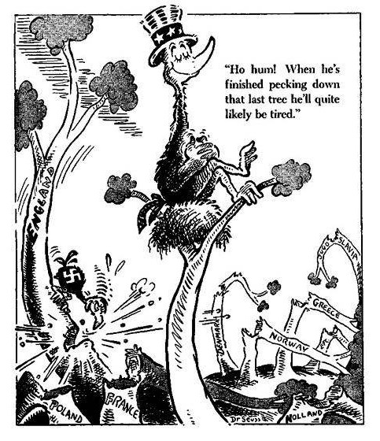

Slide 10
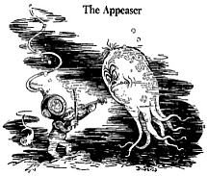

Slide 11
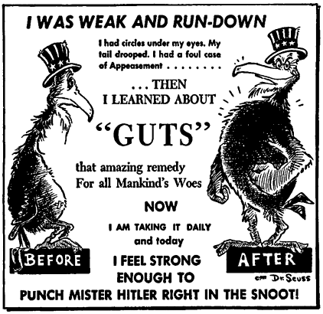

Slide 12
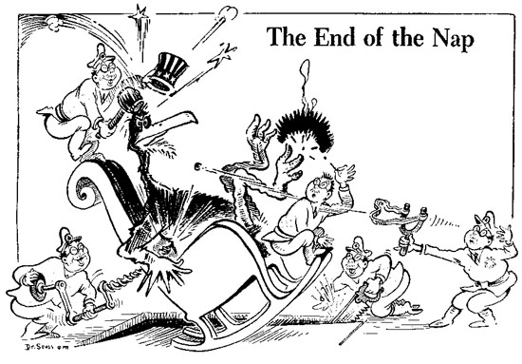

Slide 13
What Does Canada Think?
While Hitler was gaining power in the 1930s, Canada did not seem to be paying attention. Why? There are 6 reasons:
Memories of WWI
Wasn’t WWI “the war to end all wars?”

Slide 14
The Great Depression
European problems are not important when millions of Canadians are in poverty

Slide 15
Pacifism
Many Canadians wanted peace
Many politicians wanted to stay neutral (not take sides)

Slide 16
Isolationism
We wanted to worry about our own business
We were not important enough to have a large influence (and we were ok with this!)

Slide 17
Politics
PM Mackenzie King was not worried about Hitler
He was concerned with Canadian unity first

Slide 18
King visits Germany in 1937
King was impressed by Hitler. He wrote, "My sizing up of the man as I sat and talked with him was that he is really one who truly loves his fellow-men, and his country, and would make any sacrifice for their good." (Diary, June 29, 1937) Hitler appeared to be "a man of deep sincerity and a genuine patriot." (Diary, June 29, 1937) King saw similarities between himself and Hitler, writing, "As I talked with him, I could not but think of Joan of Arc. He is distinctly a mystic .... He is a teetotaller and also a vegetarian; is unmarried, abstemist in all his habits and ways." (Diary, June 29, 1937)

Slide 19
Appeasement
King supported Britain and France at the Munich Agreement, which was the Policy of Appeasement (Give Hitler what he wants)

Slide 20
Hitler’s Steps to War
1936: Hitler Occupies the Rhineland
March 1938: Germany annexes Austria
September 1938: Hitler is given the Sudetenland (part of Czechoslovakia) in Munich Agreement signed by Britain, France, & Germany
March 1939: Germany takes the rest of Czechoslovakia
August 1939: Germany and USSR sign non-aggression pact
September 1, 1939: Hitler invades Poland
September 3, 1939: Britain and France declare war
September 10, 1939: Canada declares war

Slide 21
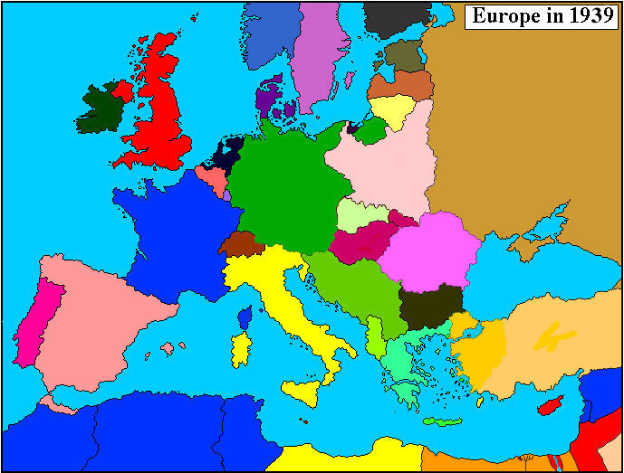

Slide 22
At War!
Within the first four weeks of action (1940) Hitler’s army occupied Poland, Denmark, Norway, Belgium, Luxembourg, and the Netherlands
France was next
Within 6 weeks France had fallen
Dunkirk→ 300,000 British and French soldiers rescued after being surrounded by the German army (May 1940)
PM King hoped Canada would be a supplier of materials rather than men, in a limited war
Supply routes to Europe meant the survival of the British people

Slide 23
Blitzkrieg→ “lightening warfare” this was the German method of attack
Strike hard and fast
This was how Hitler marched through Europe

Slide 24
‘The Blitz’
The Battle of Britain (July to October 1940)
England proved to be a challenge for Hitler
Determined to destroy the spirit of the British
Pounded London and southern England nightly
Londoners got used to spending their nights in air raid shelters or in underground subway stations

Slide 25
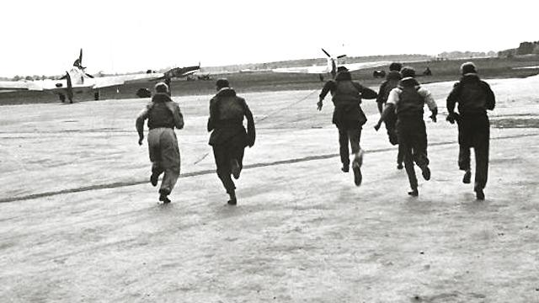

Slide 26
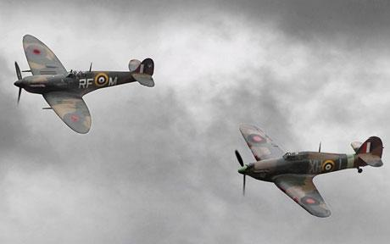
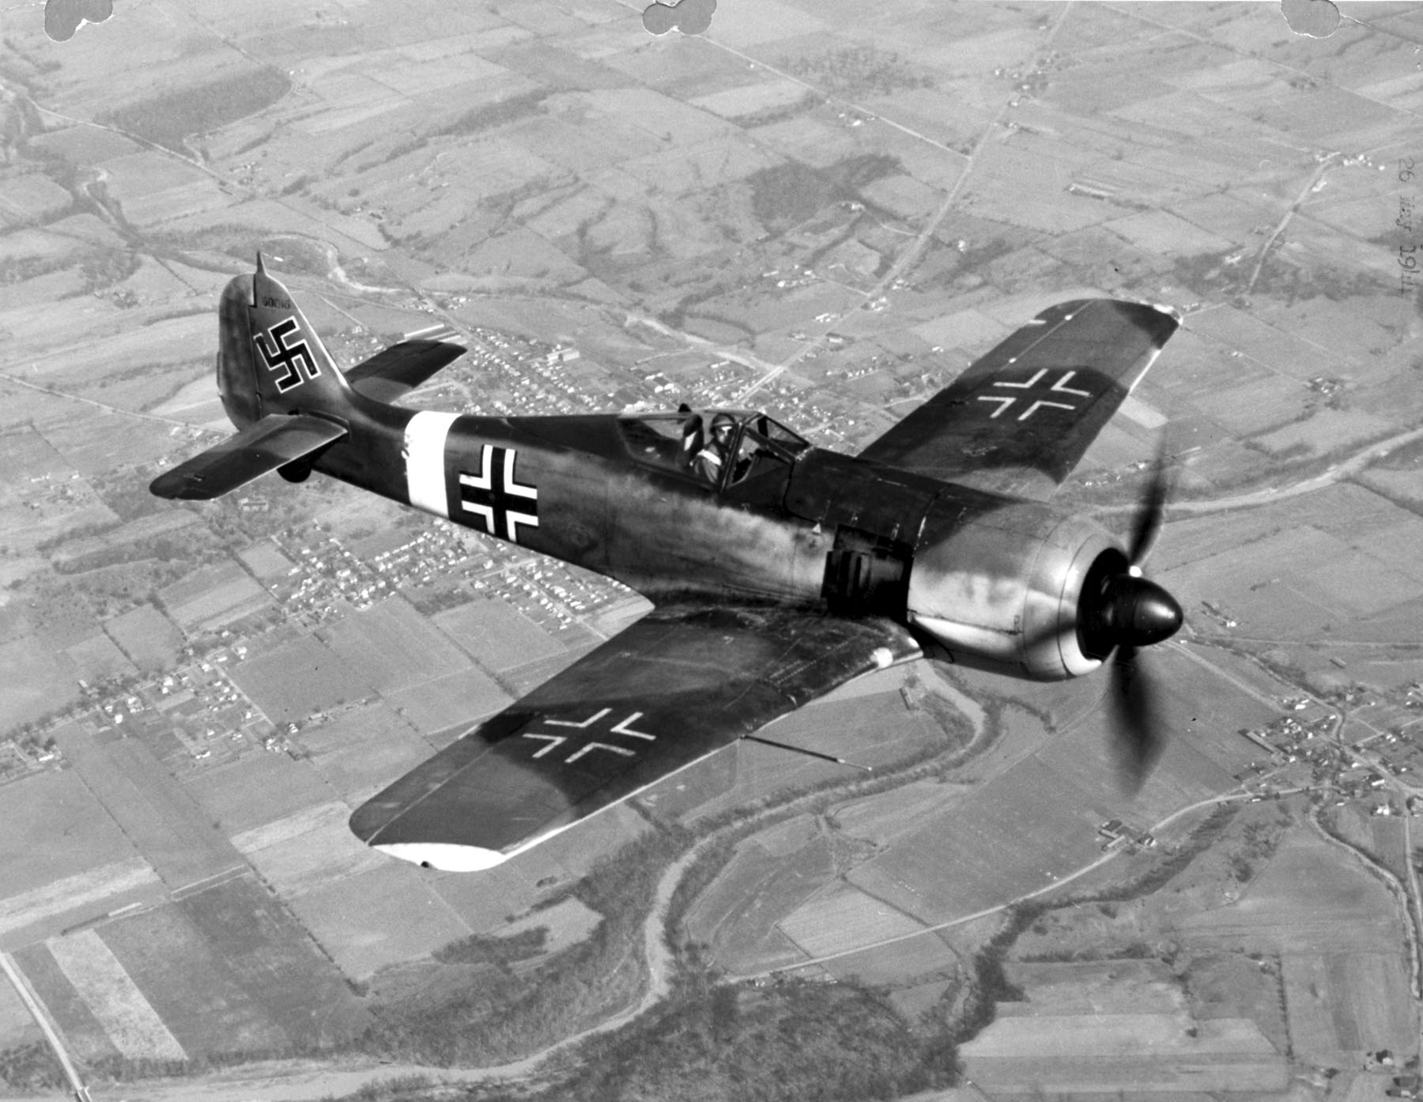

Slide 27
RAF shot down 3000 Nazi planes in 2 months
Churchill “Never was so much owed by so many to so few.”
Lives of young pilots were measured in weeks
16 of the first 25 Canadian pilots perished

Slide 28
Canada’s Role
War Measure’s Act was invoked
Nazi sympathizers were arrested
Communist party was outlined
Orders for goods flowed from Britain
Companies were told what to produce and when
Canada and US made an agreement on the joint defense of N. America

Slide 29
Canada welcomed 1000s of British children for the duration of the war
97 training schools for airmen were opened in Canada
Roosevelt said, ”Canada was the aerodrome of democracy”
Butter, sugar, meat, tea, gasoline, and tires were rationed
Scrap metal and rubber was collected and reprocessed for the war effort

