Slide 1
Early Stages to the War
Lesson 44
CHC 2DR

Slide 2
Early Stages to the War
Big Question: What role did Canada play early in the war?
Minds-On: Review Question
Note and discussion

Slide 3
Match the leader to their country:
Winston Churchill
Mackenzie King
Adolf Hitler
Hirohito
Harry Truman
Benito Mussolini
Haile Selassie
Joseph Stalin
Francisco Franco
Neville Chamberlain
Tojo
Franklin D Roosevelt
Canada
Great Britain
USA
Germany
Japan
Spain
Italy
Ethiopia
USSR

Slide 4
What do these terms mean?
Totalitarian
Fascism
Communism
Appeasement
Anti-Semitism

Slide 5
War Begins
Thousands of Canadians signed up immediately
Happy for a steady job
An adventure
Right thing to do
Allies were not prepared for war
Hitler and Stalin took advantage of this

Slide 6
First Canadian arrived in Britain in December 1939
Sept 1939-May 1940 called the ‘phony war’
Hitler continued to take Europe but the allies weren’t ready
Stalin invaded Finland, Estonia, Latvia, Lithuania

Slide 7
Blitzkrieg:
‘lightning war’ to overwhelm the opposition
Germany used strong air support, troops, tanks (Panzers), and artillery to advance quickly and effectively
Denmark fell in one day, Norway in a month
Netherlands, Belgium, Luxembourg also fell
France was next

Slide 8
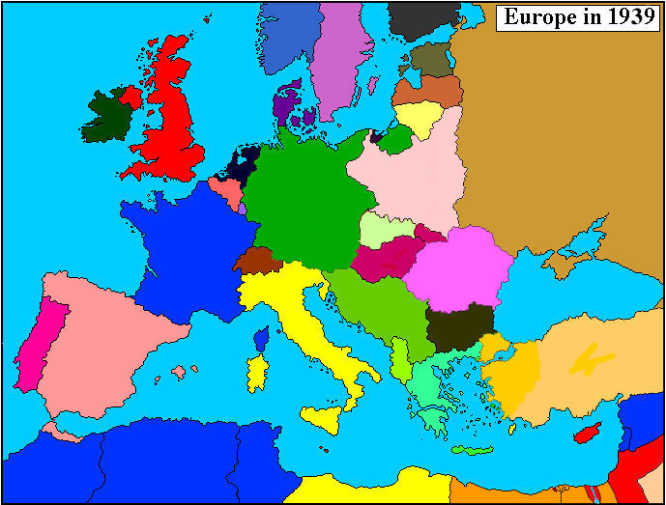

Slide 9
French prepared for a WWI-style battle
Dug in with support of British and allied soldiers from defeated countries
Germans surprised the allies with Blitzkrieg and defences collapsed
338 000 troops retreated to port of Dunkirk

Slide 10
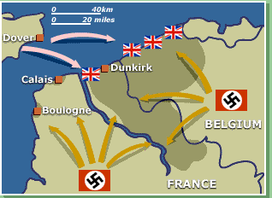

Slide 11
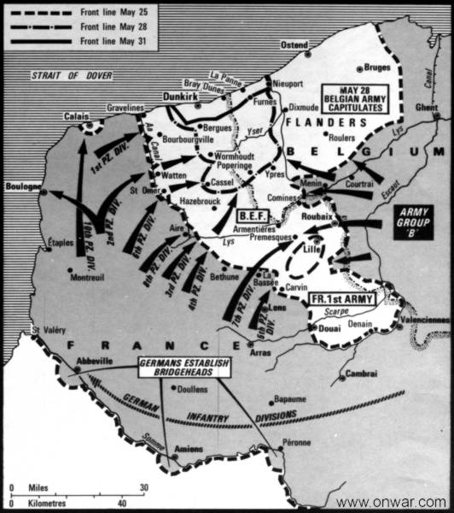

Slide 12
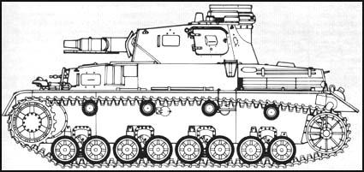

Slide 13
Miracle of Dunkirk (May 1940)
Hitler paused to think about whether or not to attack Britain by sea or air
Considered his first fatal mistake of the war
Gave Allies time to achieve a dramatic rescue
“Operation Dynamo”
An armada of 800 fishing, pleasure, and commercial boats, operated by civilians
Complemented 222 naval vessels that couldn’t get into the small harbour

Slide 14
Smaller boats picked up troops from the beach and transferred them to the ships
Under fire from the shore, many were sunk
All troops returned to Britain (although their equipment was left behind)
A military defeat was turned into a moral victory

Slide 15
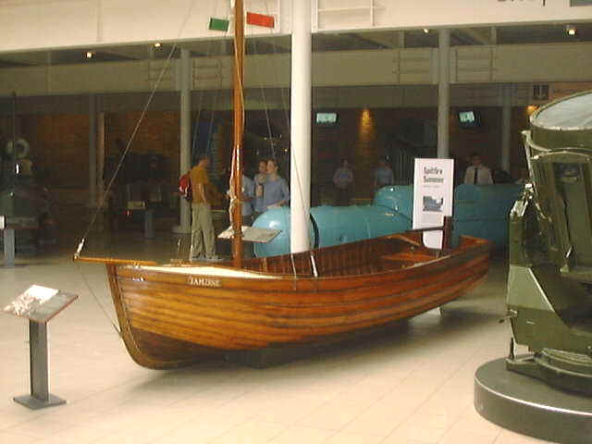
The Tamsine

Slide 16
At the time, British Prime Minister Winston Churchill called Dunkirk evacuation “a miracle of deliverance,” and the operation provided an important morale boost when the outlook for the Allies was bleak.
How could this outcome, which marked a crushing defeat for the Allies, be considered a miracle?

Slide 17
France Surrenders
June 25, 1940, France surrendered
Northern and Western France is controlled by the Germans
In the South, in the town of Vichy, a puppet government was set up by Germany
Now, Hitler controlled nearly all of Western Europe and could focus on Britain

Slide 18
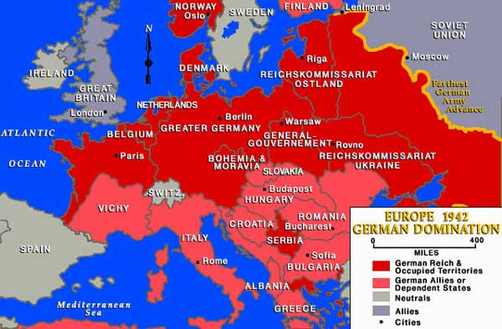

Slide 19
The Battle of Britain
140 000 German troops were along the English Channel
Hilter ordered the Luftwaffe (air force) to gain control of the skies of the English Channel and Great Britain
Planned to destroy airfields, factories, radar station, etc.
Started July 10, 1940

Slide 20
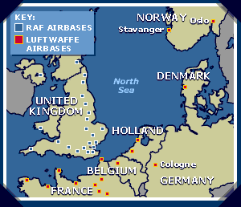
RAF was outnumbered by the Luftwaffe
Not enough trained pilots or crew
British radar was superior
Canada and other Allied countries were sending replacement aircraft and pilots
100 Canadian pilots served

Slide 21
Britain was still losing the battle until a German bomber accidentally bombed London
The RAF then bombed Berlin
Hitler was angry
Focused attention on bombing London, rather than airfields (big mistake!)
57 consecutive nights, London was bombed
Known as ‘the Blitz’

Slide 22
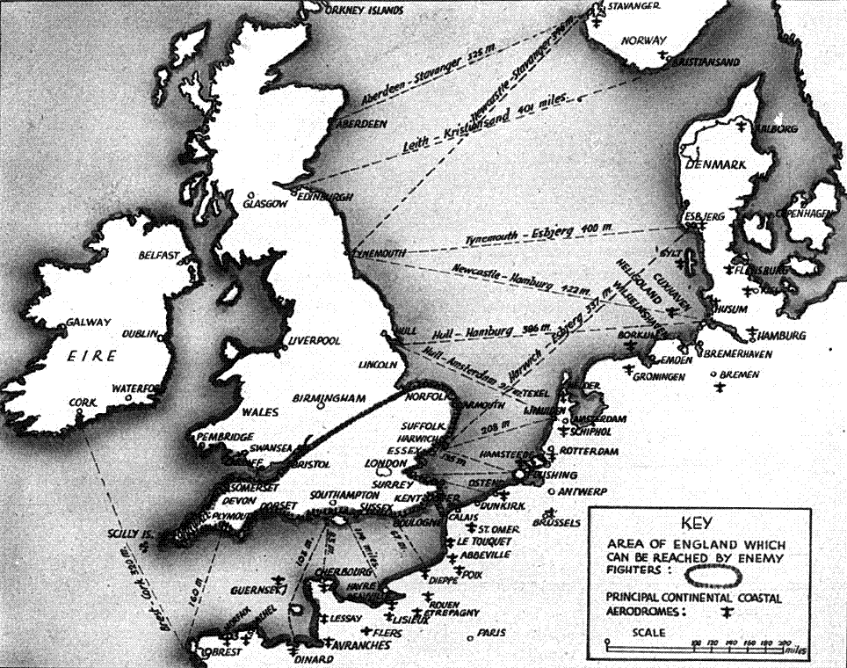

Slide 23
Killed around 43 000 people
Reduced much of the city to rubble
But, gave RAC a chance to regroup and rebuild
By May 1941, the Battle of Britain came to an end
Churchill said, “Never in the field of human conflict was so much owed by so many to so few.”

Slide 24
Hitler had hoped to break the spirit of the British people (so they would surrender)
Had the opposite effect

