Slide 1
1941-1942 Canada Plays Its Part
CHC 2DR
Lesson 46

Slide 2
Canada Plays Its Part (1941-42)
How did Canada contribute to the war, beyond the battlefield?
Minds-On: Review questions
Action: Note and discussion
Consolidation: Things that make you go ‘hmm’.

Slide 3
Who is the leader of…
Russia
USA
Canada
Britain (at the start of the war)
Italy
Germany
Ethiopia
Spain
Britain (later in the war)

Slide 4
What was the Battle of Britain?
How long did the Blitz last?
What was the St Louis incident?

Slide 5
Mind’s On – Picture Analysis
How many pictures do you take a day? What do you do with them?
How many of those will you look at or consider important tomorrow? Next week? Next year?
Why do historians consider photographs important pieces of evidence? What problems might they present?
On the following slide you will be shown an image. As a class we will work through ‘What Do You See?’ and then discuss some specific ‘Inferences’

Slide 6
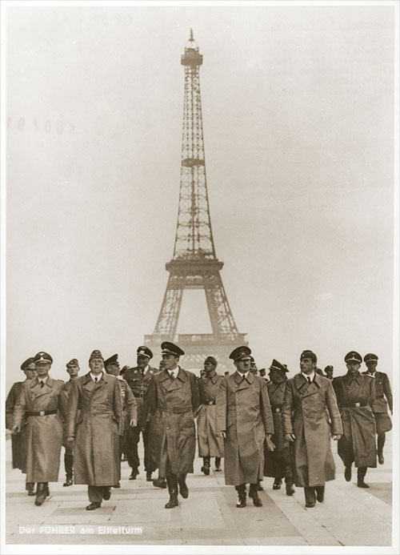
What Do You See?
What can we infer about this
particular group of Nazis?
Based on what you know, what stage of the war might this be?
Why do you think the location of
this photo is important?
What do you think is happening elsewhere in Europe?

Slide 7
Canadian Battles (1940-1943)
What We Know:
1933 – Hitler takes power
1936 – Germany occupies Rhineland
1938 – Germany occupies Austria
1939 – Germany occupies Czechoslovakia
1939 – Germany and USSR sign non-aggression pact
1939 – Germany invades Poland
1939 – War is declared on Germany
What Happens Next:
1939/40 – Canada mobilizes with great support, arrive in England for continued training
1940 – Germany sweeps through western Europe with occupation of France in June. The French government goes into exile.
1940 onward – Germany begins building up defences on ‘Atlantic Wall’ or ‘Fortress Europe’ (coast of France)

Slide 8
Picture Analysis
You will be given a picture of a Canadian involvement during 1940-1943. With the picture you get you will a) write what you see on the left and then b) make 4 inference questions based on that picture
Meet with people that have the other 3 pictures. Ask each other the questions you’ve made

Slide 9
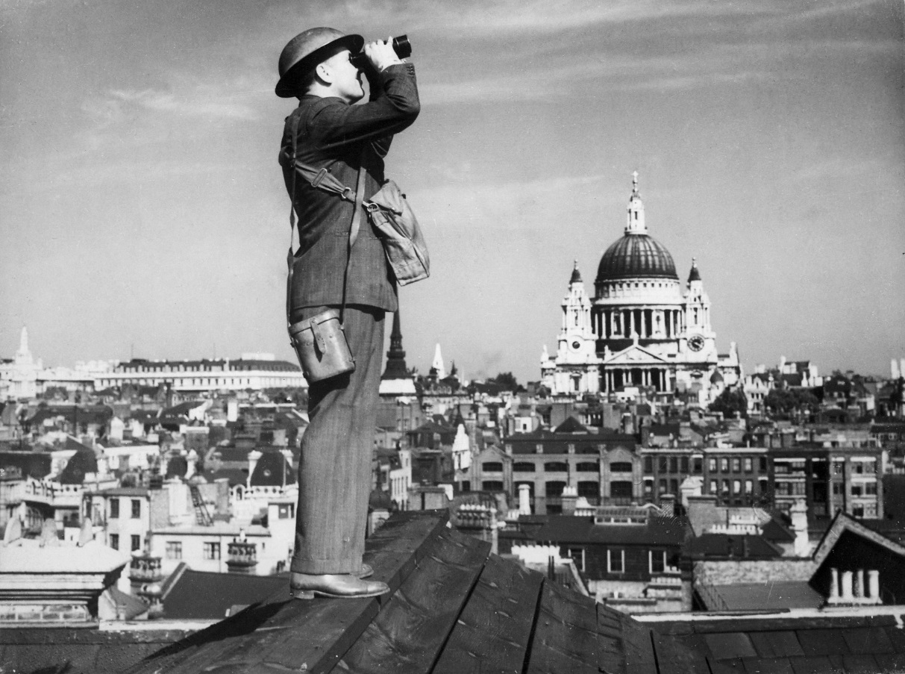
1.
What Do You See?
Make 3-5 Inference Questions

Slide 10
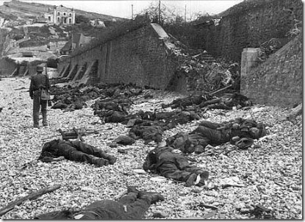
2
What Do You See?
Make 3-5 Inference Questions

Slide 11
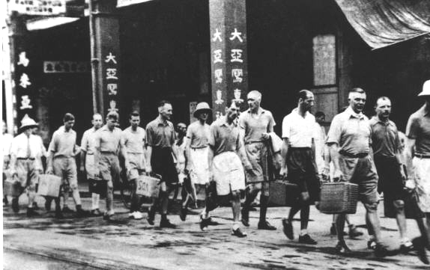
3
What Do You See?
Make 3-5 Inference Questions

Slide 12
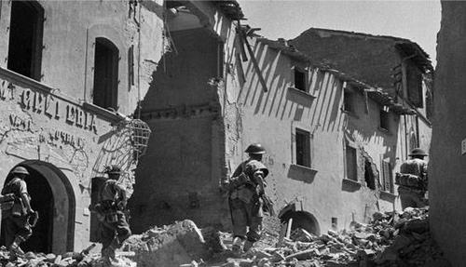
4
What Do You See?
Make 3-5 Inference Questions

Slide 13
Canada in the Pacific
Pearl Harbor was bombed on Dec. 7, 1941
Japan felt threatened by the US’s strong naval presence in the Pacific (even though the US was still neutral)
According to FDR: “a date which will live in infamy” (famous speech, declaring war)

Slide 14
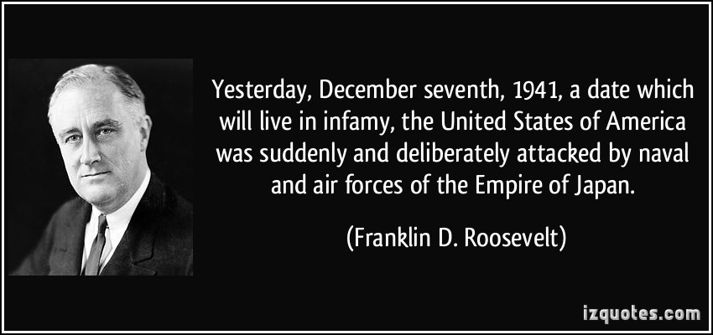

Slide 15
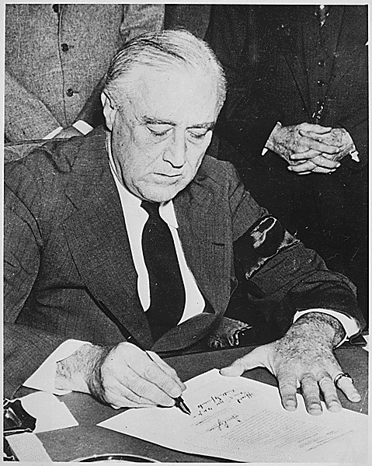

Slide 16
Hong Kong
8 hours after the attack at P.H., other bases in SE Asia were also attacked
Including Hong Kong, where 1975 Canadian soldiers had arrived a few weeks earlier to support British and Commonwealth troops
No match for 50 000 Japanese troops
Hong Kong fell on Christmas Day, 1941

Slide 17
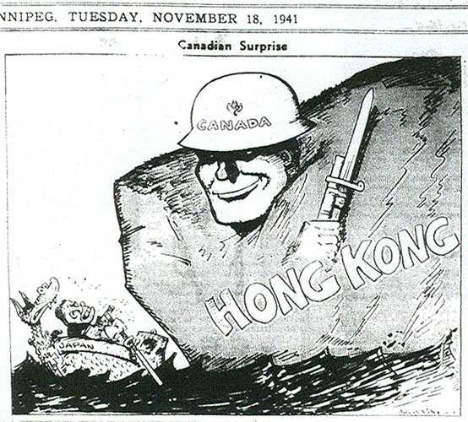

Slide 18
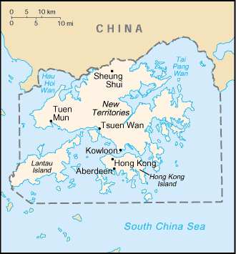

Slide 19
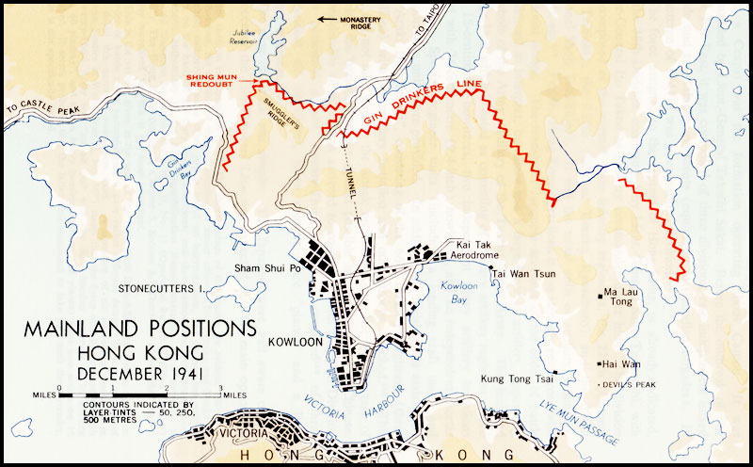

Slide 20
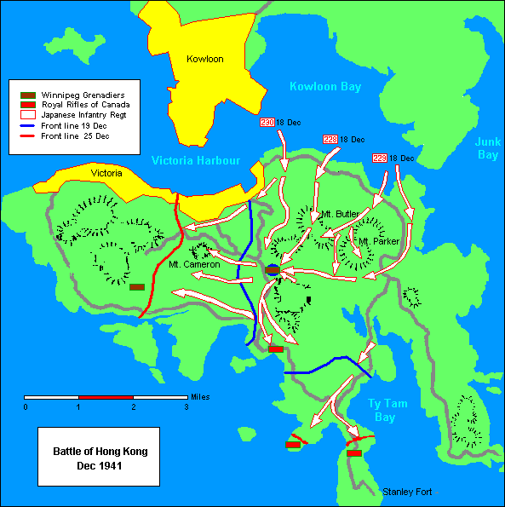

Slide 22
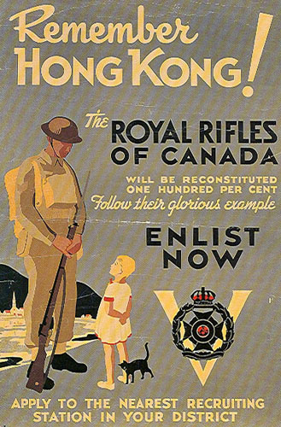

Slide 23
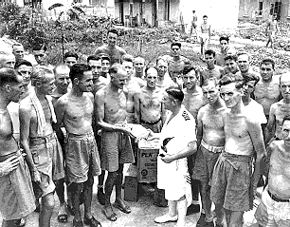
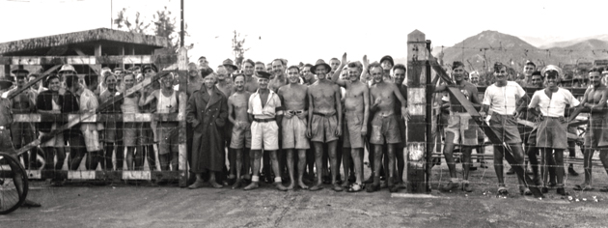

Slide 24
1685 Canadians survived and were made POWs
“[The Japanese soldiers] were pretty rough on us. They tied our hands together with barbed wire. A lot of boys that fell and couldn’t walk because they were wounded so badly, they were cut loose and bayoneted right there.”
-Don Nelson, survivor

Slide 25
260 Canadians died as POWs, first in the camps and later when they were forced to work as slave labour in shipyards and mines
Many veterans have asked for apologies from the Japanese government
Canadian gov’t has compensated them
Ethical Dimension: Do these veterans—or any others—have a right to expect compensation for harsh treatment while they were POWs?

Slide 26
Hitler and the USSR
Hitler broke the non-aggression pact in June 1941 (Operation Barbarossa)
Attacked USSR with 3 million troops and 3000 tanks
Now Germany was fighting on 2 fronts
Led to death of 20 million Soviet people
900-day siege of Leningrad cost 700 000 lives lost to bombing and starvation

Slide 27
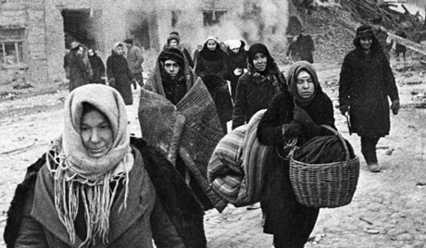

Slide 28
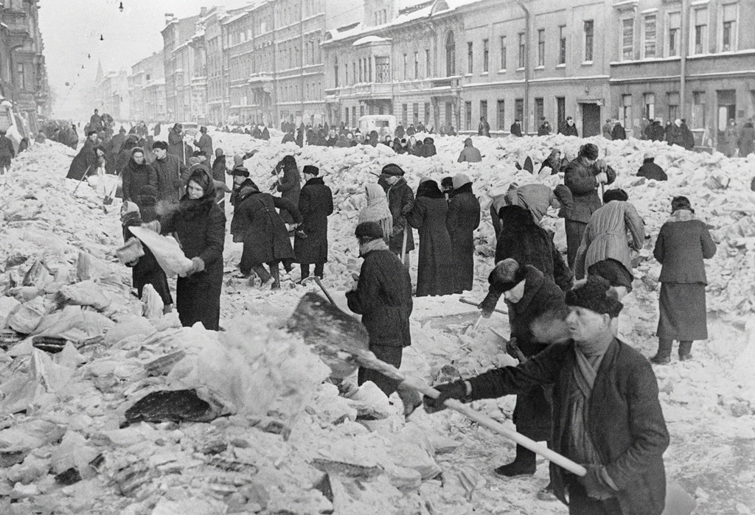

Slide 29
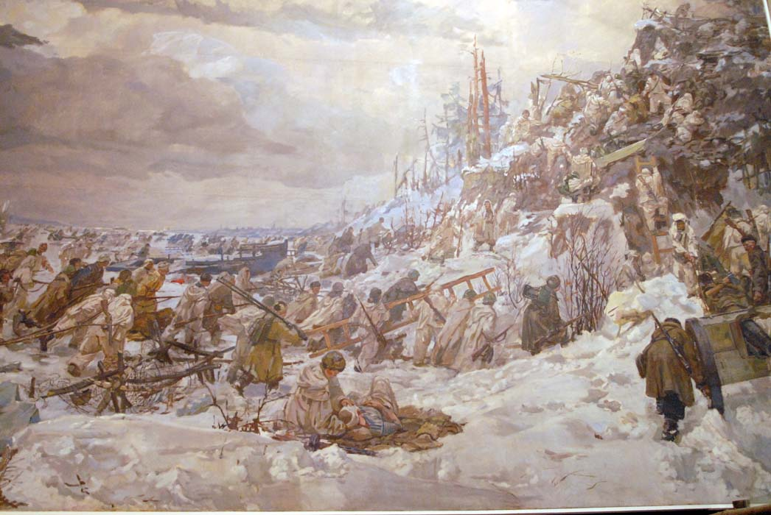

Slide 30
Dieppe
Soviets wanted Allies to launch an attack, to alleviate the pressure on the USSR
Allies weren’t quite ready but wanted a morale boost
Sent 2nd Canadian Infantry Division to raid Dieppe, a French seaport (Operation Jubilee)
August 19, 1942
Why did it fail?

Slide 31
Lost the element of surprise when it met a German convoy
Poorly planned landing sites (Germans could fire on Allies)
Beaches were barricaded so tanks couldn’t succeed

Slide 32
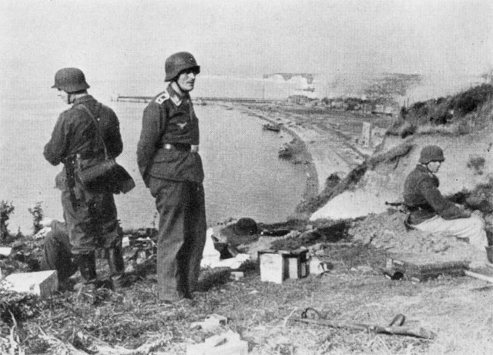

Slide 34
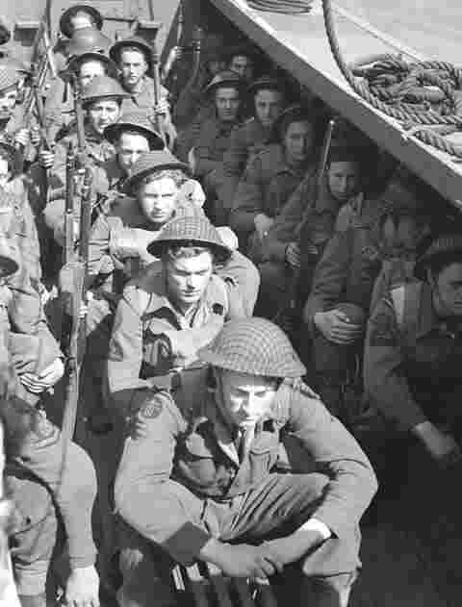

Slide 35
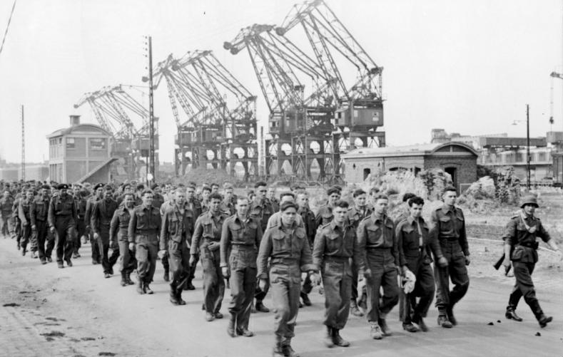

Slide 36
Consequences
6033 allied troops
4963 were Canadian
907 Canadians killed
587 wounded
1946 captured
Greatest loss of Canadian lives during the war

Slide 37
Historical Perspective:
To put a positive spin on the Dieppe raid, Allied leaders tried to focus public attention on what they had learned from this ‘practice run.’ If you had been a journalist writing about lessons learned at Dieppe, what would your report have said?

Slide 38
The Battle of the Atlantic
Britain relied on supplies and reinforcements from Canada
U-boats (German navy submarines) tried to sink Allied ships crossing the N. Atlantic
Naval vessels protected the cargo ships in convoys
Canadian naval ships met British naval ships in the mid-Atlantic

Slide 39
U-boat ‘wolf packs’ had the upper hand at the beginning (143 ships sunk in July 1942)
By mid-1943, Allies were better experienced and trained
Submarine tracking had improved
navy and air force had grown
(13 ships, 13 000 members in 1939; 375 ships, 110 000 members in 1945)

Slide 40
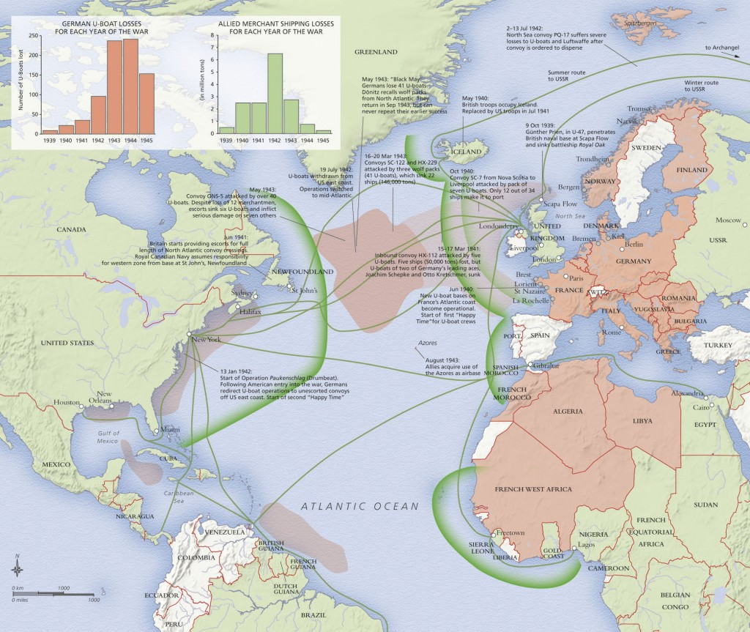

Slide 41
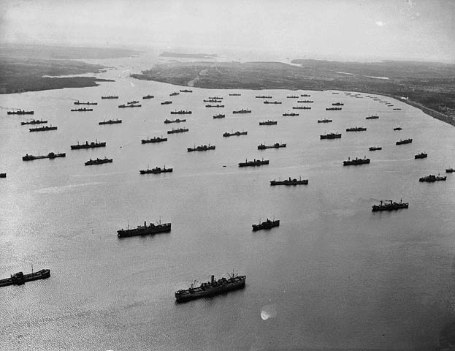

Slide 43
2000 naval members were killed
1600 merchant mariners were killed (including 8 women)
“The Battle of the Atlantic was the dominating factor all through the war. Never for one moment could we forget that everything happening elsewhere, on land, at sea, or in the air, depended ultimately on its outcome, and amid all other cares we viewed its changing fortunes day by day with hope or apprehension.”
-Winston Churchill

Slide 44
Science and Technology
Key Question:
Are science and technology the key to winning wars?
Axis and Allies raced to achieve technological supremacy
Could these developments win the war on their own?
What other factors might sway the balance?

Slide 45
1. Radar
Use of radio waves to detect objects
British were the first to develop a usable system
Detected enemy planes and told fighter pilots where to go (in a timely manner)
In the Battle of Britain, pilots got the info so quickly that interception rates (shooting down a plane) reached 75%
Key to RAF (and RCAF) success

Slide 46
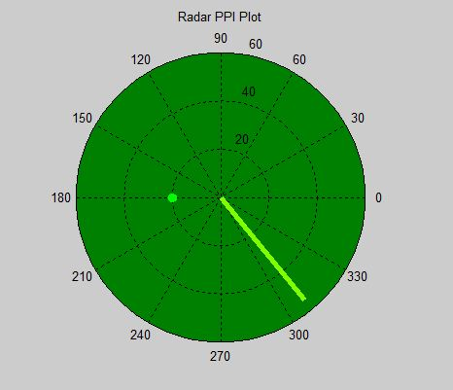
Radar ‘countermeasures’ were developed
Allies dropped 1000s of tiny strips of tin foil to jam enemy radar (called ‘chaff’
Canadian scientists continued to refine radar
Plan Position Indicator, is used today

Slide 47
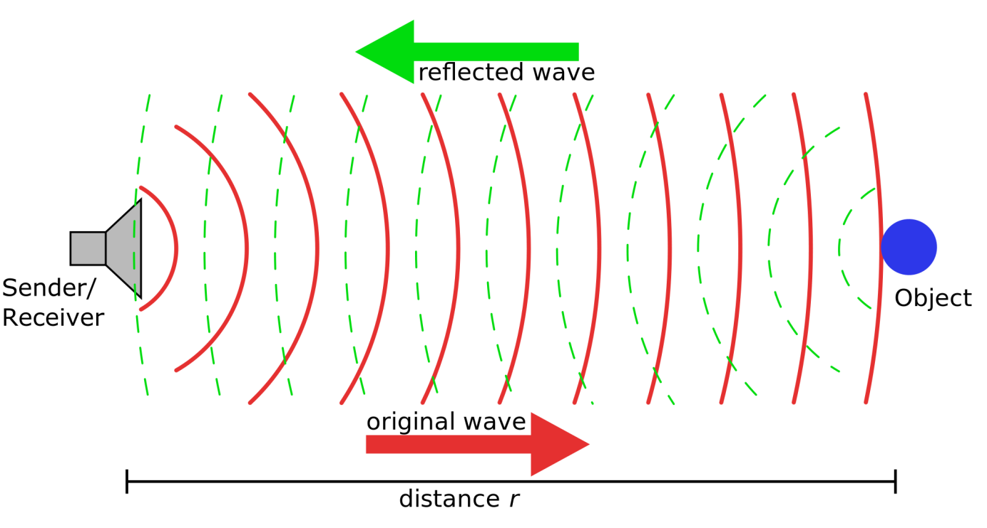
2. Sonar
Uses sound waves to detect objects
For detecting submarines
Could be used to destroy submarines before they threatened the convoys

Slide 48
3. The Enigma Machine
Looked like an electric typewriter
Scrambled keystrokes to make a code
Recipient had to know how to unscramble the code
Germans invented it but British quickly learned how to decipher it (unbeknownst to the Germans!)
Modern encrytion software is a spin-off of this machine

Slide 49
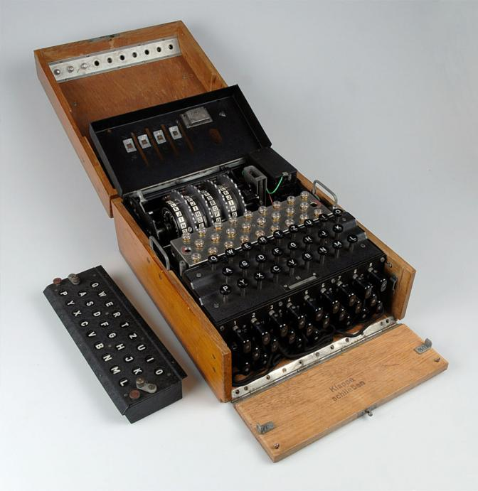

Slide 50
4. Better Food and Medicine
Researchers figured out which nutrients were essential to human health
Used to help keep soldiers healthy
American researchers created the “D-ration” chocolate bar with 1800 calories, and essential vitamins and minerals
Hershey produced them
3 billion bars were given to all Allied soldiers between 1940-1945

Slide 51
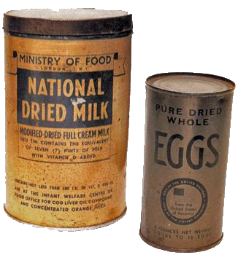
Canada’s National Research Council developed high-protein powdered foods such as eggs and milk that could easily be shipped overseas
Chemistry!

Slide 52
Penicillin had been discovered in 1928
Was manufactured on a massive scale in the USA during the war
Given to soldiers and civilians
Reduced the number of amputations required
Given to soldiers when wounded so that they would be fine until they saw a doctor

Slide 53
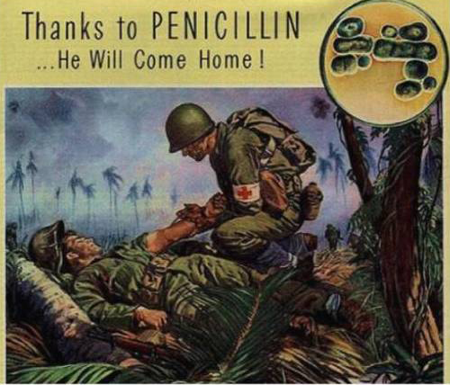

Slide 54
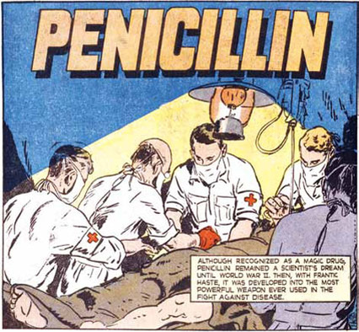

Slide 55
Consolidation
3 statements:
I really understand….
I sorta, kinda, almost understand…
I have a lot of questions about…

