Slide 1
The Italian Campaign
Lesson 49
CHC 2DR

Slide 2
The Italian Campaign
Learning Goal: Analyze the role of the Canadians in the storming of Europe.
‘Quiz’
Finish yesterday’s note on food and medicine
Italian campaign note and questions

Slide 3
Quiz
Name one of the Nuremberg Laws.
Why did Hitler send Jews to ghettos?
What was “Kristallnacht”?
What happened at Dunkirk? (also spelled Dunkerque)
Why did Britain ‘stand alone’ in Europe by 1941?
What happened to the Canadians in Hong Kong?
Why did the raid at Dieppe fail?
Name one thing the allies learned to do better next time?
What was the ‘Black Pit’?
What impact did German U-boats have on the war?

Slide 4
4. Better Food and Medicine
Researchers figured out which nutrients were essential to human health
Used to help keep soldiers healthy
American researchers created the “D-ration” chocolate bar with 1800 calories, and essential vitamins and minerals
Hershey produced them
3 billion bars were given to all Allied soldiers between 1940-1945

Slide 5
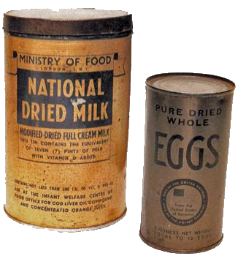
Canada’s National Research Council developed high-protein powdered foods such as eggs and milk that could easily be shipped overseas
Chemistry!

Slide 6
Penicillin had been discovered in 1928
Was manufactured on a massive scale in the USA during the war
Given to soldiers and civilians
Reduced the number of amputations required
Given to soldiers when wounded so that they would be fine until they saw a doctor

Slide 7
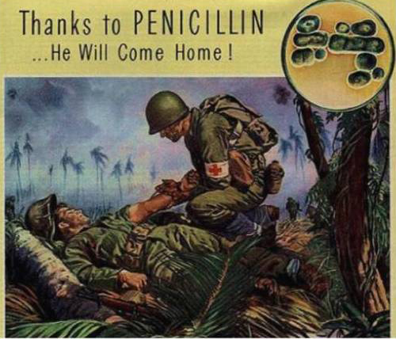

Slide 8
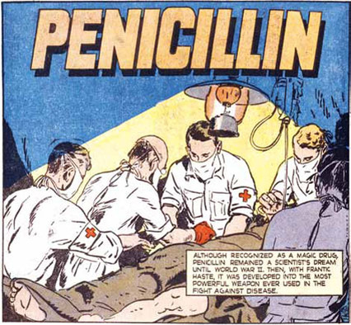

Slide 9
The Italian Campaign

Slide 10
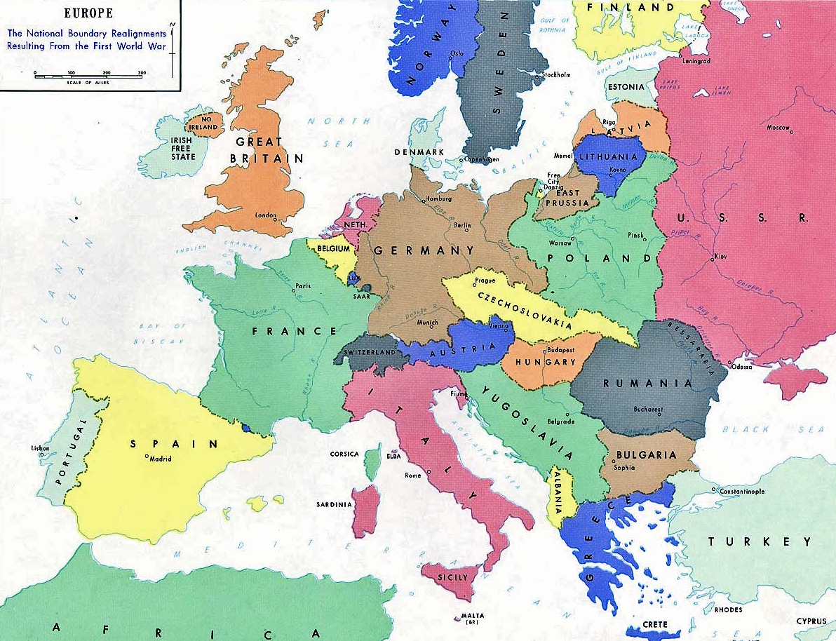

Slide 11
How to take back Europe
Step 1: Capture Sicily!
Lots of mountains
Very hot
Lots of well-organized German and Italian defenders who were not happy to retreat!
Just a small island... But not so easy to capture!

Slide 12
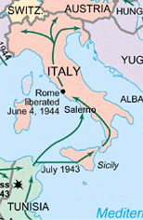
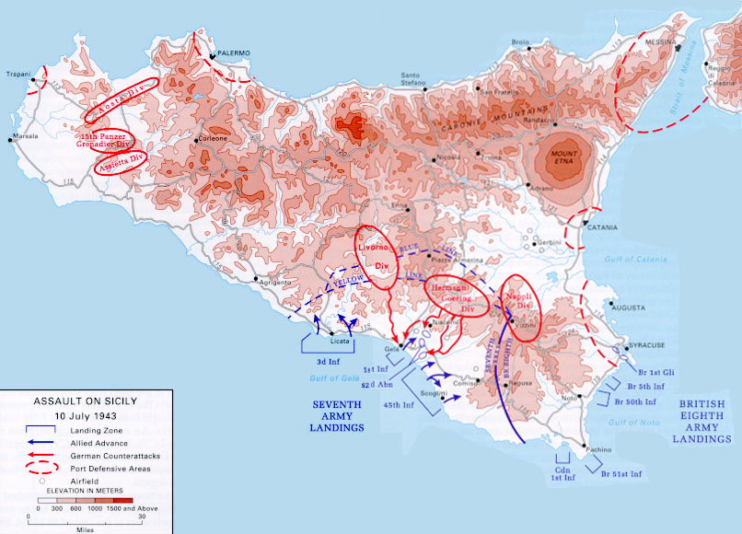

Slide 13
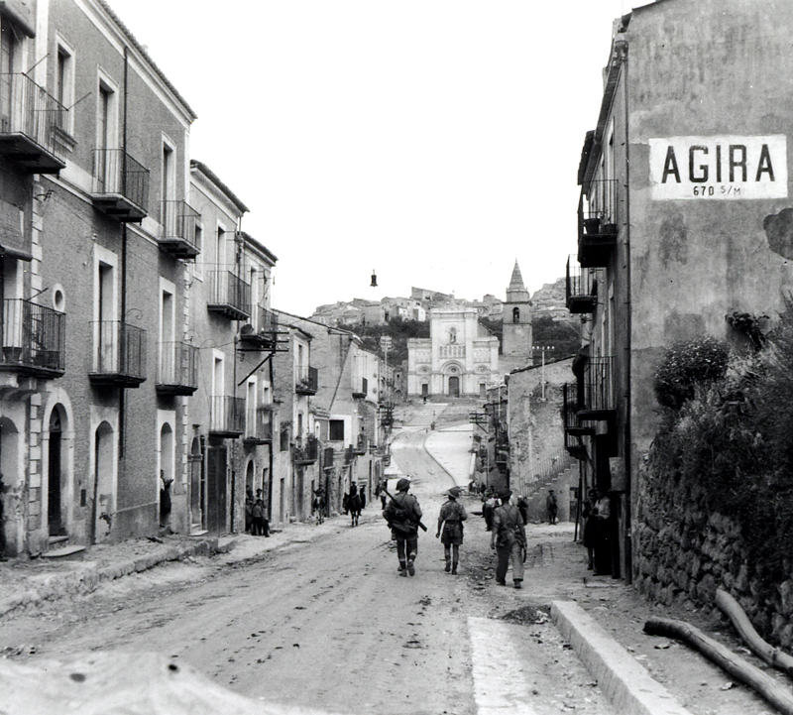
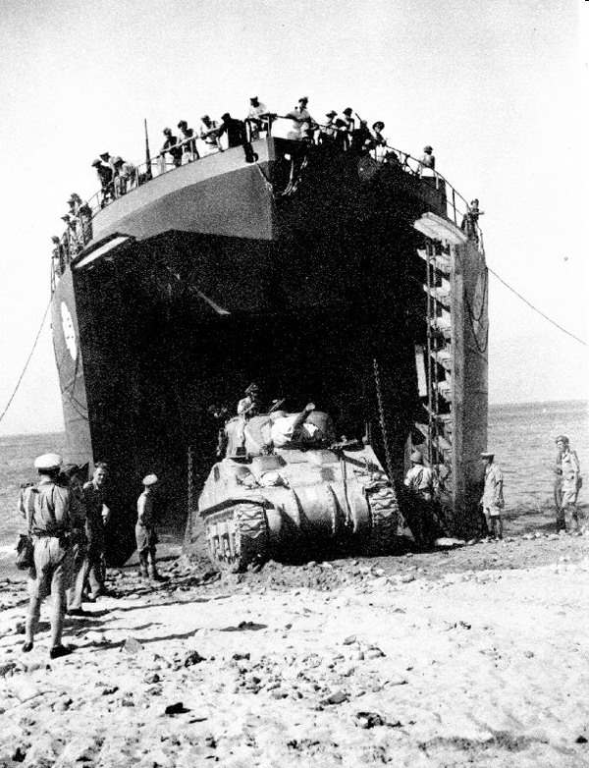
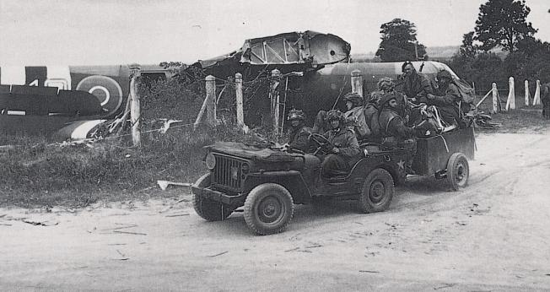
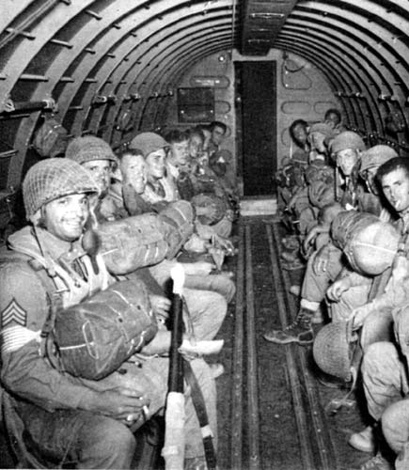

Slide 14
Step 2: Mainland Italy!
Germans took the high ground
Lots of rain and bad roads
Canadians took the town of Ortona with steep roads and stone buildings
Developed the ‘mouseholing’ technique

Slide 15
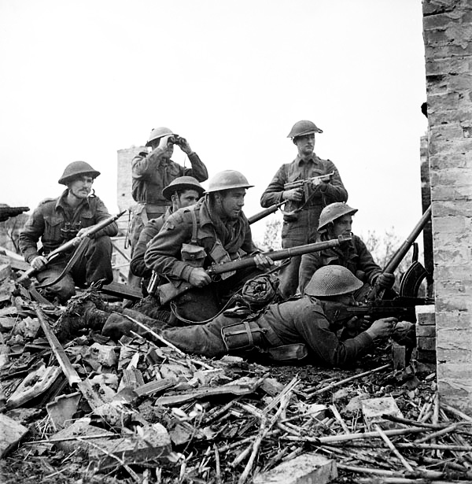
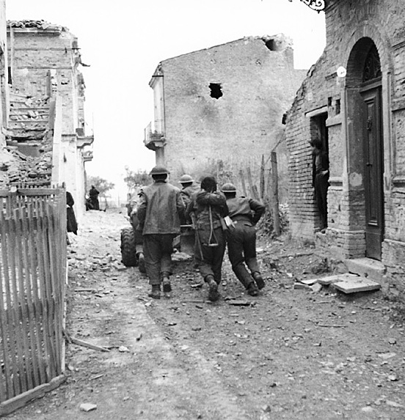
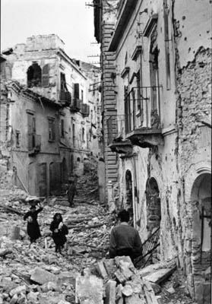

Slide 16
Tasks:
Read the hand out and answer the attached question sheet in complete sentences.
D-Day Dodgers reading

Slide 17
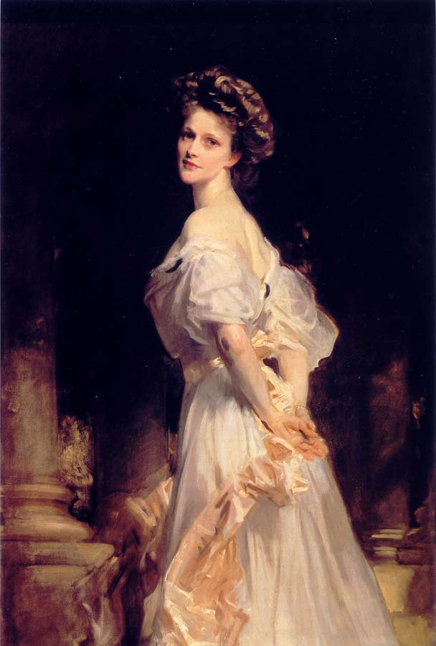
‘D-Day Dodgers’
Lady Astor’s comment in Parliament
Probably meant as a nickname not an insult
Soldiers made up a song to poke fun at the idea that they’d avoided real war by staying in ‘Sunny Italy’
Listen!

Slide 18
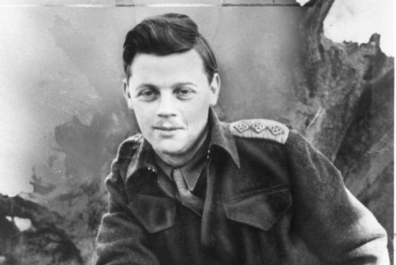
Farley Mowat
Canadian writer who served in Italy
Led a rifle platoon in Sicily and into Ortona
Suffered from ‘battle stress’ and was given a job in intelligence

Slide 19
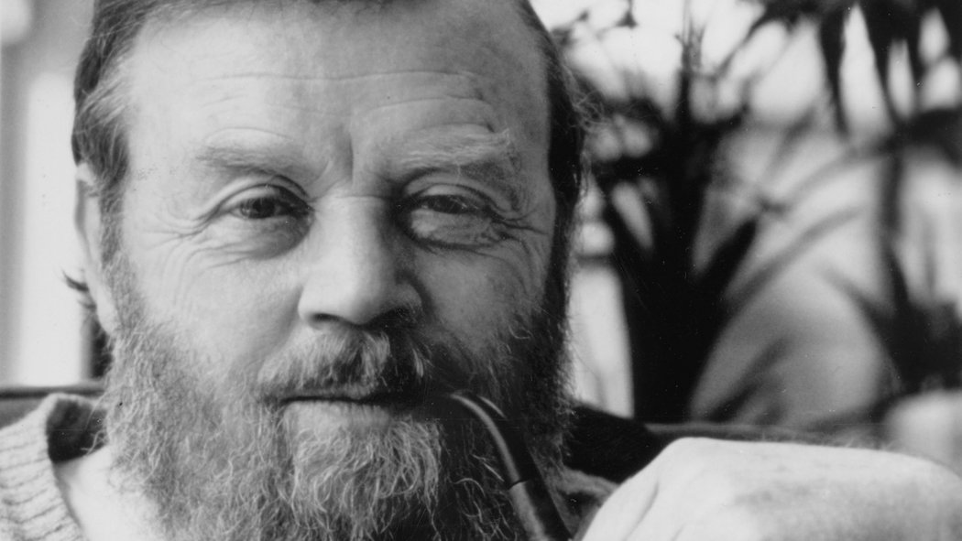
Wrote novels
Was an environmentalist
Died in May 2014, at age 92.

Slide 20
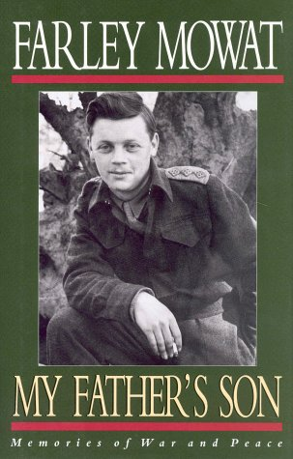
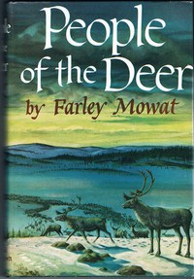
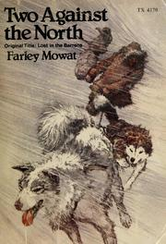
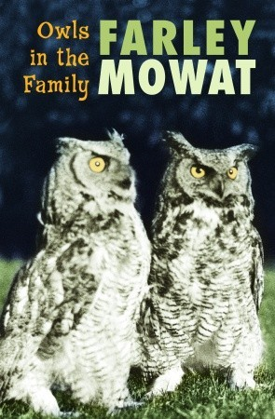
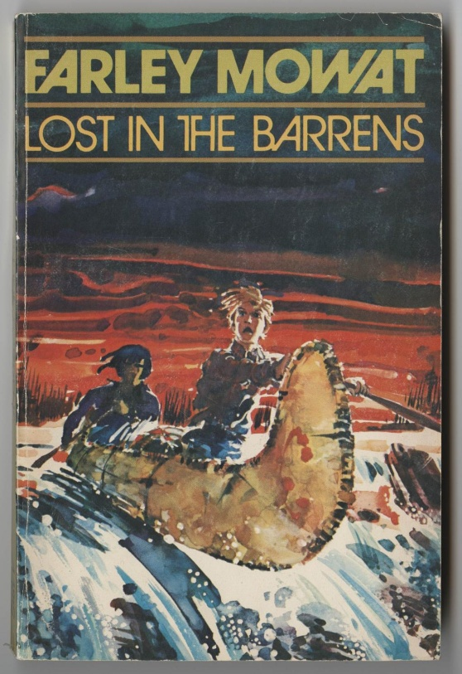

Slide 21
Consolidation
3 statements:
I really understand….
I sorta, kinda, almost understand…
I have a lot of questions about…

