Slide 1
The Normandy Invasion
CHC 2DR
Lesson 49

Slide 2
The Normandy Invasion
Agenda:
Minds-On: Lessons from Dieppe
Action: Note and discussion
Video & Note-taking
Consolidation: 3 Things

Slide 3
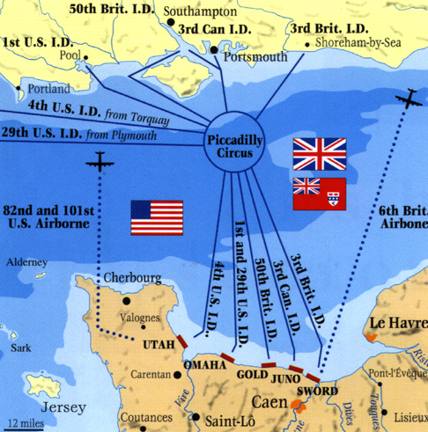

Slide 4
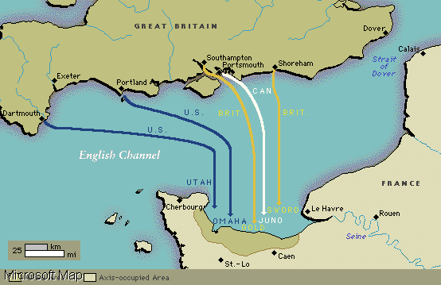

Slide 5
Planning
Element of surprise was essential
Built up a fake airbases, installations, tanks, etc. across the Channel from Calais
Allied forces were actually gathering further west

Slide 6
D-Day
June 5, 1944 was chosen for the launch of “Operation Overlord”
Bad weather delayed the assault for 24 hours
Began on the morning of June 6
Under cover of air and naval bombardments, ships started ferrying 150 000 American, British, and Canadian troops across the channel

Slide 7
Canadians landed at Juno Beach, one of 5 beaches landed on that day
Improvements since Dieppe:
Better landing craft
Better communication links
More effective naval and air support
Special tanks to crush German bunkers & clear minefields

Slide 8
Germans were completely surprised
Most Allied commanders didn’t even know the landing site until they opened that morning’s orders

Slide 9
Juno Beach
14 000 Canadians landed on 8 km stretch of beach
Faced concrete bunkers, land mines, barbed-wire barriers, and deadly machine guns
Canadians were able to fight past all this
Penetrated further inland than anyone else, by the end of the first day
340 killed, 574 wounded, 47 captured

Slide 10
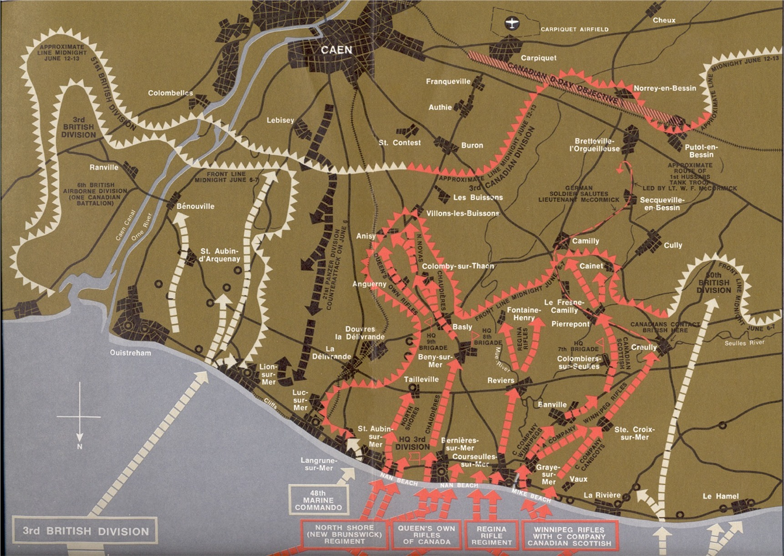

Slide 11
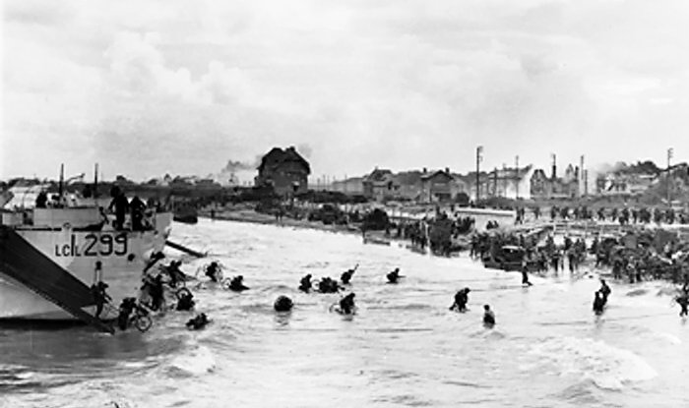

Slide 12
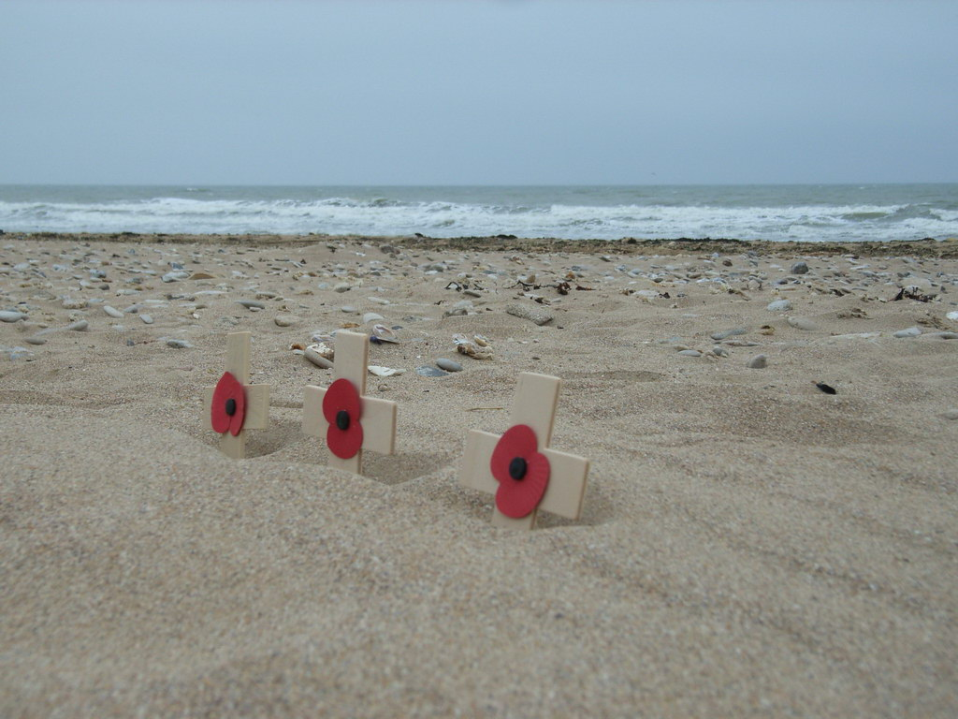

Slide 13
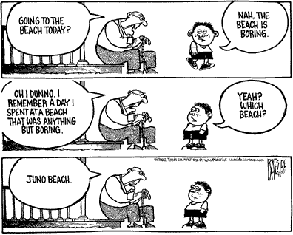

Slide 14
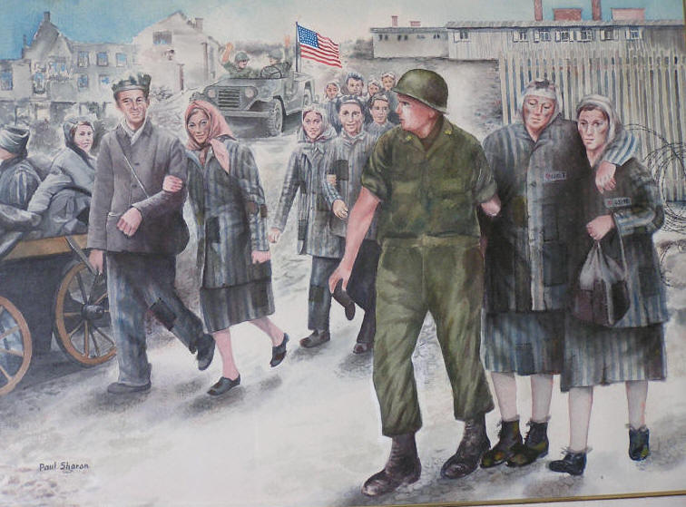
WWII Ends
Following the Normandy invasion, the Allies spent 11 months pushing the Germans out of other nations
This was called the ‘Liberation’

Slide 15
What the Canadians Did
General Crerar had all 5 Canadian divisions under his command
It was the first time that a) all the Canadian army was together and b) under a Canadian leader
April 1945, Canadians had to go north into Holland and free it (Liberate it)
They cleared north-east Europe; canals, bogs, dedicated Nazis, severe fighting

Slide 16
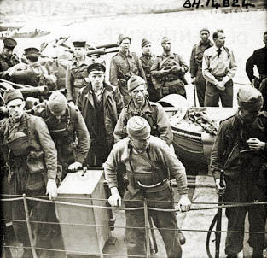

Slide 17
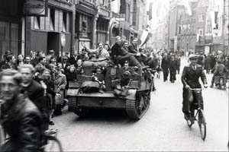
A truce was called in Holland to get food to starving Dutch citizens
Canadians flew in food and dropped it by parachute
9000 Canadians were freed from German POW camps
May 8, 1945 – “VE DAY” – Victory in Europe – official holiday
This was the greatest celebration Canada had ever seen

