Slide 1
1945 Assignments
CHC 2DR
Lesson 51

Slide 2
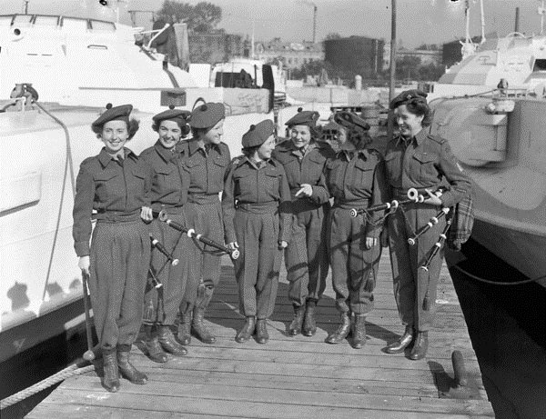
End of WWII Assignment
Creating Canada (black textbook):
Page 293, Q1 (2 marks), Q2 (5 marks)
Page 314, Q1 (5 marks), Q2 (5 marks)
Page 318, Q1 (6 marks), Q2 (6 marks), Q3 (5 marks)
CSI (red book)
Pages 84 & 85, During Reading Q3 (don’t forget the part at the top of page 85. (10 marks)
Page 88, During Reading Q1 (4 marks), Q2 (3 marks), Evidence 4.27
Page 89, During Reading (4 marks)
Page 90, Evidence 4.37 (5 marks)

