Slide 1
WWII Ends & the Holocaust
Lesson 70
CHC 2DR

Slide 2
WWII Ends & the Holocaust
January 11, 2012
Agenda:
Key Words
Worksheets
Objective:
I will explain how the Holocaust was discovered.

Slide 3
Key Words
Liberation: freeing people from a bad government
Holocaust: the death of millions during WWII
Concentration camp: a work camp or prison camp for those who were hated by the Nazis
Ghetto: an area within a city where people of similar backgrounds live

Slide 4
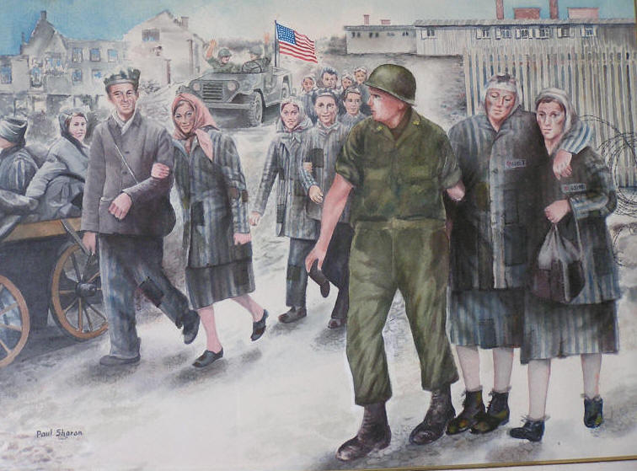
WWII Ends
Following the Normandy invasion, the Allies spent 11 months pushing the Germans out of other nations
This was called the ‘Liberation’

Slide 5
What the Canadians Did
General Crerar had all 5 Canadian divisions under his command
It was the first time that a) all the Canadian army was together and b) under a Canadian leader
April 1945, Canadians had to go north into Holland and free it (Liberate it)
They cleared north-east Europe; canals, bogs, dedicated Nazis, severe fighting

Slide 6
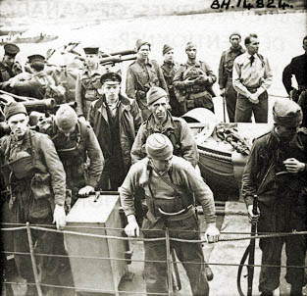

Slide 7
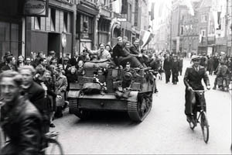
A truce was called in Holland to get food to starving Dutch citizens
Canadians flew in food and dropped it by parachute
9000 Canadians were freed from German POW camps
May 8, 1945 – “VE DAY” – Victory in Europe – official holiday
This was the greatest celebration Canada had ever seen

Slide 8
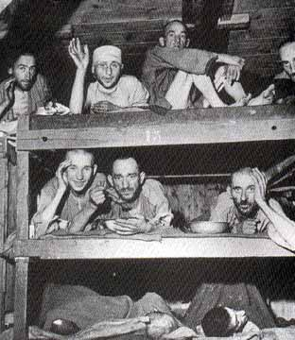
The HoloCaust
A War Within A War

Slide 9
From the time Hitler first came to power, in ______, the persecution of Jews and others deemed to be not of the “_______________” was ongoing
But it was not until the war was _________, that the Allies realized the true extent of the___________
As the Allies arrived in German ____________they saw exactly what Hitler’s elimination of all who weren’t part of his “Master Race” meant.
“Holocaust” means ‘____________ ____ _______’

Slide 10
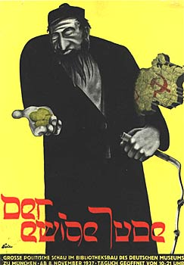
Hitler’s Tools
1. Propaganda
Described the _________ as vermin, rats, lice, etc. (there were only 600 000 in Germany)
Showed how those who spoke against the regime were to _________ for Germany’s problems (Communists, ____________, Jehovah’s Witnesses, ________ )
Told Germans they were destined for _________________

Slide 11
2. Specialty Groups
Gestapo (Geheime Staatspolizei)
Established to eliminate ______________________
Secret political police who helped establish the first concentration camps
Thousands were detained without _________ or ________________
All who opposed Hitler were _____________ and suppressed

Slide 12
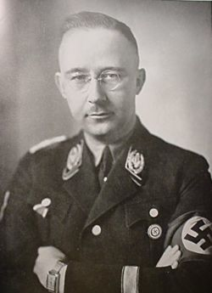
SS (Schutzstaffel)
Action squads, or ____________ ______________
Headed by Heinrich Himmler
Protected _____________
Began mass ______________ in winter 1941-1942

Slide 13
Brownshirts (Storm Troopers)
_______________ army maintained by the Nazi party
Threatened to cause ________________
_________________ __________
Led the attacks on ____________________ “the night of broken glass”

Slide 14
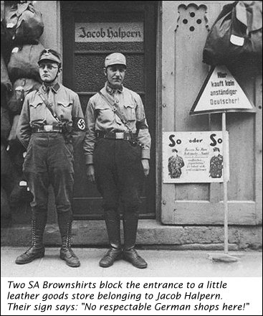
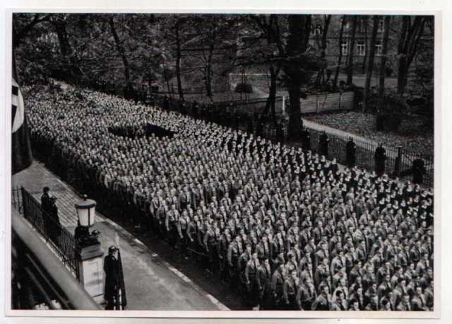

Slide 15
Einsatzgruppen (Mobile Killing Units)
Formed to carry out _________________
Travelled around Nazi territory killing _________________
Members received higher pay & a share of the goods ___________________

Slide 16
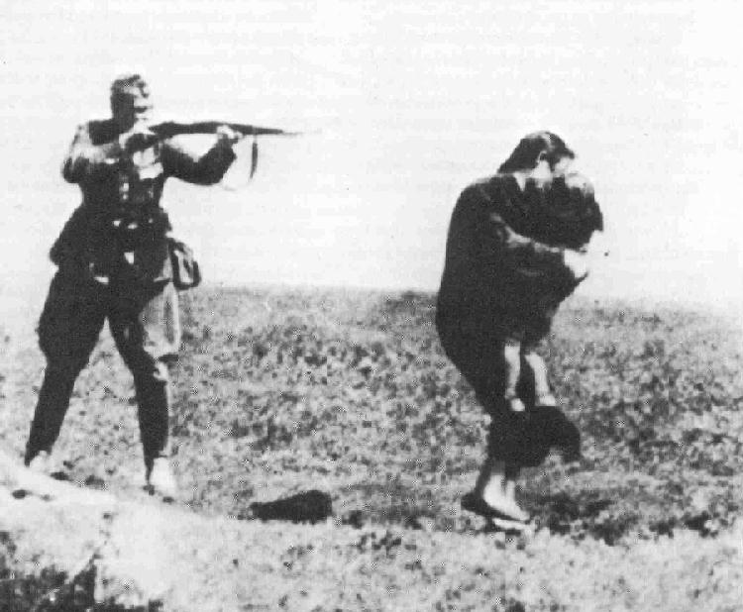
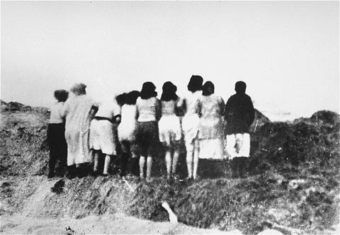

Slide 17
3) Special Programs
Ghettos
To remove Jews from German _________________
Usually in ______________, central areas of cities
Became _____________, disease-ridden, and the people were _______________
Residents often worked in ________________ factories for the war effort
In Warsaw, Poland, an ________________occurred in 1944
Showed what people could do when they worked to ________________ oppression
It took the Nazis months to crush the Warsaw uprising

Slide 18
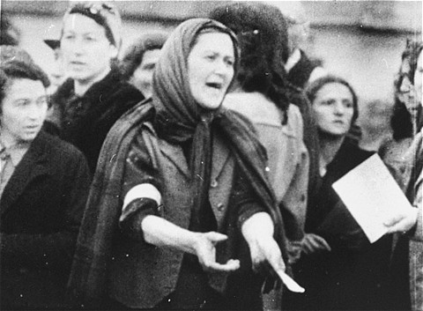
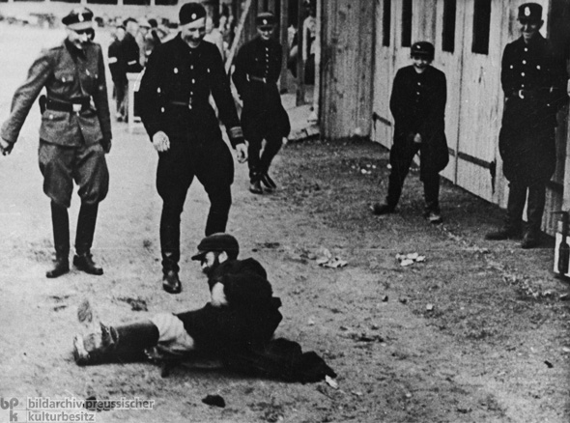
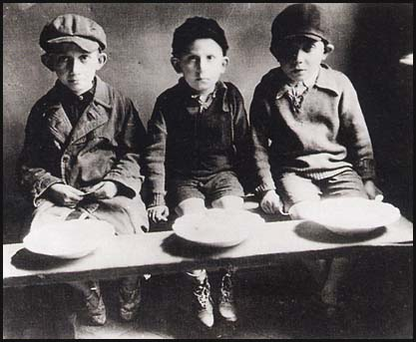
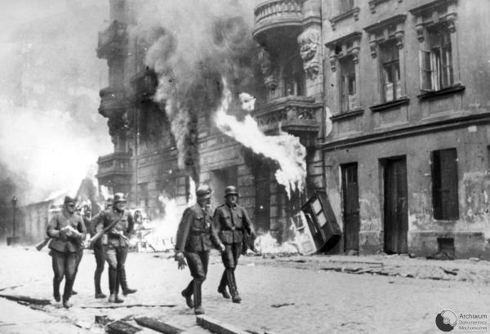

Slide 19
Concentration Camps
Set up in ___________ or even remote areas to house those who didn’t fit the Nazi ideal
Detainees worked at forced _____________
Many were subjected to barbaric _______________ experiments
Very little food and conditions were ___________________
Included Dachau, Bergen-Belson

Slide 20
The Final Solution
Reached at the Wannsee Conference in January 1942
An annihilation policy to deal with the “______________ _______________”
Those who could no longer ________ were to be killed
Extermination camps were built including Auschwitz (could ‘process’ __________ a day), Treblinka, Belzec, and Sobibor

Slide 21
Used Zyklon-B __________ in chambers designed to look like ______________ to effectively kill thousands at a time
All ____________ parts were removed (hair, gold fillings, etc.)
Bodies were ____________ in huge crematoriums
At Treblinka, prisoners were told they were going to ____________… all their belongings were left in the Canada Room before they went to the _______________

Slide 22
In August 1942, the news of this ______________ slaughter began to filter out
The Montreal Star headlined, “Nazi Slaughterhouse—Germans Massacre Million Jews in Extermination Drive”
No one ________________ it
Between 1939 and 1945, of the ____ million Jews living in Europe, between 5.6 and 6.9 million were killed (____% of the population)

