Slide 1
Egypt
Lesson 15
CHW 3MR

Slide 2
Egypt
Learning Goal: explain how Egypt became the dominant culture of its region
Agenda:
Review for Wednesday’s quest
Egypt? What do you know?
Intro to Egypt note..

Slide 3
Civilization Quiz
Part 1: Identify and give the significance of 5 of 9 terms, names, places, etc. (2 marks each)
Part 2: Answer 4 of 5 questions. Each is worth 4 marks. May be answered in point form.
Part 3: Choose 1 of 2 questions to answer in formal paragraph form (a 9-sentence like paragraph) Worth 10 marks.
Total: 36 marks

Slide 4
What do you know?...
Religion
Symbols
Heroes
Geography
Monuments
Skills

Slide 5
Egypt
Egypt was a product of its geography
The water of the Nile River made Egypt fertile
The deserts on either side of the Nile, protected Egypt from the outside world
The Mediterranean Sea brought trade from the outside and an exchange of cultures
For much of Egypt’s history, it was conservative and stable

Slide 6
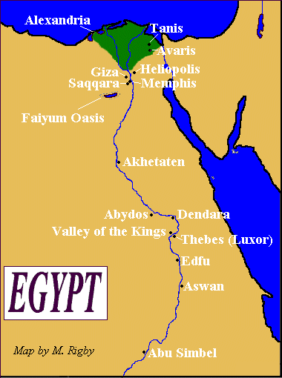

Slide 7
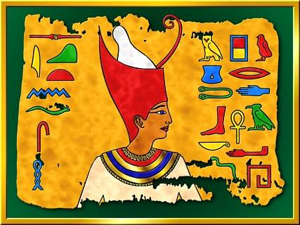
King Menes united Upper Egypt and Lower Egypt in about 3100 BCE
The civilization lasted over 3000 years
Divided into 3 eras, characterized by its own accomplishments

Slide 8
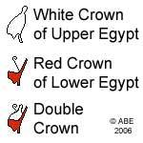
The Old Kingdom (2575-2150 BCE)
Uniting the 2 regions with the
double crown (red crown and
white crown)
The king was considered a god
Egypt acquired great wealth through trade and innovation
3 massive pyramids build at Giza by Khufu (Cheops)

Slide 9
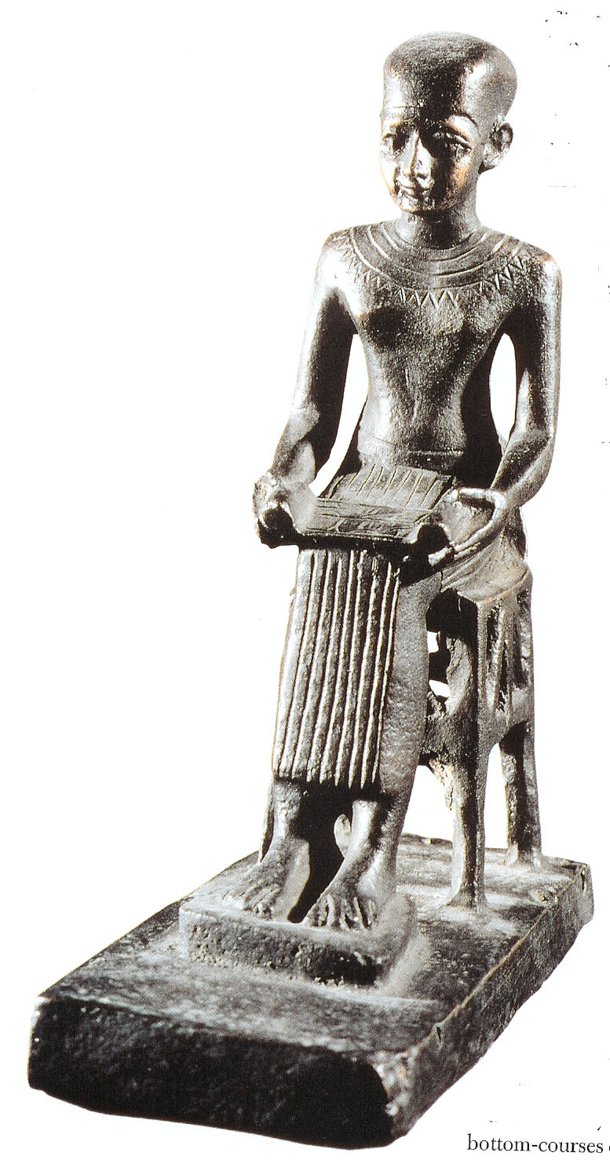
Imhotep was assistant to the Pharaoh Djoser
Founded Egyptian medicine
Architect who designed the Step Pyramid
Created stone sculpture to illustrate all aspects of Egyptian life

Slide 10
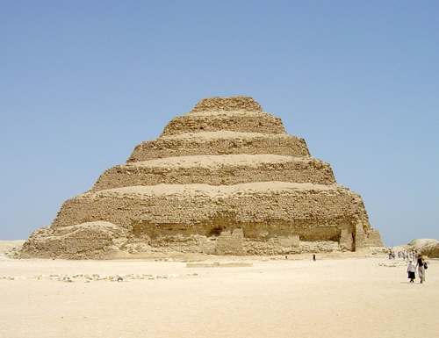

Slide 11
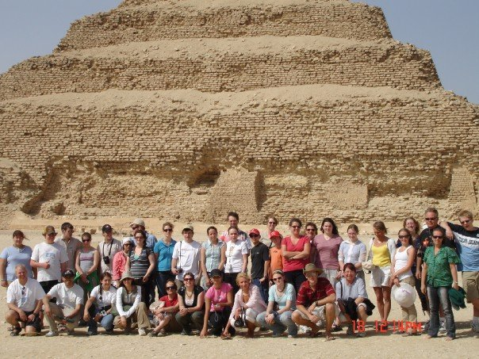

Slide 12
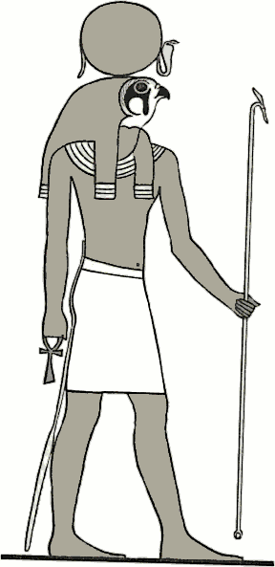
The Middle Kingdom (2055 -1640 BCE)
After 150 years of instability Egypt was reunited
Capital was moved to Memphis
Rise of the god Amon who merged with the Sun god Re (Amon-Re)
The Hyksos invaded and occupied Egypt for 150 years
Egypt then retook their land and emerged stronger than ever

Slide 13
Idea of god-king remained key to political life
Pharaoh was the son of Amon-Re
Could mediate between gods and people
Laws were fair and humane
Equal to all people, regardless of class or gender

Slide 14
Laws were based on precedents
Punishments were severe
Abundant food supplies were a measure of wealth
Excess food was traded for other supplies
Skilled trades passed from father to son

Slide 15
The New Kingdom (1539-1075 BCE)
Egypt’s Golden Age
Hatshepsut
Female ruler who ruled as a king
The first powerful female ruler
Expanded trade
Massive building (including her tomb) (p64)
Was the step-mother of Tuthmosis III
He led many military campaigns

Slide 16
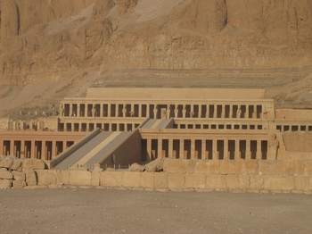

Slide 17
A huge military was created in this time
The new idea of one god emerged during the reign of Akhenaton
Kind Tut reigned during the New Kingdom
Ramses II was a great builder who left impressive monuments and temples
Not long after his reign Egypt fell to invading foreigners

Slide 18
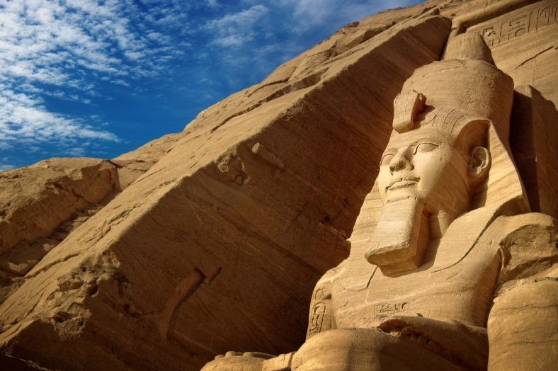

Slide 19
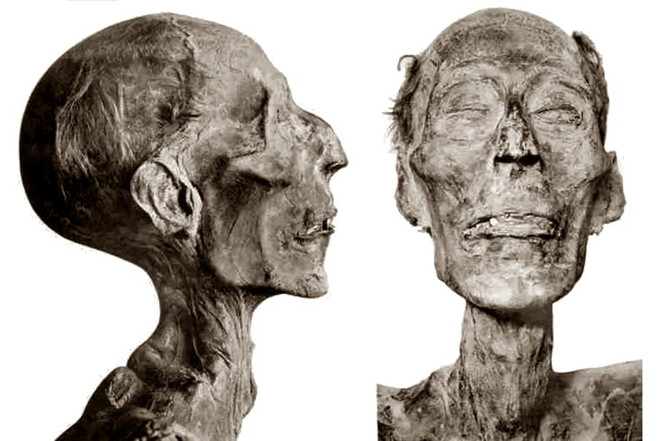

Slide 20
Task:
Work on Chapter 2 questions from your textbook.

Slide 21
Characteristics of Egyptian Civilization

Slide 22
State Religion

Slide 23
Agricultural Intensification

Slide 24
Class System

Slide 25
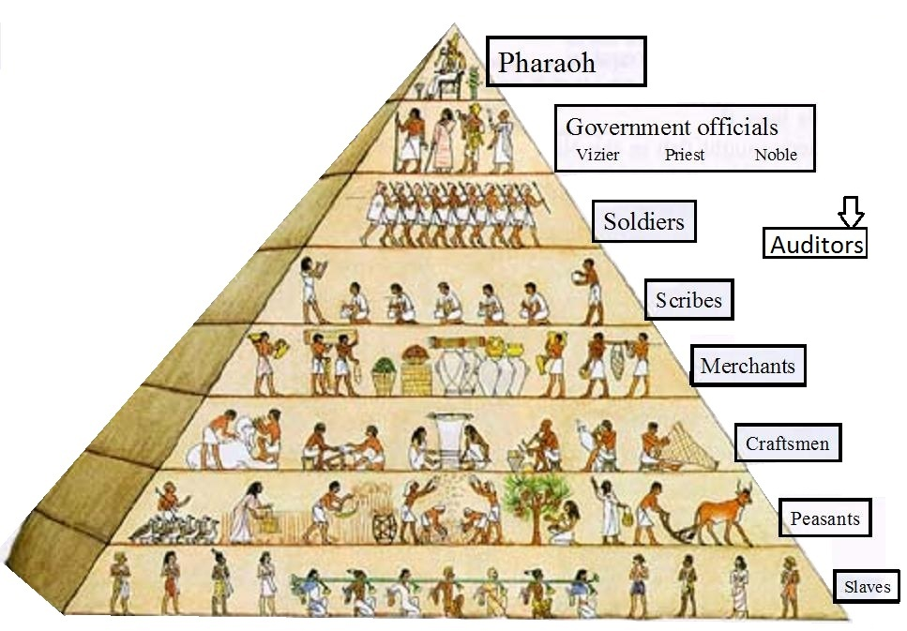

Slide 26
Merchants and Trade

Slide 27
Centralized Government

Slide 28
Development of Science and Writing

Slide 29
Occupational Specialization

