Slide 1
The Persian Wars
CHW 3MR
Lesson 36

Slide 2
The Persian War
Learning Goal:
Explain the ways in which the Greeks have manipulated our understanding of the Persians
Crash Course video
Note (hand out) on the Persian war
Video of the Persian war
… Athenian Empire

Slide 3
Athenian Empire
CHW 3MR
Lesson 37

Slide 4
Athenian Empire
Learning Goal:
Discuss how Athens was able to, for a brief moment in time, achieve cultural greatness.
Review
Note and discussion
DVD (Pericles Takes Athens to Glory)

Slide 5
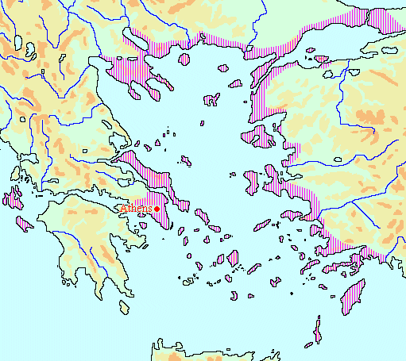
Athenian Empire
Following the Persian wars, the Delian League was formed to protect Greece
In 454 BCE, the Delian League treasury was moved from the island of Delos to Athens

Slide 6
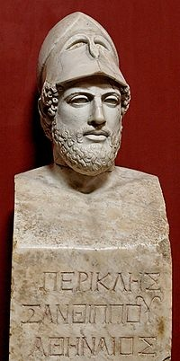
The beginning of an empire
This was Athens period of glory → lasted 30 years, under Pericles
Sparta was concerned about the power of Athens, despite a peace treaty

Slide 7
Athens controlled coastal and island states while Sparta had a large land power called the Peloponnesian League
Athens was progressive, worldly, and rich
Sparta was considered strong but backwards
Rivalry finally led to war

Slide 8
Pericles Takes Athens to Glory
Watch the DVD and add information to your note that will help you better understand the impact of Athenian Empire

Slide 9
Peloponnesian War
Corinth was a member of Sparta’s Peloponnesian League but was a powerful trading city → more independent
Athens tried to prevent Corinth from achieving prosperity
Sparta decided that this was against the peace treaty
This became the longest, most bitter, and costly war in Greek history
Lasted 27 years

Slide 10
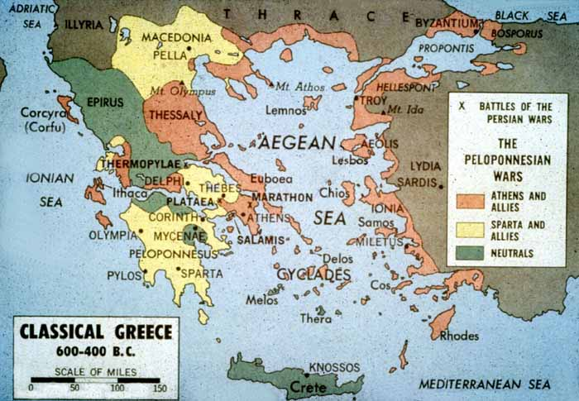

Slide 11
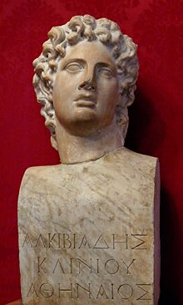
Athens had the best chance of winning until it was struck by a plague, in 430 BCE (2nd year of the war)→ Pericles died
A new leader was chosen→ Alcibiades

Slide 12
418→ Athens failed in a direct attack on Sparta
416→ Athens attacked Melos and won
415-413→ Athens attempted to capture far off Syracuse (on Sicily)
this was a disaster
408→ Persians supported Sparta
Sparta learned to destroy Athenian ships

Slide 13
405→ final battle
Sparta captured and burned the Athenian fleet while it was on shore, searching for food
Rather than kill or enslave all the Athenians, Sparta only demanded complete surrender and total loss of freedom
Sparta unleashed a 2 year reign of terror
Athens was retaken by exiles and democracy was restored in 403
Athens recovered but was never a great power again

Slide 14
Pericles’ Funeral Oration
Read this oration and respond to the questions

