Slide 1
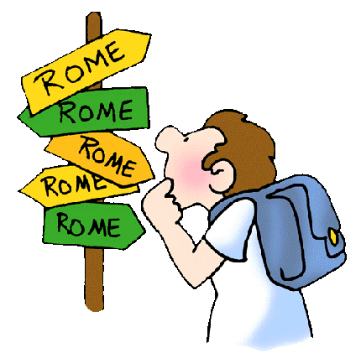
Rise of Rome
CHW 3MR
Lesson 45

Slide 2
The Land: The Italian Peninsula
Central location in the Mediterranean
Separated from the rest of Europe by the Alps
Surrounded on 3 sides by water
Allowed for coastal trade and water transport
Land fertile… but as urban population grew, they began to rely on imports
Climate relatively mild
Climate, agricultural prosperity, and location were all factors in the rise of Rome

Slide 3
The Etruscans: Forerunners of the Romans
Emerged as a distinct culture c 1000BCE
Sophisticated native people inhabiting north-central Italy
We know about them from burial customs
Artwork in their tombs
Skilled artisans and accomplished traders
Had their own language and alphabet

Slide 4
By mid-4th century BCE they had retreated back to central Italy
Influences on Roman life: numerals, fondness for blood sports, belief in Hades and the underworld gods, augury, excessive superstition

Slide 5
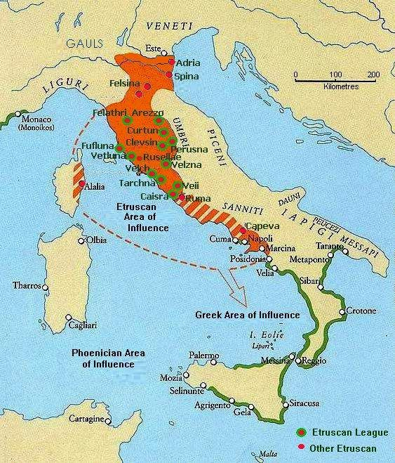

Slide 6
The Roman Kingdom (753-509 BCE)

Slide 7
Founding Myth: Romulus & Remus
Twin brothers left to drown in the Tiber River, washed ashore and raised by a female wolf and then a shepherd
Fought over who would found Rome
Romulus killed Remus
Can you think of similar stories in other cultures?

Slide 8
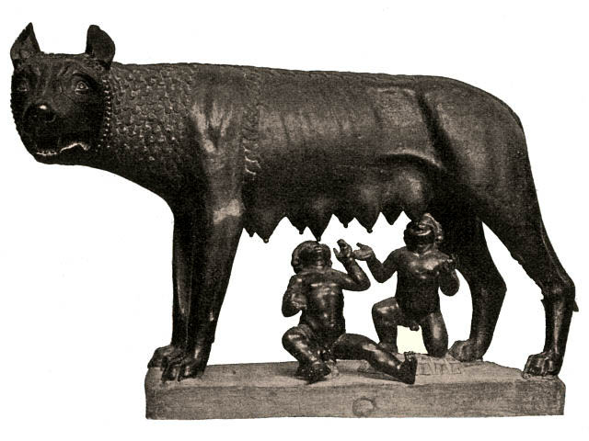

Slide 9
7 Kings of Rome
Developed monarchy with absolute patriarchal power
Similar to father as head of household
Monarch served as legislator, head of military, head judge, & chief priest to people
1st was Romulus

Slide 10
Tarquinius Priscus: 5th Etruscan king of Rome
616-579 BCE
Built a temple to Jupiter Optimus Maximus (best and greatest)
Common feature of Roman towns
Also built the cloaca maxima; the great sewer

Slide 11
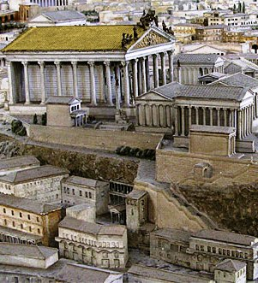

Slide 12
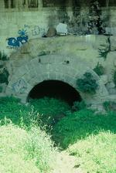
Hills were tunneled into the course of the construction of the sewers, and Rome was a "city on stilts" beneath which men sailed when Marcus Agrippa was aedile. Seven rivers join together and rush headlong through Rome, and, like torrents, they necessarily sweep away everything in their path. With raging force, owing to the additional amount of rainwater, they shake the bottom and sides of the sewers. Sometimes water from the Tiber flows backwards and makes its way up the sewers. Then the powerful flood-waters clash head-on in the confined space, but the unyielding structure holds firm. Huge blocks of stone are dragged across the surface above the tunnels; buildings collapse of their own accord or come crashing down because of fire; earth tremors shake the ground - but still, for seven hundred years from the time of Tarquinius Priscus, the sewers have survived almost completely intact.
[Pliny the Elder, National History, 36.104-106; tr. J.F. Healy]

Slide 13
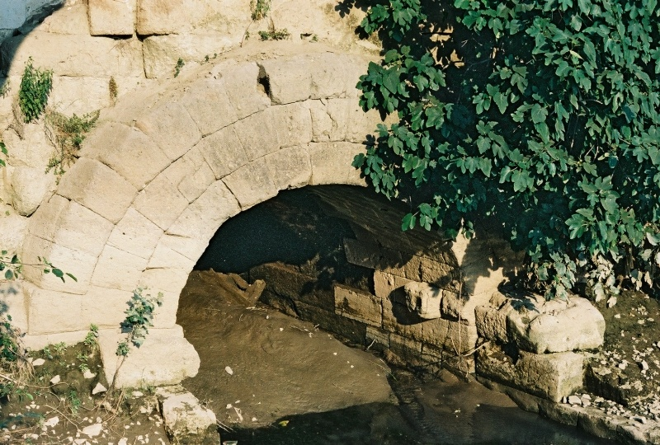

Slide 14
Tarquin the Proud: 7th King
Expelled by rebellion because of his son’s crime of rape
“The Rape of Lucretia”
This expulsion led the way for Romans to form a democratic republic

Slide 15
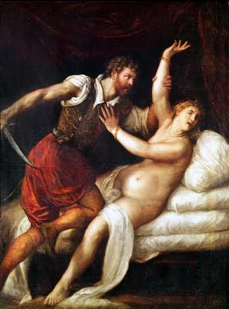
Titian’s interpretation

Slide 16
Livy’s version
Read the hand out and discuss the question:
“ What virtues does this story put forth for Roman society through the example of Lucretia? Why would this story have mattered to Romans?”
Match this with the story of the founding of Rome… what does this say about Rome?

Slide 18
The Roman Republic
‘Res Publica’ = public matter
Senatus Populusque Romanus (SPQR) = ‘the Senate and People of Rome’
Public upset with domineering attitudes of Etruscan kings
Eliminated the monarchy
New democratic government saw constant tension

Slide 19
Composed of several assemblies from which the magistrates were drawn
At first, Rome had a constitution which laid down the traditions and institutions
Not formal or written down
Placed importance on the role of the officials
Political organization was trying to regulate tensions in society

Slide 20
Governing the Roman Republic
Read pages 168-172 and answer the following questions:
1. Describe the patricians and the plebians. (168)
2. What tension existed in the Roman Republic? (168)
3. What was the role of the consuls? (169)
4. When would a dictator be appointed? (169)
5. What was the role of the Praetors and the Censor? (171)
6. Why was the Concilium Plebis established? (171)
7. What challenges did the Roman Republic face? (172)

Slide 21
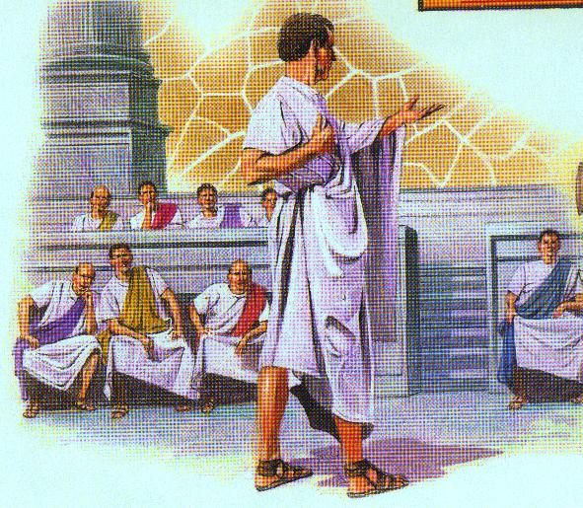

Slide 22
Structure of Government Under the Republic
2 Consuls Head of Government | 300 Senate members | Assembly
Patricians | Patricians | Plebian
1 Year Term | Lifetime
Consuls chose the senators |  | Elected the Consuls
Ran the government, overseeing the work of other government officials | Advised the consuls. Advised the assembly | Elected government officials including judges
Directed (Commanded) the army | Directed spending, including tax dollars
In emergencies, consuls would choose a dictator—a single ruler to make quick decisions | Made relationships concerning foreign relations | Declared war or peace
Acted as judges | Approved laws passed in the assembly | Voted on laws suggested by officials
Consuls could veto each other (veto is Latin for ‘I forbid’)

Slide 23
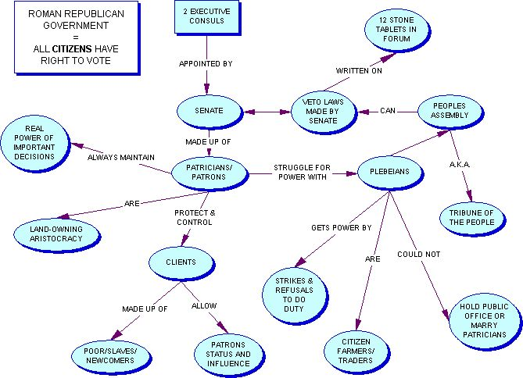

Slide 24
Growth of the Roman Republic
From the 5th century BCE on, the Roman Republic underwent great expansion and faced extreme dangers

Slide 25
1. Gauls (North)
Celtic people from Europe
390 BCE invaded Rome because they needed more land for their growing population
Although originally beater, the Romans strengthened themselves and fought back, reclaiming their territory and the Gauls’

Slide 26
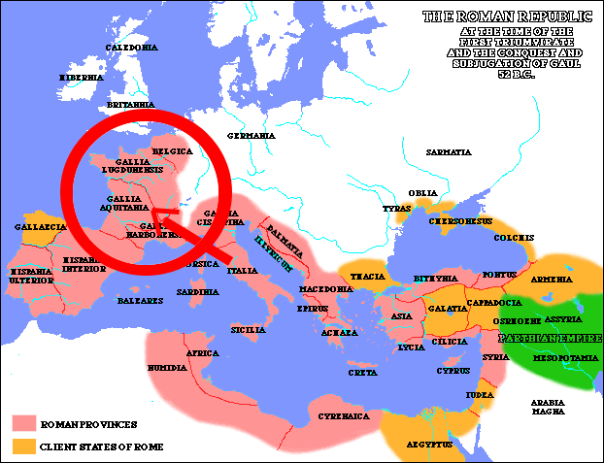

Slide 27
2. Greeks (East)
Romans decided to expand into Greece
Needed the land to produce wine, leather, and woolen goods for their population
Needed to develop a strong military to conquer other civilizations
Weapons and armour became a commodity to be traded

Slide 28
Rome sent a senatorial committee to Corinth and they were treated poorly
Rome was upset by this insult so they attacked and plundered Corinth
As Rome became richer and more comfortable it spread out across the Italian peninsula
This ‘Romanization’ became a model for future conquests over Europe

Slide 29
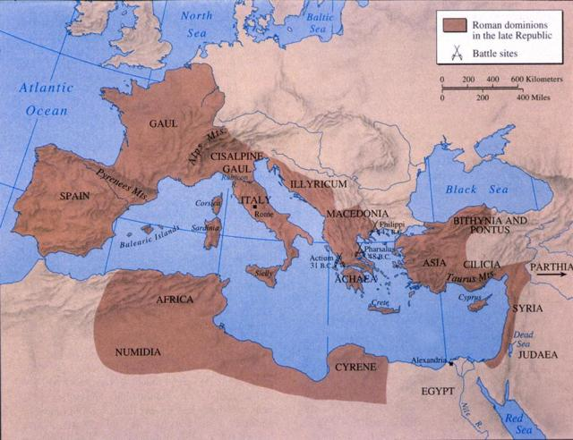

Slide 30
3. Carthaginians (South)
Originally from Phoenicia, but settled in North Africa
They were traders with a commercial empire
Controlled the Iberian Peninsula (Spain & Portugal)
The greatest maritime power of its time
Roman trade conflicts with Sicily & Spain upset the Carthiginians

Slide 31
