Slide 1
The Punic Wars
Lesson 52
CHW 3MR

Slide 2
The Punic Wars
Learning Goal:
Use the Punic Wars to explain how Rome dealt with its unruly neighbours.
Video (review of the Republic’s birth)
Note and discussion
Video and discussion

Slide 3
The Punic Wars
264-146 BCE
A total of 3 conflicts
‘Punic’ because ‘Punicus’ was the Roman word for Carthage
Sicily became the land most fought over

Slide 4
First Punic War (264-241 BCE)
Entirely on Sicily
Rome laid siege to the cities on Sicily and destroyed their navy
This was the first time that Carthage had lost power of the sea
A treaty was signed in 241 BCE
Carthage gave up Sicily and had to pay Rome for the costs of the war

Slide 5
Rome later seized the islands of Corsica and Sardinia
Carthage was furious!
Even Roman historians looked back on this as a bad idea!
They said it was rash and unethical
Carthage reinforced its presence in Europe by sending Hamilcar Barca to Spain to build colonies and an army
Their power grew as they made allies with the native Iberians

Slide 6
Second Punic War (218-202 BCE)
Rome allied itself with one city in Spain (Saguntum)
Hannibal (Hamilcar’s son) assumed command of Spain in 221 BCE
He ignored Saguntum until it started throwing its weight around
He conquered it
This led to the second war

Slide 7
Carthage had created a terrifyingly large army
Hannibal marched this army (including elephants!) out of Spain, across the Alps and invaded Italy
Although tired, his army smashed the Roman armies
Within 2 months all of northern Italy was conquered
A horde of Gauls came to help Hannibal (50 000 +)
Now he had to take on Rome itself

Slide 8
Rome appointed a dictator (Quintus Fabius Maximus) who decided to wait out Hannibal
He was removed from power!
Hannibal moved into southern Italy and the 2 consuls sent out an army of 80 000 to meet him
Although they outnumbered Hannibal’s men, they were wiped out by his “pincer” strategy
50 000 were annihilated in 1 day

Slide 9
All Rome’s allies in the north and south turned to support Hannibal!
The central part of Italy remained loyal to Rome
Hannibal was weak and couldn’t lay siege to or storm Rome
In 211 BCE, he marched up to the gates of Rome… and that land was sold at auction for full price! (the Romans were pretty confident!)

Slide 10
The Romans gave Publius Cornelius Scipio the job of conquering Spain… by 206 BCE he had done it
This was Hannibal’s source of supplies … he was cut off!
Hannibal was left alone in Italy
Scipio crossed to Africa in 204 BCE
Battle of Zama (202 BCE) Hannibal met his first defeat
In modern day Tunisia
Rome developed an ego and thinks of itself as a great force in the Mediterranean!

Slide 11
Rome forced the Carthiginians to:
1. Pay war reparations
2. Forfeit their commercial empire
3. Dismantle navy
Scipio was renamed Scipio Africanus
Does this remind you of another treaty?

Slide 12
What happened to Hannibal?
Was always afraid of being taken prisoner
Took poison that he always carried around in a ring
Left a note that said: “Let us relieve the Romans from the anxiety they have so long experienced, since they think it tries their patience too much to wait for an old man's death.” (sometime around 183-181 BCE)

Slide 13
Third Punic War (146-149 BCE)
Carthage began rebuilding within 50 years and became strong
Cato, a great Roman statesman, kept Carthage on everyone’s mind by concluding each speech with, “I also think that Carthage should be destroyed.”
After demanding that Carthage abandon the city and move inland (it refused) Rome declared war

Slide 14
Rome stormed Carthage, went house to house slaughtering everyone
Those not killed were sold into slavery
Harbour was destroyed
Land in the surrounding area was sown with salt to destroy it
The Roman general, and grandson of Scipio Africanus said: “We have made a desert and called it peace.”
What is the significance of this comment?

Slide 15
Task:
Read “World Civilizations” pages 162-165.
Answer the 3 ‘Reflect and Analyze’ questions at the top of p 162
Answer the first 2 ‘Reflect and Analyze’ questions at top of p 163
Answer the 3 ‘Reflect and Analyze’ questions at the bottom of p 165.
Take time to look over the other handouts about Rome, the Punic Wars, and the Growth of their empire

Slide 16
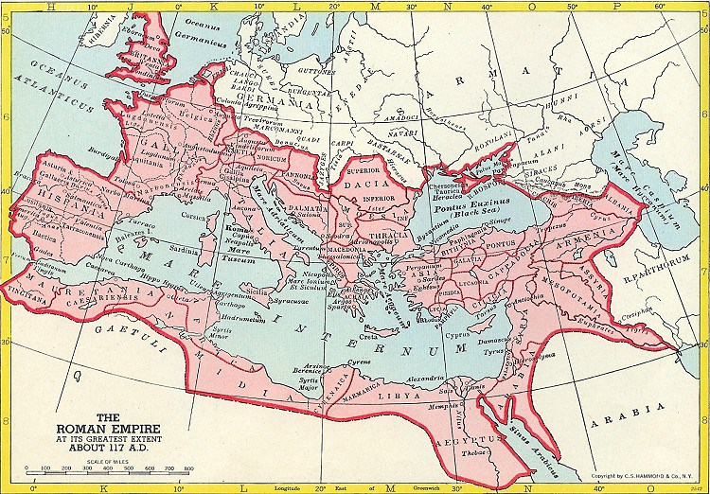

Slide 17
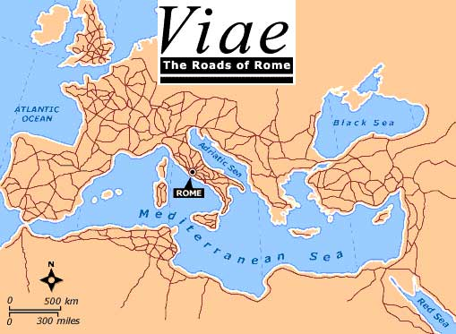

Slide 18
