Slide 1
Republic to Empire Key Emperors
CHW 3MR
Lesson 54

Slide 2
Republic to Empire—Key Emperors
Learning Goal:
Explain the transition to imperial rule and the impact on the people of the Empire
Review
Note and Discussion
Reflection

Slide 3
The Roman Empire
After the Fall of the Republic
For 500 years, after the death of Caesar, the Rome remained the centre of western civilization
The Republic had to endure a power struggle and civil war
In 43 BCE, Octavian, Marc Antony, and Lepidus formed the Second Triumvirate

Slide 4
Meanwhile, Pompey (son of the other one!) ruled the waters of the Mediterranean
Lepidus was exiled and never really did his job
In 36 BCE, Pompey was defeated

Slide 5
Marc Antony fell in love with Cleopatra and married her (although he already had a Roman wife→ Octavian’s sister!)
Cleopatra was the ruler of Egypt and had a child with Julius Caesar
They took control of the eastern region without consulting anyone
Octavian defeated them in a naval battle (31BCE)
They committed suicide in 30BCE
Caesar’s son was put to death
Octavian became the master of Rome

Slide 6
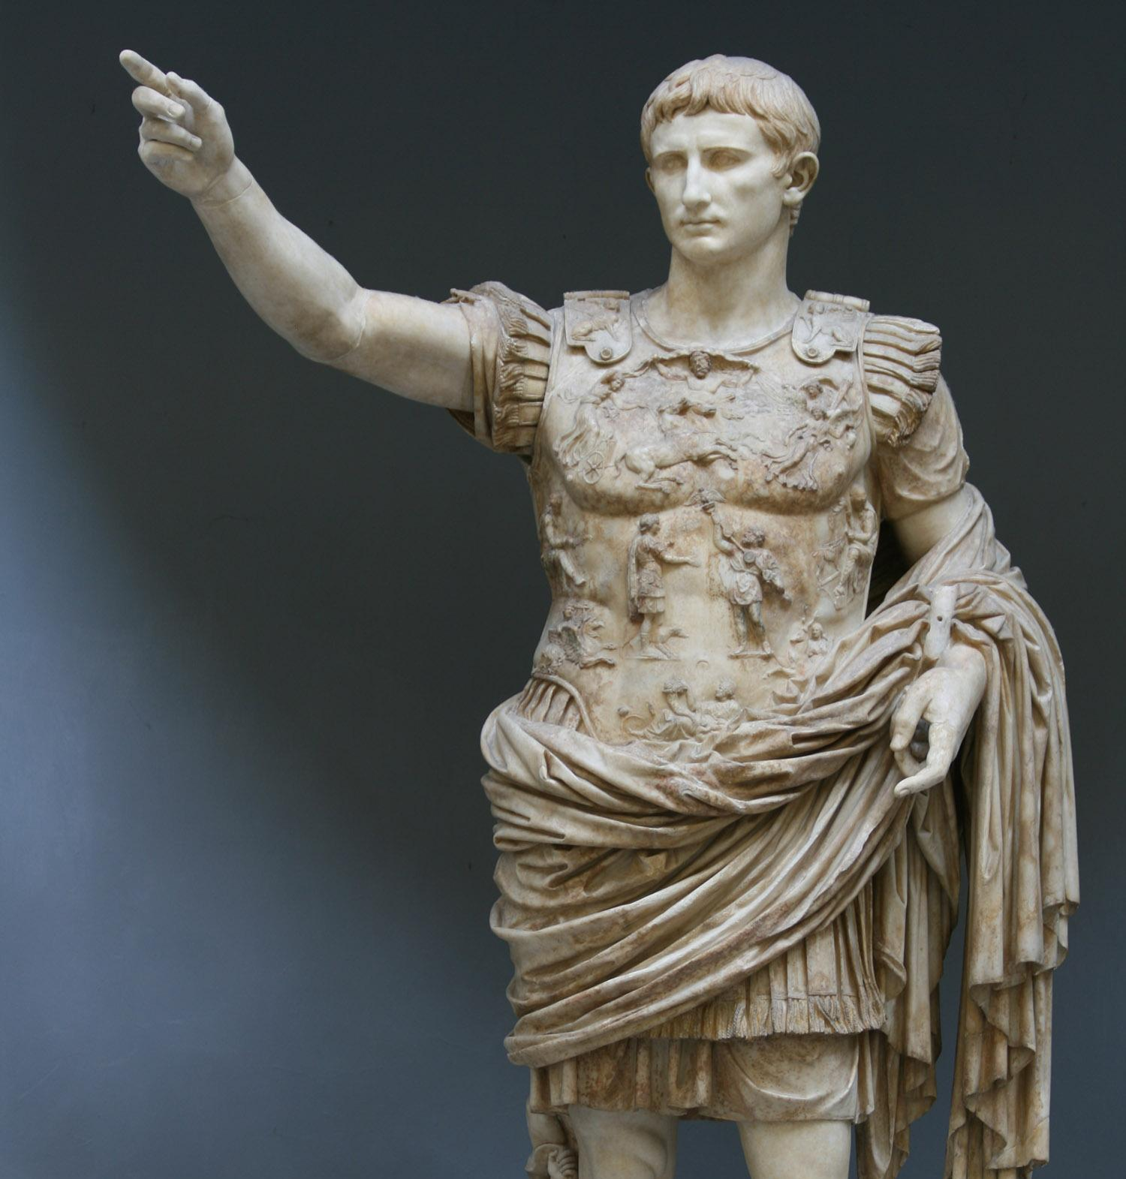
The Age of Augustus

Slide 7
Octavian ‘returned’ the Republic to Senate control in 27 BCE
He was given the name “Augustus”
This was all a ploy
In the end he maintained control of the important armies and regions
Over the next few years he became Tribune of the People then Pontifex Maximus

Slide 8
Began to portray himself as a descendant of Venus
He understood the Roman devotion to religion
Augustus is considered to be the first Roman Emperor
He gained control by keeping the people content
He died in August 14 CE (the month was named for him!)
The period is called the “Principate” from the only title he liked to use, “Princeps”→ first among equals

Slide 9
He encouraged people to work for the government or the army
There was a police force, a civil service, and firefighters
He was great at public relations
Literature, the arts, religion flourished
Encouraged the building of great monuments and temples
Roman style of architecture and sculpture emerged and outlived Augustus

Slide 10
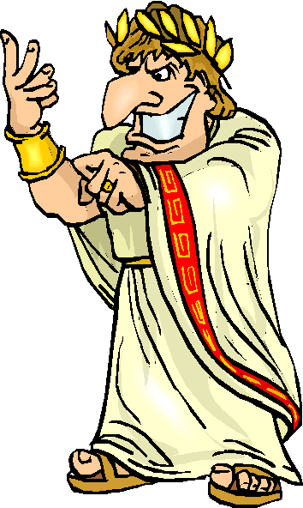
Successors of Augustus

Slide 11
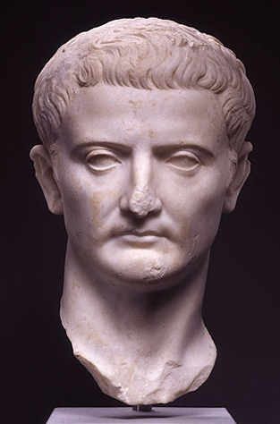
Tiberius (14-37 CE)
Didn’t last long in Rome, he retired to Capri, and was replaced by two praetorian prefects

Slide 12
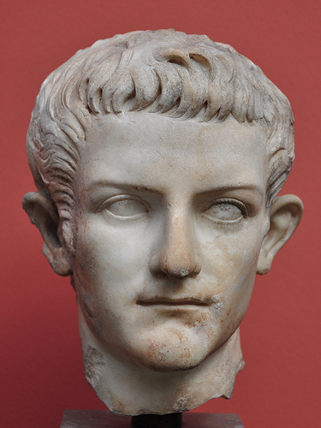
Caligula (37-41 CE)
His rule quickly became known for cruelty and ‘vice’
Made his horse a member of the Senate (no respect!)
Had adulterous and incestuous affairs
Was murdered by a group of conspirators in 41 CE

Slide 13
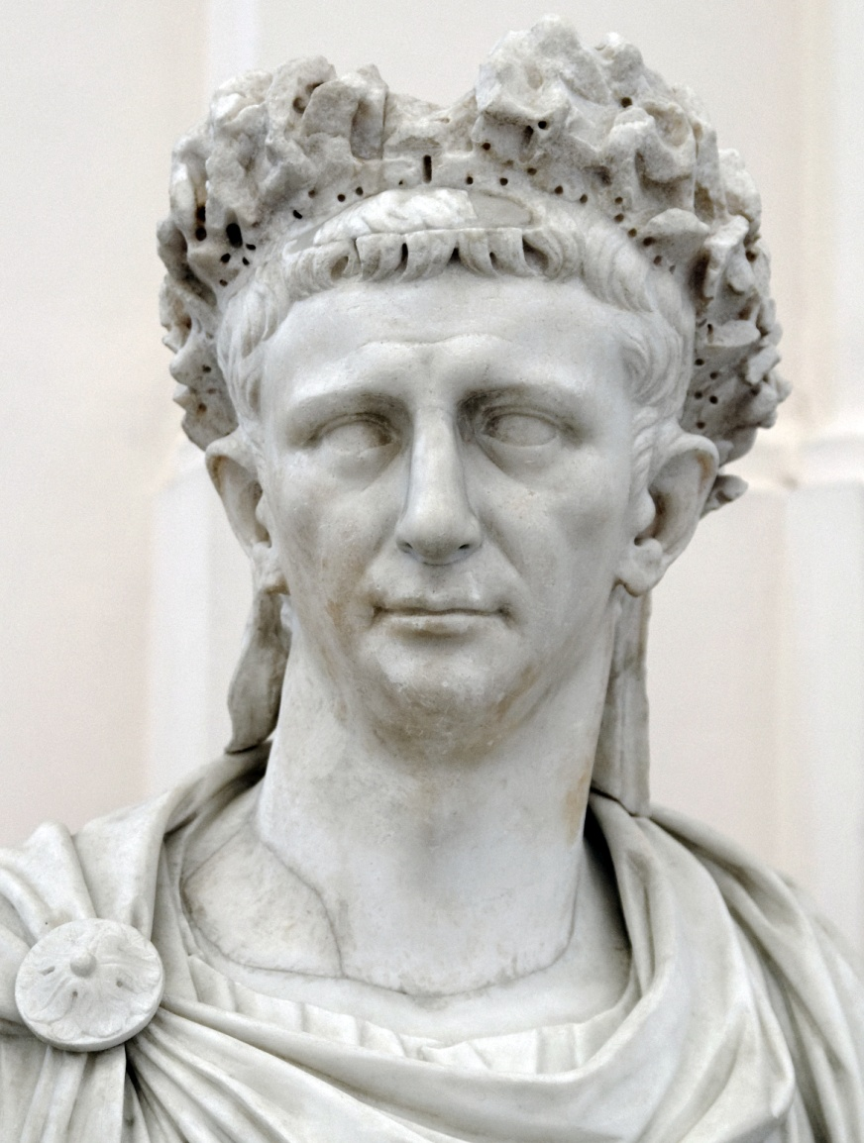
Claudius (41-54 CE)
Was very competent
Conquest of Britain began
Married his first cousin, who already had a son, Nero

Slide 14
Nero (54-68 CE)
Was tired of his mother so he had her killed
He was very unpopular with the people
Rumoured that he had started the fire that destroyed Rome in 64 CE
He blamed the Christians and had them tarred and burned while he had a party
He was assassinated in 68

Slide 15
Vespasian (69-79 CE)
Reformed the finances and organized the Empire
Completed huge building programs throughout (including starting the Colosseum in Rome
Took part in the invasion of Britain in 43
Urinals in Romance languages are named after him (‘vespasiano’ in Italian, ‘vespasienne’ in French)
Put a tax on the collection of urine (good in manufacturing)

Slide 16
Titus (79-81 CE)
Eruption of Mount Vesuvius in 79 CE
Led to the preservation of Pompeii
He sent emergency aid which was the first time this had been done in history

Slide 17
Trajan (98-117 CE)
Spent the years before his reign as an administrator in the provinces (Spain, Rhineland, Hungary)
Gave Rome many buildings and monuments
He expanded the Empire’s borders by paying them close attention (spent much of his reign away from Rome)

Slide 18
Hadrian (117-138)
Trajan’s adopted son
Served in the legions and as a senator
Travelled throughout the empire
Got to know his subjects
Encouraged building projects to keep soldiers busy and define borders of the empire

Slide 19
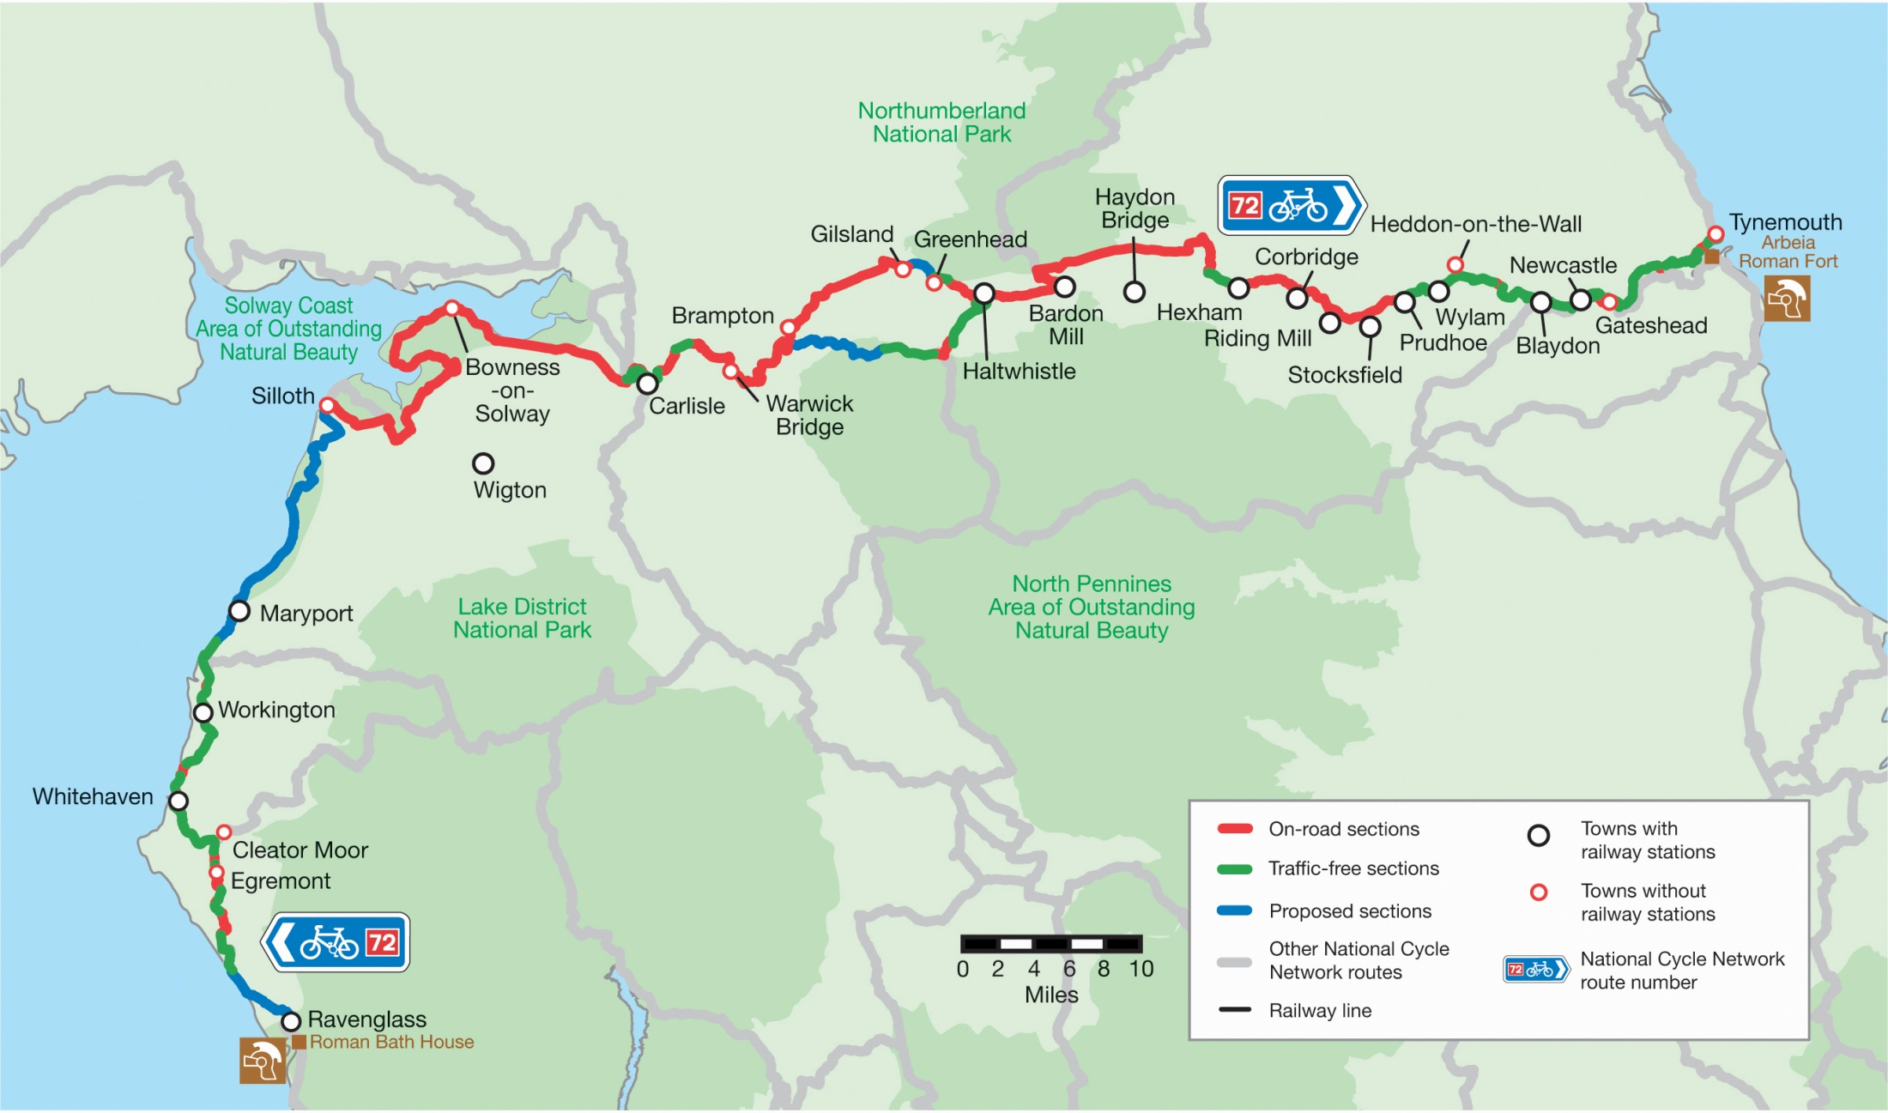
Hadrian’s Wall

Slide 20
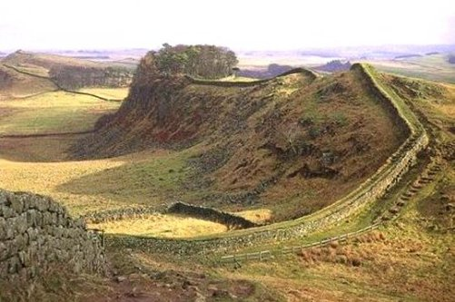

Slide 21
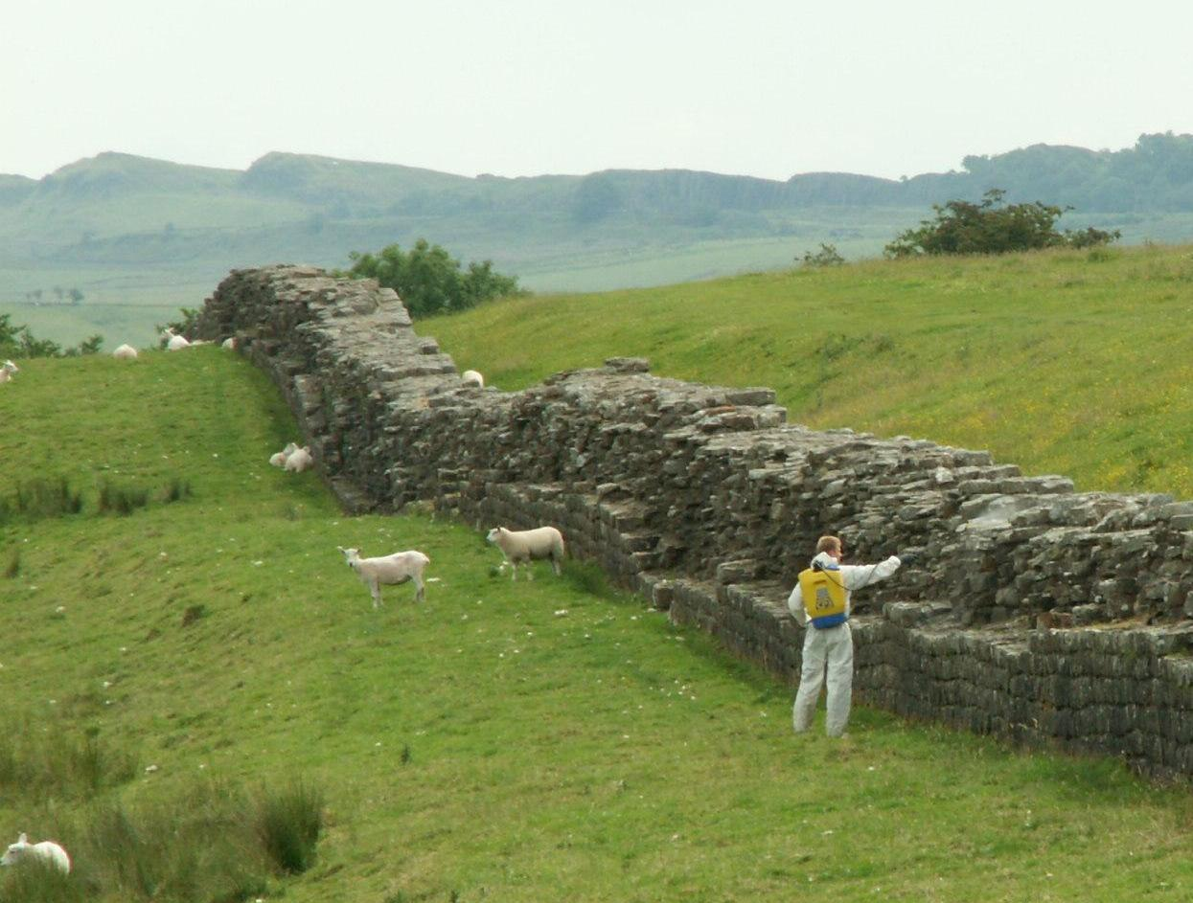

Slide 22
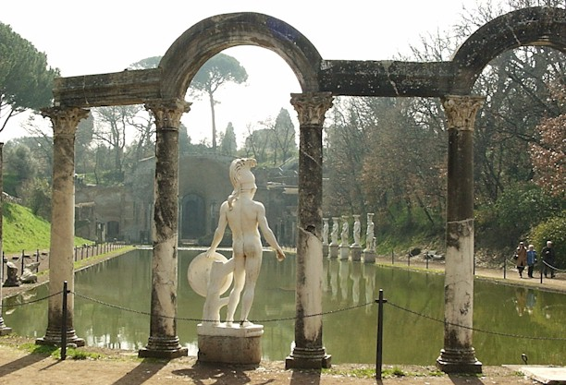
Garden of Tivoli

Slide 23
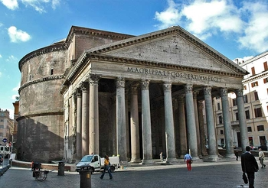
Pantheon

Slide 24
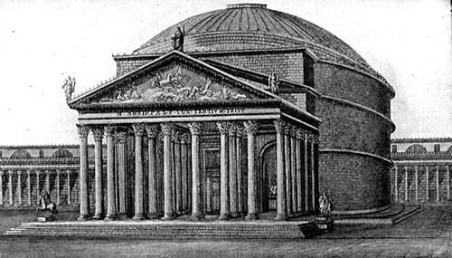

Slide 25
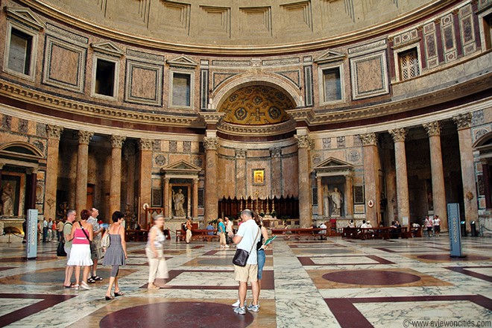

Slide 26
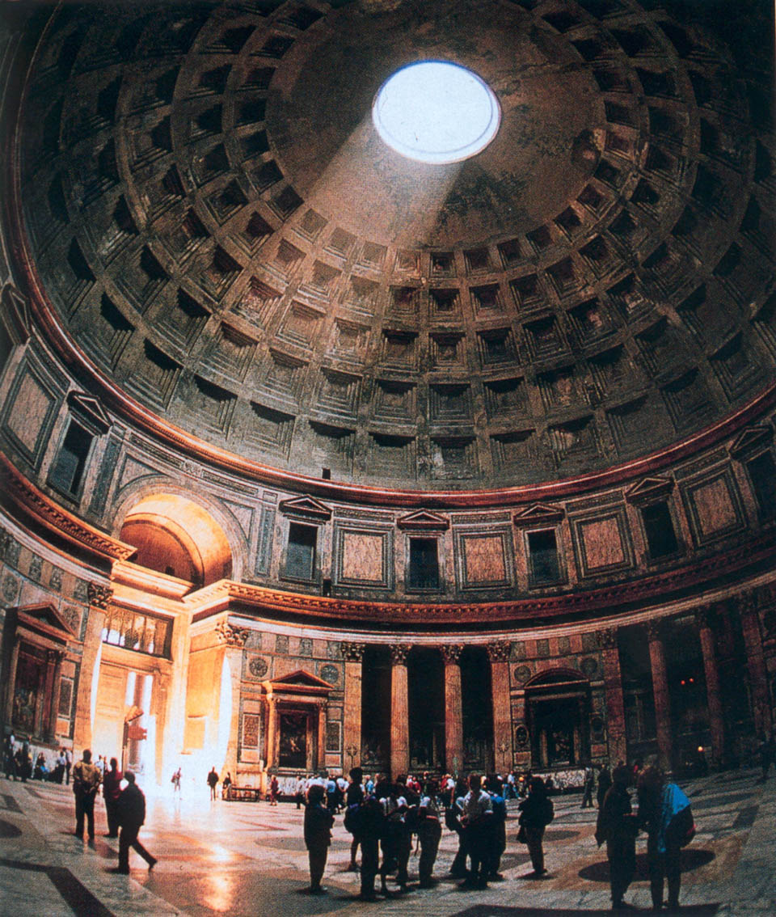
The Oculus

Slide 27
Reflection
What similarities do you see in these leaders?
What risks do you see in the imperial system?
Can you make connections between Rome, and Europe in the early 1900s?
Which emperors do you want to know more about? Why?

