Slide 1
Notes on Islam
CHW 3MR
Lesson 65

Slide 2
Introduction to World Religions

Slide 3
Imagine that you are part of an isolated society that has no particular religious beliefs. Write a creation story that describes your tribe’s beliefs about how the earth was made.
b. Imagine that you are part of an isolated society that has no particular religious beliefs. Describe what this particular tribe thinks happens when a person dies.
c. Think of the conflicts in the world today that are based on religion. What are some of them, where are they
occurring, and why do you think religion has played a factor?

Slide 4
Notes on Islam
Various physical environments led to many differences in Muslim culture
Some were very wealthy while others were just scraping by
Cities such as Baghdad, Cairo, Damascus, and Samarkand were major trading centres

Slide 5
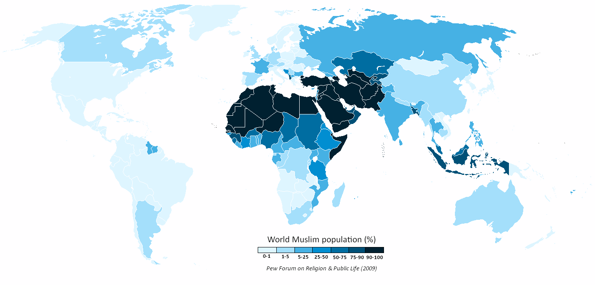

Slide 6
Women
In the nomadic society of Arabia, women had been subordinate to men
They did, however, give political advice, write and recite poetry, & take religious leadership jobs
They could also marry more than one man!
Women couldn’t hold political offices
Muhammad’s teachings, made things better for women
Outlawed female infanticide
Gave women and girls the right to inherit

Slide 7
As Islam spread… it met different traditions in Byzantium and Persia
Sexual segregation and veiling for upper class women
Women’s status was assimilated so that Islamic law made life better than before for Arab women but lower than it had been in Persia
Although women continued to be absent from public life, they were vital behind the scenes
Ambitious women could inherit money and property and have it publicly managed by someone else

Slide 8
Women worked in the fields and tended livestock
Because of segregation, female peddlers, healers & religious leaders worked with women
In Muhammad’s day, women didn’t veil themselves, but later Islamic scholars interpreted the Qur’an as requiring head to toe modesty

Slide 9
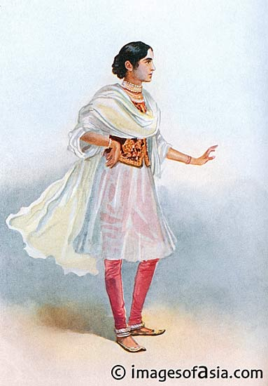
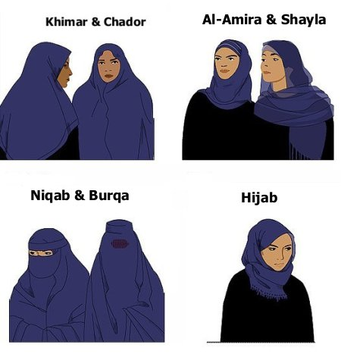

Slide 10
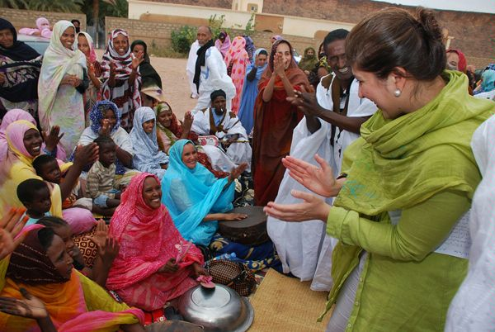

Slide 11
Education
Very important to all middle eastern people: Muslims, Christians, and Jews
Need to develop an understanding of God’s Will… how God wanted people to live
Muslim scholars studied algebra, trigonometry, geometry, astronomy, chemistry, etc.
They travelled around and shared ideas; used Greek and Indian knowledge

Slide 12
Created law schools called madrasas and grads became administrators and teachers
Europe was wallowing in the dark ages and was far behind Islam in knowledge and art
Cross-cultural influence went from Middle East to Europe
Arabic numbers with zero invented in India are now widely used
Arabic words entered European languages: sofa, ottoman, admiral, arsenal, mattress, orange, sherbet, yogurt, coffee

Slide 13
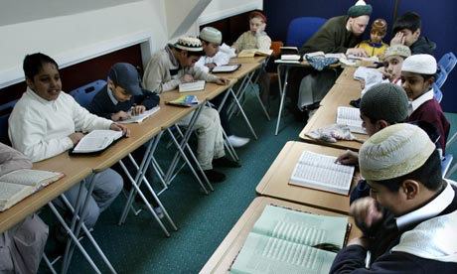
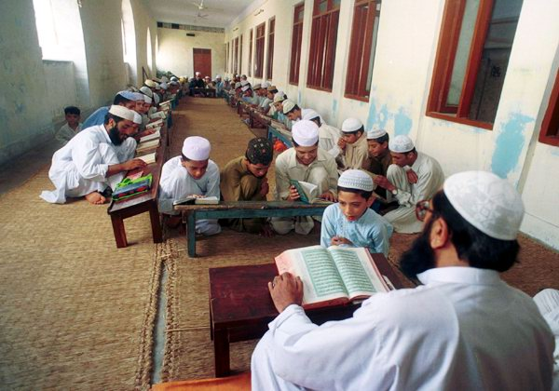

Slide 14
So What’s the Fuss?
1. Dome of the Rock
A mosque in Jerusalem
Land sacred to all 3 religions
Jews: God prevented Abraham from killing his son (they pray in the direction of this stone
Muslims: where Mohammed ascended to heaven
They have fought to control this area for centuries… really a political struggle, not religious

Slide 15
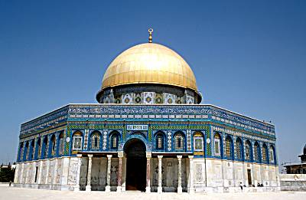
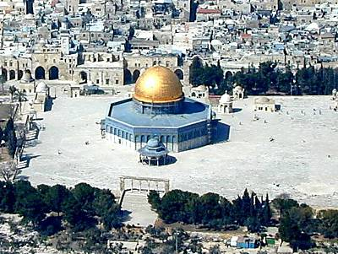

Slide 16
2. Crusades
started in 1096 to regain the city of Jerusalem for the Christians
Christians massacred Jews and Muslims
Muslims, under Saladin, regained Jerusalem

Slide 17
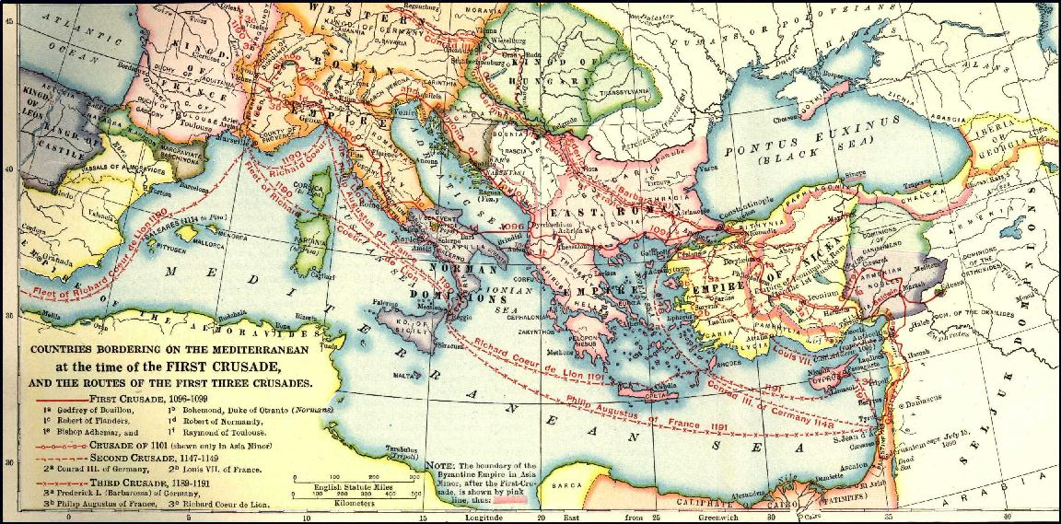

Slide 18
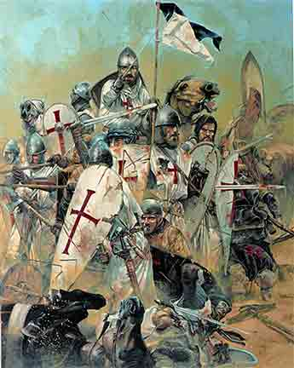

Slide 19
3. State of Israel
Created after WWII for displaced Jews
Palestine (a part of the Ottoman Empire since the 16th century) had become a British protectorate after WWI
Jewish immigration was encouraged prior to WWII
Upset the Muslim (Arab) inhabitants

Slide 20
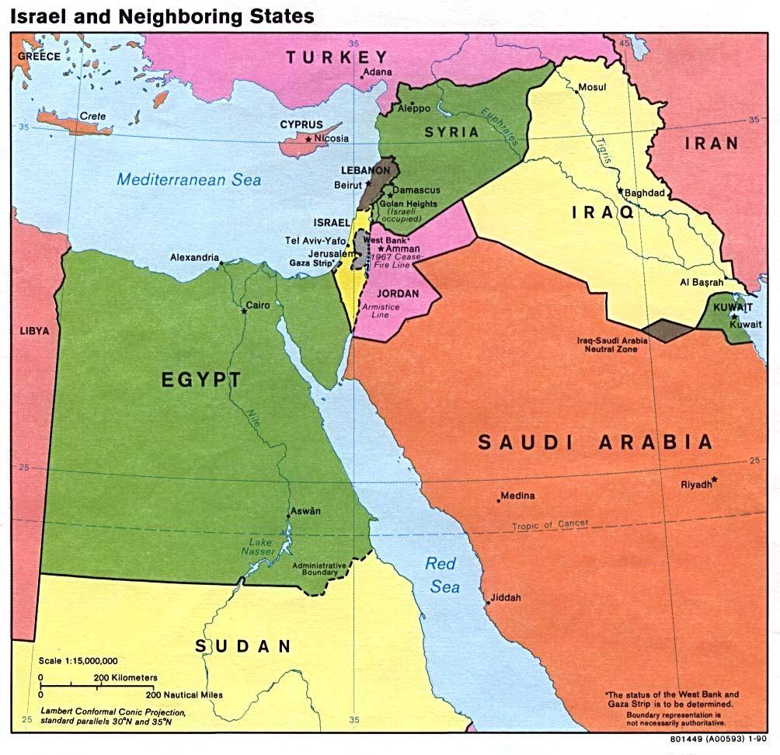

Slide 21
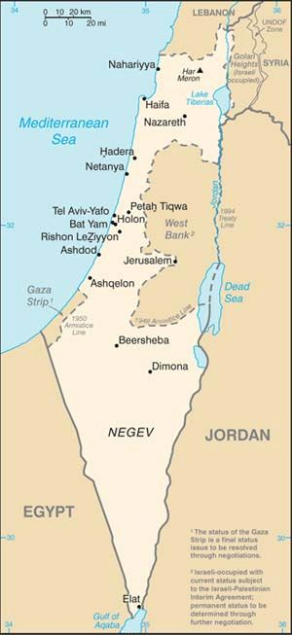
Currently 7.9 million people
5.9 million are Jewish (75%)
1.6 million are Palestinian (20%)

Slide 22
Inside Islam (History Channel)
Islam: Empire of Faith (PBS)

