Slide 1
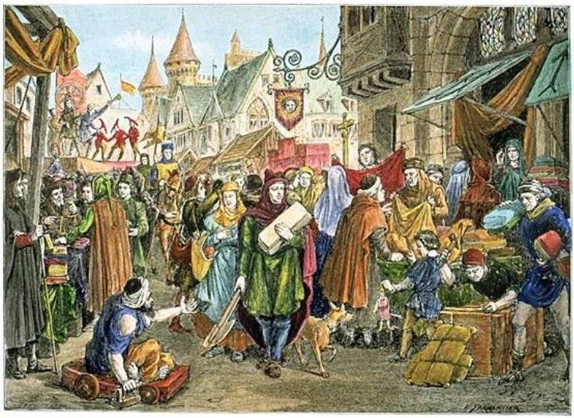
Coming Out of the Middle Ages
CHY 4C/4U
Lesson 2

Slide 2
Coming Out of the Middle Ages
Learning Goal: Explain the values that led to the dawn of the Renaissance.
Discussion (from yesterday) and written response
3.5 minute video
Note and discussion

Slide 3
Step 4: Debrief
How did you decide?
What trends did you notice?
What is missing and why?
Criteria for Historical Significance:
(the four Rs)
Relevance to narrative
Resonant today
Reveals the past
Results in change

Slide 4
Historical Thinking Concepts (HTCs)
Historical Events
Historical Significance
Cause and Consequence
Continuity and Change
Historical Perspective
Ethical Dimension
Evidence
WWI
WWII
Magna Carta
Industrial Revolution
9/11
Great Depression
JFK Assassination
Fall of Soviet Union (or Berlin Wall)
American Civil War
Baby Boom
Holocaust
Moon Landing

Slide 5
Written Response
What do you better understand about historical significance?
What else have you learned about the other historical thinking concepts that we applied in these discussions?
Write in third person, so that you begin to write in formal historical style.
If you have time, tell me what area of history most interests you and why?

Slide 6
3 ½ minute video
https://www.youtube.com/watch?v=6EAMqKUimr8
We’ll watch it twice
  1) just watch
  2) write down as many events as possible

Slide 7
Europe 1450ish
Government
Religion and Philosophy
Artistic expression
Class Structure and Role of Women
Trade and Economics (Occupational Specialization)
Science and Technology
Agriculture

Slide 8
High Middle Ages
Government
Monarchies across Europe
Heredity based
Advisors from the aristocracy
Influence from religious leaders

Slide 9
2. Religion and Philosophy
All of the world’s major religions had been formed
The majority of people were believers
Religion influenced all that people did
Scientific thought was just beginning to provide answers

Slide 10
Artistic Expression
In Europe, gothic architecture seen in churches and government building
Painting and sculpture

Slide 11
4. Class Structure
Feudalism
Land owned by the monarch and worked by the peasants
Women were property of men
Almost no opportunity for movement between classes
Be content with who you are… be the best peasant or lord you can be

Slide 12
5. Trade and Economics (Occupational Specialization)
Boys usually followed their father into work
A system of apprenticeship was formed
Guilds were created to maintain standards within each trade
Skilled trades were in demand for building work
Trade routes were lengthy and complex (Silk Road)
Goods from Africa, Asia, and Europe were readily exchanged
This led to cultural exchange as well

Slide 13
Science and Technology
Printing press was the cool new technology
Made universal literacy a real possibility
Took control of books from the hands of the monks (church)
Other technologies:

Slide 14
Agriculture
The feudal system kept farms running
However, many people were trying to seek their fortunes in new towns
Trades and traders became prosperous
Of course, good or bad harvests impacted everyone

Slide 15
Task:
Do a little bit of research about one of the topics from the video at the start of class. Create a Google Slides slide with information about your topic.
Include:
  Date of event (person’s life, etc.)
  How this event changed the world
  The significance to the modern world
  An image to support your information

