Slide 1
Absolutely Absolutism and Parliamentary Progress
CHY
Lesson 33

Slide 2
Absolutely Absolutism & Parliamentary Progress
Learning Goal:
Compare and contrast the strengths and weaknesses of absolutism and constitutionalism.
Review terminology
Note on significant events
Discussion
** Homework: Read pages 102-107 on the slave trade

Slide 3
Terminology
Absolutism
Divine right of kings
Oligarchy
Parliamentary supremacy
State sovereignty
Constitution
Constitutional monarchy
Civil rights

Slide 4
Hapsburgs
Ruling dynasty in central Europe
Struggled to be absolutist but empire was too big
Parts of Italy, Bohemia, Hungary, and others
Government had to maintain balance due to diversity within their borders

Slide 5
Loss of power due to 3 things
Protestant reformation
Impact of the Ottomans in Turkey
Inbreeding, designed to cement their rule

Slide 6
Thirty Years’ War
Causes:
Continued religious conflict between Catholics and Protestants, particularly in areas that are now Germany & Czech Republic
Peace of Augsburg (1555) held for almost 50 years but by 1600s, it was beginning to crack
Hapsburgs wanted control of Catholic thrones and married into all of them
Protestant regions of Germany allied themselves with England and Netherlands

Slide 7
Phase 1: Bohemia (1618-1625)
Protestants felt their lives were being restricted so sought support from Eng, Danish and Dutch
Catholics ganged up and defeated them
Phase 2: Denmark (1625-1629)
Protestants further beaten by Catholics of HRE
Phase 3: Sweden (1630-1635)
Catholics defeated Swedish supported HRE Protestants, but Catholic Cardinal Richelieu starts to worry about power of Hapsburgs so he supports Sweden
Phase 4: France (1635-1648)
In order to protect French absolutism, Richelieu supports protestants against the Hapsburgs in Spain

Slide 8
Outcome:
33%-66% of all males in German territory died
All countries involved were devastated by losses
Still religious divide that was unlikely to be solved by war
Absolute rulers were finally more powerful than the religious leaders

Slide 9
Treaty of Westphalia (1648)
(historic region of Germany)
Recognized state sovereignty
+300 German princes given right to decide the faith of their principalities
This religious division continued to influence in modern times with Otto von Bismarck and Adolf Hitler

Slide 10
Significance:
Last major war of religion in Europe
Answered the question of autonomy of individual states
Politics more powerful than religion
No more Catholic empire (HRE), Europe now divided into modern states

Slide 11
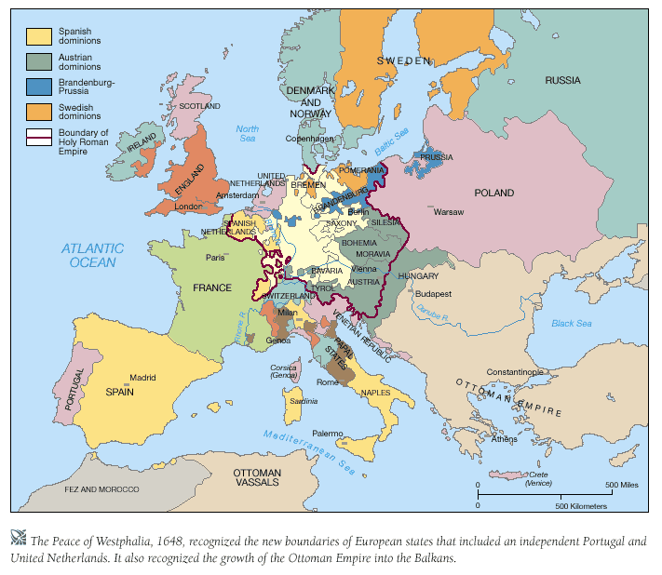

Slide 12
Seven Years War (1756-1763)
New alliances had been drawn up in Europe; in some cases changing time-honoured rivalries
This led to war
Fought in Europe, India, and North America
Boundaries in Europe remained unchanged
Possession of colonies abroad did change
France lost N American colonies (us!) and Britain got sole control of India

Slide 13
England and Constitutionalism
Constitutionalism: state in which authority is distributed legally among a number of different institutions and levels
This became the way of things in England and the Netherlands
In England, it came about after a civil war

Slide 14
Puritan Revolution
2 opposing protestant groups in England: C of E and Puritans
King was head of C of E (had Catholic leanings)
Charles I (1625-49) tried avoiding parliament and governing by personal rule
Infuriated Puritans: Some left for America
Scottish Presbyterians rebelled against Charles
Meant Charles had to summon Parliament
Parliament decided to limit the king’s power

Slide 15
This led to civil war in 1642 between parliamentarians and the king
Parliamentarians led by Oliver Cromwell and his New Model Army
Dissention within the parliamentarians over whether king should be constitutional monarch, the role of the established church, religious tolerance, etc.
King was defeated and put on trial, declared a public enemy, and executed in 1649

Slide 16
For 11 years, England was a republic managed by Cromwell
Struggled for control
Cromwell died in 1658 and no one knew who would rule
In 1660, a newly elected parliament decided to restore the monarchy, with more limited powers
Charles II was recalled and crowned
He promptly disinterred the remains of Cromwell and two others and cut off their heads!

Slide 17
Struggle between monarch and parliament continued
James II (after Charles II) was Catholic and began appointing Catholics to powerful positions, despite legislation that forbade this
Two political groups: Whigs (opposed the king and wanted parliamentary authority) and Tories (who supported the king)
James II was old and his successor was his protestant daughter, Mary
But then, his second wife had a son…. Crisis!

Slide 18
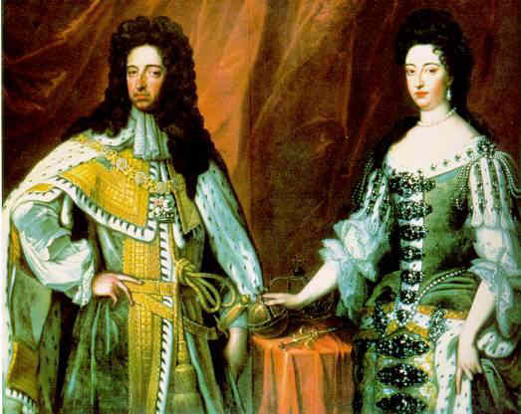
Politicians crossed to Holland and asked Mary’s husband, William of Orange to come with an army
He agreed, as long as England would support him against Louis Xiv
A bloodless invasion known as the “Glorious Revolution”
James II and family fled to France
William and Mary became joint rulers

Slide 19
Achievements:
Bill of Rights
Supremacy of parliament
Right to trial by jury
Right of parliament to impose taxes and maintain an army
Affirmed government by law and constitution
England now ruled by an oligarchy; the wealthy, landed gentry

Slide 20
Philosophers of the Time
Hobbes (1588-1679)
Wanted to develop a political science based on rational thought and observing humanity
Used thought experiment to determine whether power was necessary and where it should reside
Believed people were always struggling for power, were ruthless in acquiring it, and were competitive with each other
War was inevitable without powerful leadership

Slide 21
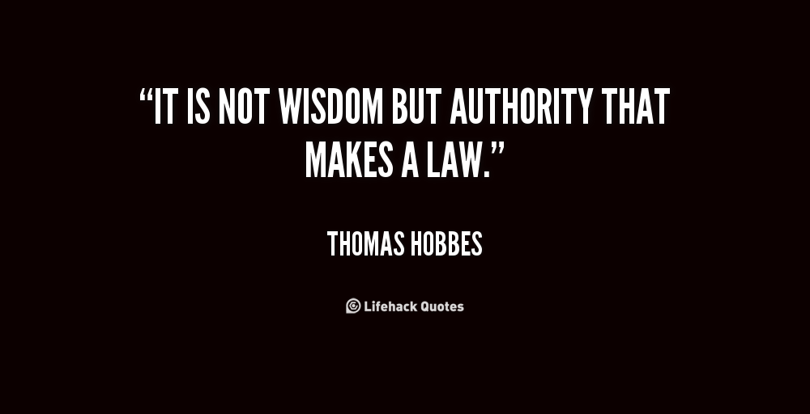

Slide 22
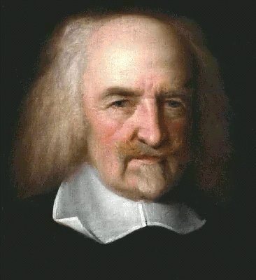

Slide 23
2. John Locke (1632-1704)
Believed that the state of nature was relatively peaceful and happy
Humanity was, by nature, good
People always retained their natural rights
Advanced the doctrine (idea) of civil liberties (rights)
The rights of life, liberty, and property
(only those with property should have political rights)
Revolution was just if the sovereign broke the contract with the people
Tyranny must be eliminated
Order is desirable (like Hobbes) but authority had its limits

Slide 24
