Slide 1
Unit 2: The Enlightenment and the Age of Revolution
1715- 1815
The Enlightenment, Revolution and Restoration, The World of the 18th Century

Slide 2
Enlightenment and Revolution
Scientific Revolution convinced people of the boundless potential of humanity
Many believed in the perfectibility of society through the application of reason- Intellectuals made public issues matters of private concern, exploring all facets of society- crime to religion
18th century Europeans were more self assured of the superiority of their civilization- some European powers had massive overseas empires (and enslaved many)
Humanism embraced human achievement and potential- lead to revolutions in all aspects of society
And its also the time of Napoleon

Slide 3
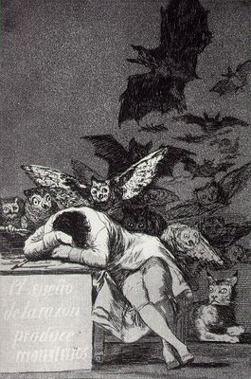
The Sleep of Reason produces Monsters- Goya 1799

Slide 4
Europe after Louis XIV
After the death of Louis, a few powerful families struggled to increase their territory and wealth: Spanish Bourbons, French Bourbons, Hanoverians in Britain, Hapsburgs in Central Europe and the Romanovs in Russia
Prussia was the new kingdom on the block with the Hohenzollerns being accepted as a monarchy by the Emperor in 1701
Ottomans were still the most feared power- controlled the Balkans, North Africa, Middle East
Some smaller European dynasties existed: Savoys in Italy, Orange family in Holland, Wasa family in Sweden and the families of the smaller German states

Slide 5
Conflicts were based on expanding territories for commercial advantage not on religious or philosophical differences
Military glory (peace was only necessary to prepare for the next war)
There were manners in war- opposite generals dined with one another, there was an honour to being a combatant, especially an officer (leading the cavalry charge)- most soldiers died of malaria and typhoid than of war
Campaigns only occurred in the summer months and never far from supplies- battles were avoided at all costs- foreign policy decisions were made in England, France and Holland for other people
Maintaining a balance of power in Europe and crippling the trade capabilities of other countries were the primary military objectives

Slide 6
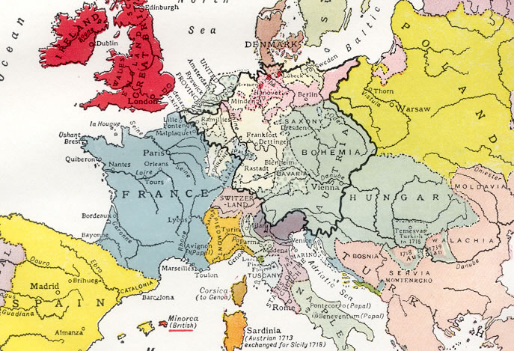

Slide 7
The Enlightenment
Most people then and now think of only themselves and their loved ones- there were some in the 18th century who began to think about the welfare of society as whole
The Reformation/Renaissance saw an increase in educated people thinking about the problems of society (in ways not exclusive to Christian doctrine
Intellectuals- in France they were the Philosophes
They believed in themselves, capable of solving problems of public matters

Slide 8
Period of freedom of thought and debate over obedience to tradition vs. Freedom
Free market, rationalism (faith in human reason), cultural optimism, and the inevitability of progress
Advocate a return to nature- a state of nature, also a belief in non-traditional religion- Deism
Human rights, public education, freedom of thought and speech, abolition of slavery, and more human treatment of criminals
Fundamental forming period of modern secular thought

Slide 9
Literacy
Absolutists cared little of educating their people- society only need educate itself to be sufficient
Book learning was thought would lead to dissatisfaction of rural life- during 18th century a very big change in the concept of education occurred
A literate population might be advantageous- 1759 Portugal had primary compulsory education- Children in middle class families were encouraged to read
During the Enlightenment information was transmitted through pages in leather bound books, newspapers (gazettes- small coin), and especially pamphlets
Wealthy and enlightened individuals held literary and philosophical discussion groups called salons in their homes, where writers and intellectuals could present and exchange ideas and opinions

Slide 10
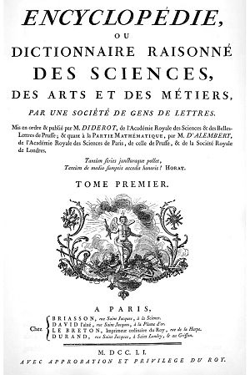
Denis Diderot, 1765
* Condemned by the Pope
The symbol of the Enlightenment

Slide 11
The Beginning of the Industrial Revolution
Not really a revolution, more a gradual series of changes in agriculture, trade and industry
1733 Flying shuttle- increased productivity (at the expense of labour) facilitated urbanization and increased consumerism
Consumerism creates jobs and stimulates commerce
Physiocrats
Spread of commercial capitalism throughout western Europe- increased volume of trade (trading companies of the new world)
Money therefore flowed into the hands of the new middle/merchant class and out of the hands of monarchs

