Slide 1
On the Eve of the French Revolution
CHY
Lesson 57

Slide 2
On the Eve of the French Revolution
Learning Goal:
Explain the situation in France that led to the revolution.
Collect essays/hand out permission forms
Note and Discussion
Reading assignment

Slide 3
What was France Like in the 1700s?
Most advanced country in Europe
Emulated by others
Others loved the language and culture of France
Looks can be deceiving
Bad harvests, high prices, high taxes, and Enlightenment ideas were causing unrest

Slide 4
Causes of the Revolution

Slide 5
1. France’s Old Order “Ancien Régime”
Social classes divided into 3 estates
Inequities led to trouble
The Privileged Estates made up 3% of the population
First Estate: clergy of the RC Church
Scorned enlightenment ideas
Less than 1% of the population; 10% of the land; 2% taxes
Second Estate: rich nobles, highest offices in gov’t
Disagreed about Enlightenment ideas
2% of pop; 25% of land; no taxes

Slide 6
Third Estate: divided into 3 groups; 97% of the pop
The Bourgeoisie (middle classes), bankers, factory owners, merchants, etc.
Well-educated, believed Enlightenment ideas
Paid high taxes and lacked privileges
Felt they deserved more… a greater degree of political power
ii) Workers in the cities, tradespeople, domestics, apprentices
Low wages, often out of work, hungry, had to steal what they needed
iii) Peasants, 80% of the pop, ½ income went to taxes, Church, dues to nobles
Peasants and urban poor resented 1 & 2 for privilege and special treatment
Eager for change

Slide 7
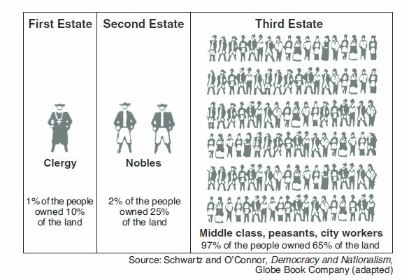

Slide 8
2. Enlightenment Ideas
Ideas were spreading among 3rd estate
Inspired by American Revolution
Questioned traditional structure of society
Began to demand equality, liberty, and democracy

Slide 9
3. Economic Trouble
1780s economy in decline
Alarmed the bankers, merchants, etc.
While production and trade were expanding, high taxes made it impossible to make a profit
Cost of living was rising
Bad weather led to crop failures, led to grain shortage, cost of bread doubled

Slide 10
Gov’t sank into debt
Partly due to Louis XVI and Marie Antoinette’s lavish spending
Had heavily borrowed to support American revolutionaries
This doubled their previous debt
1786; banks refused to lend Louis more

Slide 11
4. Weak Leadership
Louis XVI was indecisive; put off decisions
Didn’t listen to advisors
The queen often interfered in gov’t matters; gave Louis bad advice
Was from Austria (long-time enemy) and unpopular from the start
Spent too much money, was known as ‘Madame Deficit’
Louis avoided the problems until he ran out of money
Solution: impose taxes on the nobility
Second Estate forced him to call a meeting of the Estates-General– an assembly of reps from all 3 estates– to approve this tax
First meeting (in 175 years) was May 5, 1789, at Versailles

Slide 12
Reading Assignment
4C → Read the two pages provided and answer the questions circled or starred!
Identify and give the significance of the terms & names
4U → Read pages 160-167 of your textbook (From Estates-General to Many thousands of copies) and make notes on what you have read
→ Read pages 73-80 of The Modern Age. Answer the 2 questions on p 80. Question 2 can be in point form… no more than a 9-sentence paragraph

