Slide 1
Six Cities in 1500
CHY 4C/U
Lesson 3

Slide 2
Six Cities in 1500
Learning Goal:
Identify the qualities of a successful city and explain that cities legacy to the modern world.
Map of the World Discussion. Where are these places?
Quiet reading and note making
Small group discussion and analysis
Share with the class what has been learned.

Slide 3
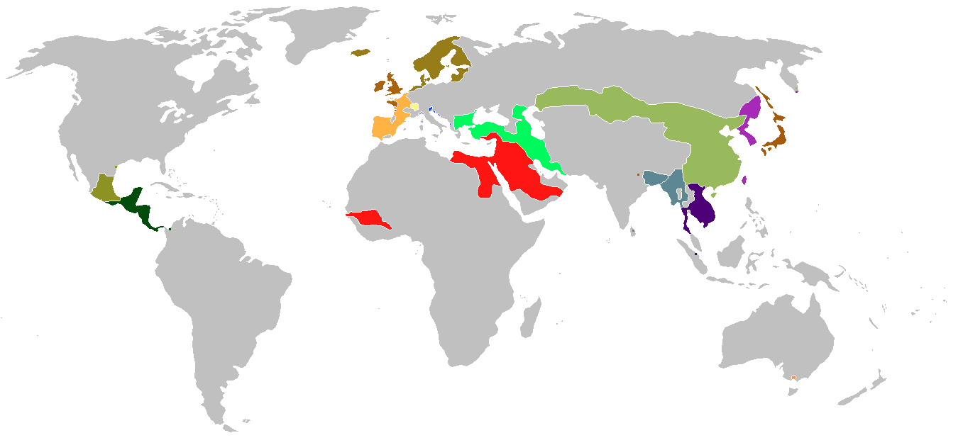
The World in 1450
Beijing
Seville
Constantinople
Tenochtitlán
Timbuktu
Delhi/Agra/
Fatehpur Sikri

Slide 4
6 very different cities in very different parts of the world:
Constantinople
Timbuktu
Seville
Tenochtitlán
Beijing
Delhi/Agra/Fatehpur Sikri

Slide 5
Step 1:
Grab a textbook and sign it out! It is yours for the semester. Please be kind to it! It may not be pretty but it has many stories to tell!
Write 2017-18, your name, Ms Bew, and Room 224 in the front cover. This is a big step towards your immortality.
Select one of the papers from the pink bucket
Go back to your desk and find information about your city on pages 5-13.

Slide 6
Step 2:
Answer these questions about your city.
How did communities develop in this city?
What was the main change that took place over time, in this city?
What significant ideas arose from this city that affected the rest of the world?
Describe the social organization of this city?
How much of the city’s evolution before 1500 was due to natural factors such as population and trade growth and how much to the intervention of rulers?

Slide 7
Step 3:
Gather with the other students who have read about the same city as you. These should be groups of 3 or 4.
Discuss the questions with each other to make sure that you all have strong, thoughtful answers.
Together, evaluate the strengths and weaknesses of your city. Make a few predictions for the future of your city. Write down the answers. Use a T-chart or other organizer if it helps.

Slide 8
Step 4:
Get in to groups based on the colour of paper you have.
Compare and contrast each city through discussion and debate. Remember to include ideas about the comparative strengths and weaknesses of each city.
Develop a set of criteria to determine what you consider to be an advanced city. Based on the cities examined, what part of the world seems to be most advanced by 1500? Use a graphic organizer to analyse each city.
How might our own perceptions of what it means to be ‘advanced’ cloud our judgement or make us biased?

Slide 9
Step 5:
Return to your own desk and complete the following task:
U: Answer questions 7, 8, and 10 from page 14 in your textbook. You may discuss with your neighbour but you must submit your own well-thought out answers.
C: Answer 2 of questions 6, 7, 8, and 10 from page 14 of your textbook. You may discuss with your neighbour but you must submit your own well-thought out answers.

