Slide 1
CLU 3MR Lesson 65

Slide 2
Sentencing
Learning Goal:
Explain how sentencing achieves the goals of Canada’s justice system.
--Note and discussion
--Complete sentencing table

Slide 3
From Sentencing to Release Chapter 9
A delicate balance of many factors: severity of the crime, the offender’s background and society’s view
Some people argue that prisons are too soft
Too expensive
Fail to reform criminals
Are there better options?

Slide 4
Imposing a Sentence
Judges have lots of freedom and leeway
Some offences have a mandatory minimum sentence, but most don’t
Judges look at precedents
Victim impact statement is asked for

Slide 5
Recent changes:
More sentences served in the community with supervision
Long-term offender label has been introduced
Also created mandatory minimum sentences
Tackling Violent Crime Act (2008) amended the Criminal Code

Slide 6
Purposes of Sentencing

Slide 7
1. Denouncing Unlawful Conduct
Condemning the crime from society’s viewpoint
Considers character and past behaviour
(revenge and retribution are not sentencing objectives in the CC)

Slide 8
2. Deterrence
To promote respect for the law
To maintain a just, peaceful, and safe society
Specific deterrence: discourages the specific criminal from reoffending
General deterrence: discourages people in society from committing a particular crime

Slide 9
3. Separation of the Offender from Society
Our incarceration rate is not as high as in other countries
Prison Stats

Slide 10
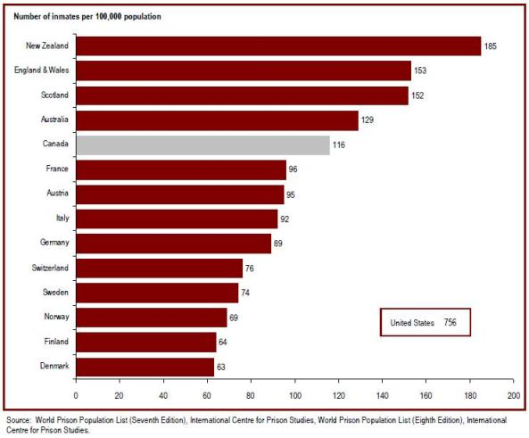

Slide 11
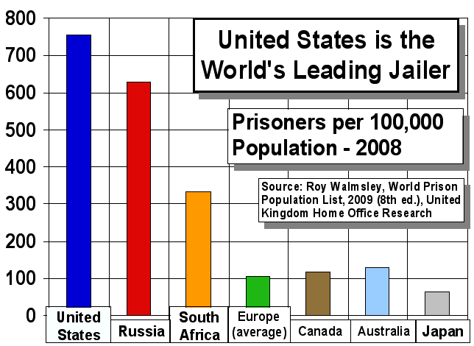

Slide 12
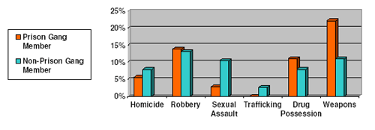
4. Rehabilitation
To help an offender successfully reintegrate back into society
To restore good mental and moral health
Education, counselling, training
To prevent recidivism

Slide 13
Others:
to provide reparations for harm done
Promote a sense of responsibility in offenders

Slide 14
Considerations in Sentencing
Must be proportional
Mitigating circumstances: factors that demonstrate the punishment should be less severe
Aggravating circumstances: factors that demonstrate the punishment should be more severe

Slide 15
Task:
Complete the hand out “Sentences” using pages 298-309 of your textbook.

